Slide 1
Capacity Building Workshop for Hungarian, Romanian and Polish experts and negotiators
WELCOME
Kinga ÖLLERER
Centre for Ecological Research (Hungary)
CBD Informal Advisory Group on Technical and Scientific Cooperation

Slide 2
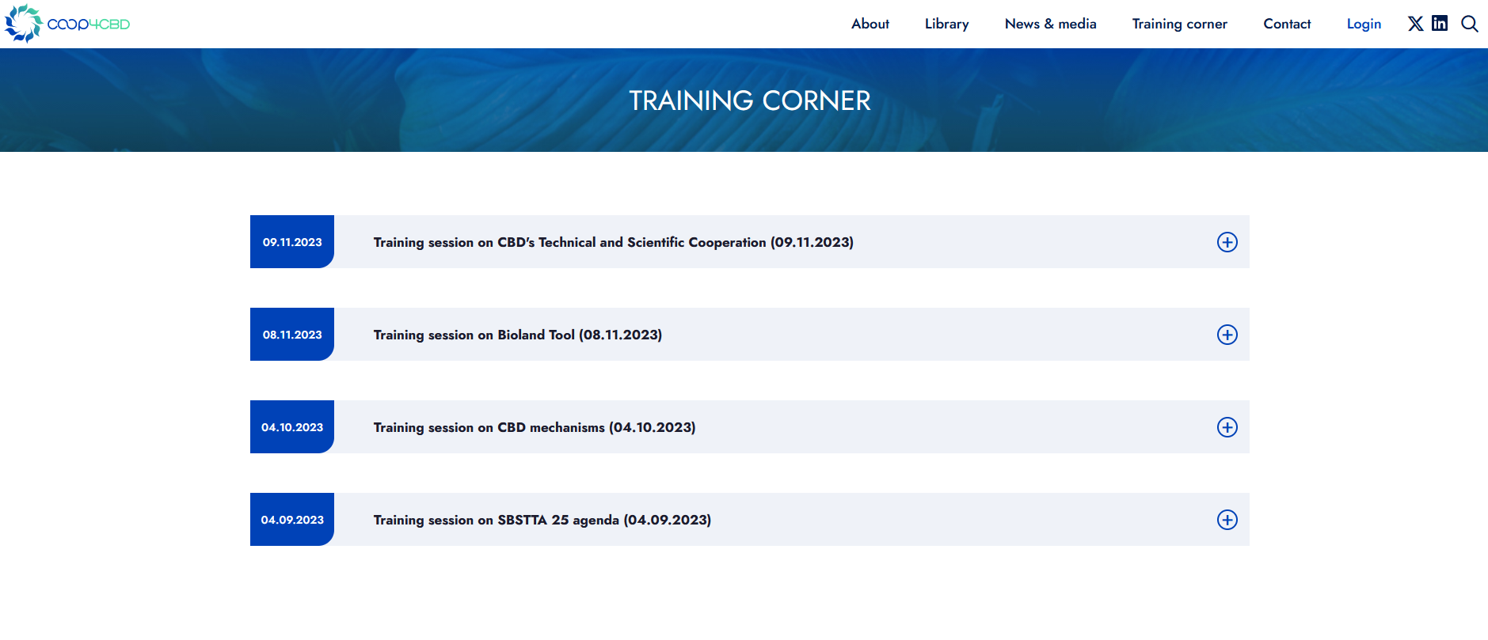
https://coop4cbd.eu/training-corner

Slide 3


Promoting CBD activities in Central and Eastern Europe: challenges and the way forward
1.5 hour workshop
Claire Brown (UNEP–WCMC), Grégoire Dubois (EC–JRC)

Slide 4


Wishing everyone a successful workshop!
Kinga Öllerer
ollerer.kinga@ecolres.hu kinga.ollerer@gmail.com
www.coop4cbd.eu
Follow CO-OP4CBD

