Slide 1
Improving Cooperation for the Convention on Biological Diversity
Ditta Greguss
biodiversity policy advisor, CBD Secondary NFP
Biodiversity and Gene Conservation Department, Ministry for Agriculture, Hungary
Capacity Building Workshop for Hungarian, Romanian and Polish
experts and negotiators / 15-16 January 2024 / Budapest, Hungary

Slide 2
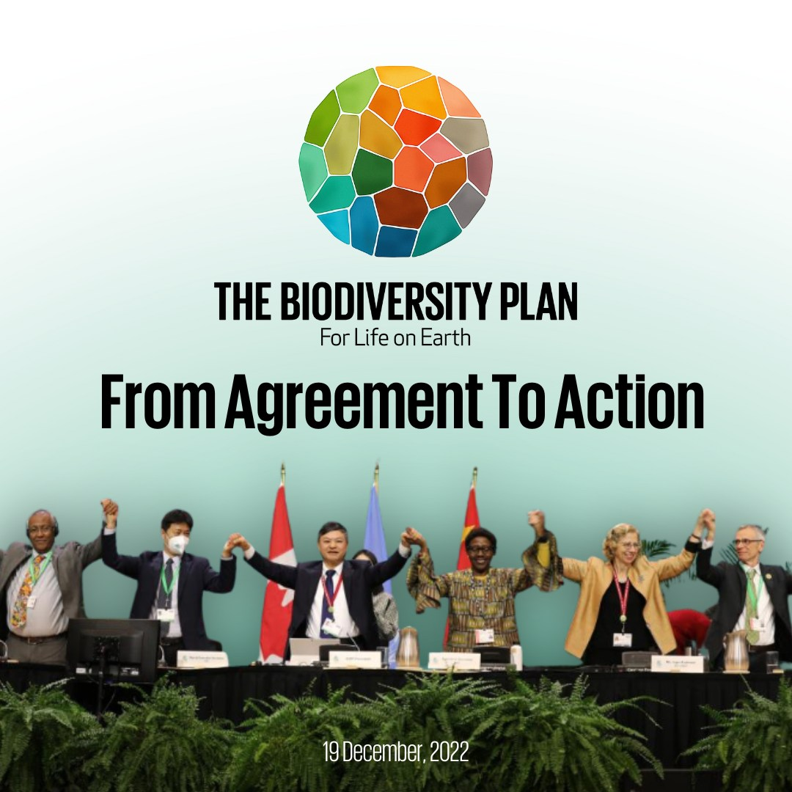
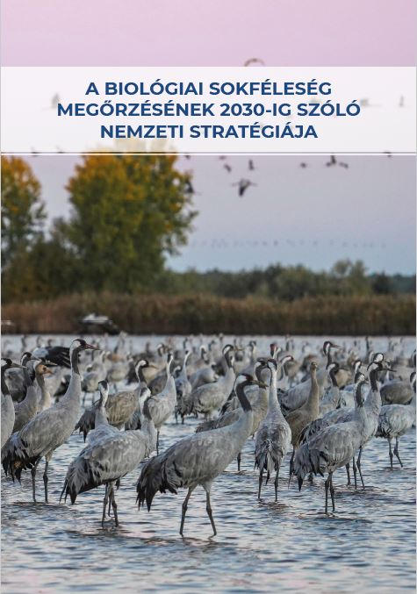
From global… … to national
Kunming-Montreal Global Biodiversity Framework
(adopted in December 2022)
Hungary’s National Biodiversity Strategy until 2030
(adopted and published in August 2023)

Slide 3
Hungary
as the EU Presidency of the European Council
from 1 July until 31 December 2024

Slide 4
Hungarian EU Presidency
CITES Animals and Plans Committee – July 2024
Second Working Group on Benefit-sharing from the Use of Digital Sequence Information (DSI) on genetic resources - August 2024
69th meeting of the International Whaling Commission – September 2024
Fifth meeting of the Subsidiary Body on Implementation of the CBD – October 2024
UN Biodiversity Conference – October 2024
44th Standing Committee of the Bern Convention – December 2024
11th Plenary of IPBES – December 2024

Slide 5
The biggest challenge: UN Biodiversity Conference
Colombia, 21 October – 1 November 2024
3 parallel decision-making meetings:
    COP16 of the Convention on Biological Diversity
    MOP11 of the Cartagena Protocol on Biosafety
    MOP5 of the Nagoya Protocol on Access to Genetic Resources and Benefit-sharing
+ High-level ministerial segment

Slide 6


Slide 7
Useful links
Kunming-Montreal Global Biodiversity Framework:
https://www.cbd.int/gbf/
and the GBF targets with guidance: https://www.cbd.int/gbf/targets/
Hungary’s National Biodiversity Strategy 2030:
currently in Hungarian (but soon it will be available in English): https://www.biodiv.hu/hu/biologiai-sokfeleseg-egyezmeny/hazai-vegrehajtas/nemzeti-biodiverzitas-strategia
Hungary’s national website (CHM) for the CBD and IPBES:
https://www.biodiv.hu/

