Slide 1
Preparation for CBD COP from the perspective of the EU Presidency
Eliška Rolfová
Ministry of the Environment, Czech Republic
Capacity Building Workshop for Hungarian, Romanian and Polish
experts and negotiators / 15-16 January 2024 / Budapest, Hungary

Slide 2
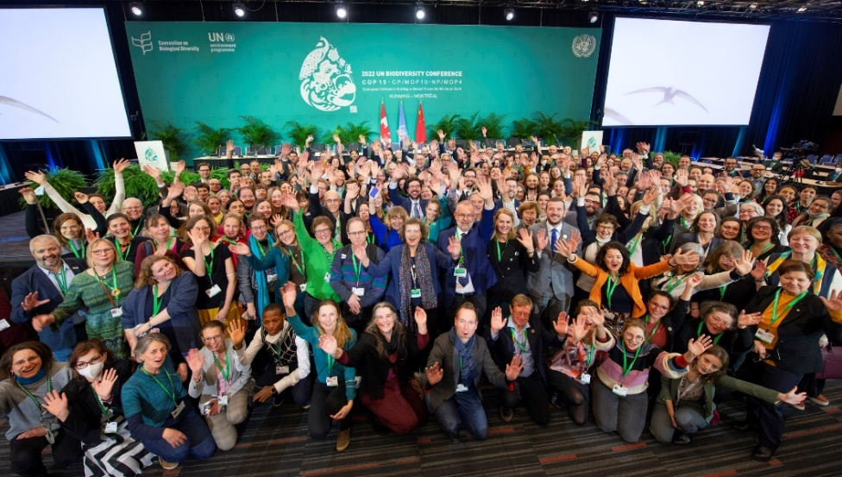
Preparation for CBD COP from the perspective of the EU Presidency

Slide 3
Preparation for CBD COP from the perspective of the EU Presidency
Internal (Presidency):
Securing resources
Building the team (around 40 members)
Timeline & workflow
Logistics
EU level:
Coordination & communication
Council Conclusions
EU+MS position papers for most of the agenda items
Workshare

Slide 4
EU Preparatory process
Presidency draft of Council Conclusions
WP IEI Biodiversity
WPE
ENVI Council
Coreper
EU+MS position papers
WP IEI Biodiversity

Slide 5
EU+MS position papers
Structure:
Team (lead authors, drafting/expert group members)
Links to relevant documents (published by CBD Secretariat)
Background information
EU+MS position
Speaking notes (summarising key issues in amendments; latest part)
Draft decision (to be adopted at the COP), including amendments proposed by the EU+MS
Drafts based on EU+MS position papers / orientation lines from preparatory meetings (SBSTTA, SBI recommendations) or from previous COPs
Need to ensure coherence across cross-cutting issues and align joint statements for corresponding items under CBD/CP/NP (such as capacity building)
EU statement (speaking notes) + amendments will be submitted to the CBD Secretariat

Slide 6
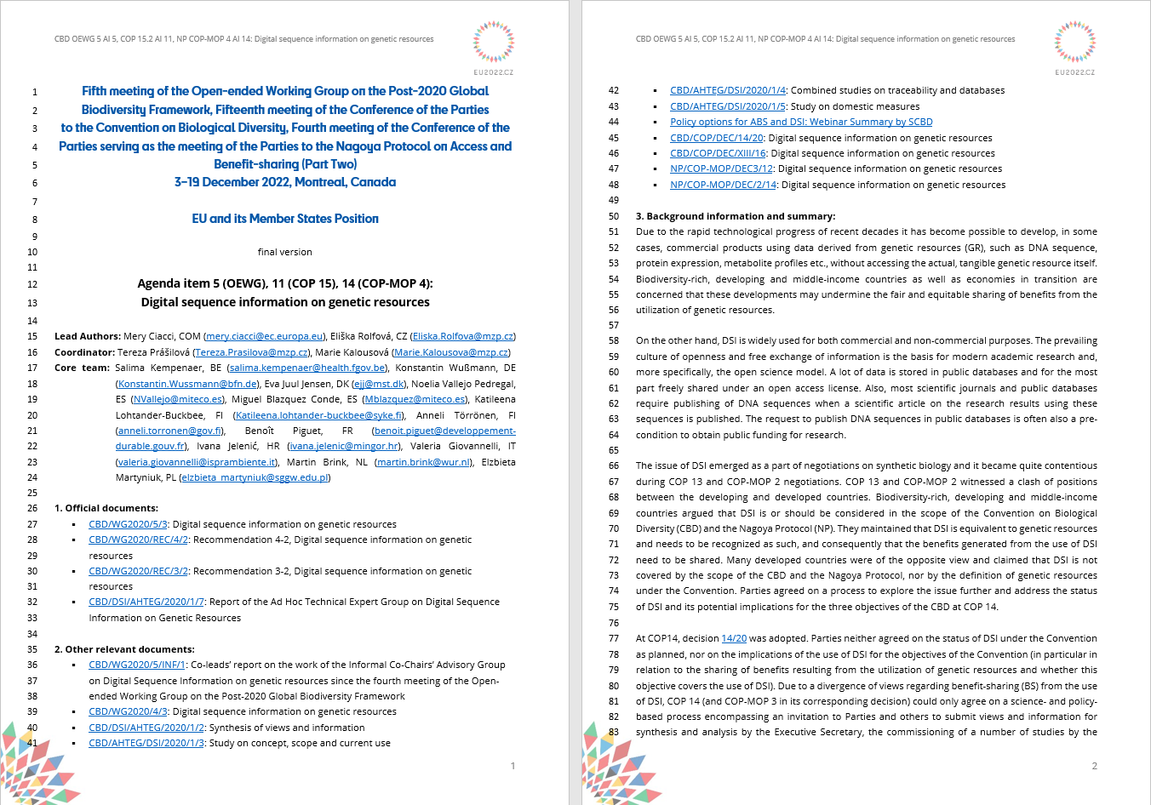

Slide 7
EU Preparatory process
Author teams: 1-2 Lead Authors (consideration of workload), coordinators, other EU/COM experts
EU (MS/COM) experts as Lead Authors (capitalising on long-term expertise) x Presidency maintains the responsibility for the overall process of decision-making at WP IEI (oversight by coordinators)
First draft → drafting/expert group (informal meetings) → WP IEI Biodiversity (Delegates Portal / meeting / informal silence procedure)
Collecting and integrating comments (technical expertise x political issues → translating scientific expertise into political decisions)
Need to distinguish expert and formal discussions
Presidency as an honest broker, ensuring transparency, integrity and inclusivity
"Retro-planning" (from the moment documents are published to final adoption of EU+MS PP)

Slide 8
At the COP
Negotiating process:
First reading (EU statement)
Contact Group / FoC → non-paper
Conference Room Paper
L-document
Adoption by the Plenary
Presidency/Commission negotiators speak on behalf of EU+MS – EU speaks with one voice
Need to check all changes in the documents along the process against the agreed EU+MS position – EU cannot react if there is no agreed position
Discussion at EU expert meetings / EU coordination meetings

Slide 9
At the COP
Concurrent meetings (COP + COP-MOPs) – 2 working groups / several contact groups / Friends of the Chair groups / „huddles“ → Presidency has to be present always
To negotiate, track progress, report back to the EU (and coordinate as needed)
Need to keep the EU colleagues properly informed (progress, agenda, what is happening when and where, documents published, etc.) – role of coordinators
Inclusive approach appreciated especially by small delegations (use of e-mail, WhatsApp)
EU:
EU coordination meetings:
in the morning (or as necessary)
need to avoid overlap
report from the Bureau
agenda needs to reflect the urgency of the issues discussed
only for EU delegates;
Expert group meetings as needed (informal)

Slide 10
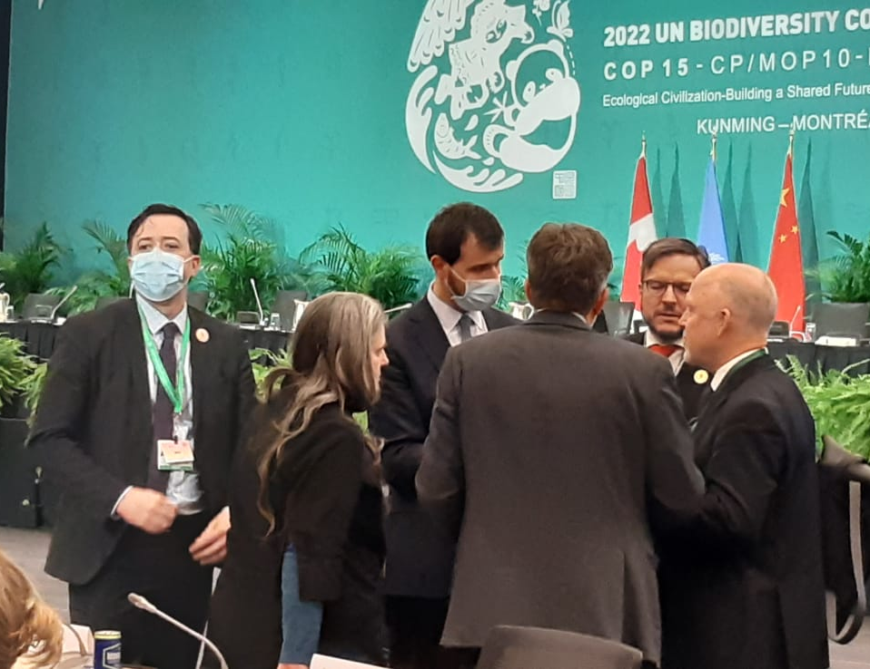
At the COP
Outreach: What happens "behind the scene"?
Need to engage in bilateral/outreach discussions
Outreach meetings (Presidency Trio, Commission; report back as appropriate)
Liaising with the UN regions (EU: WEOG+CEE)
Links to the Secretariat
Observers, NGOs (possible support if agreed by the EU)
Informal networks
Letting others bring forward EU text/positions

Slide 11
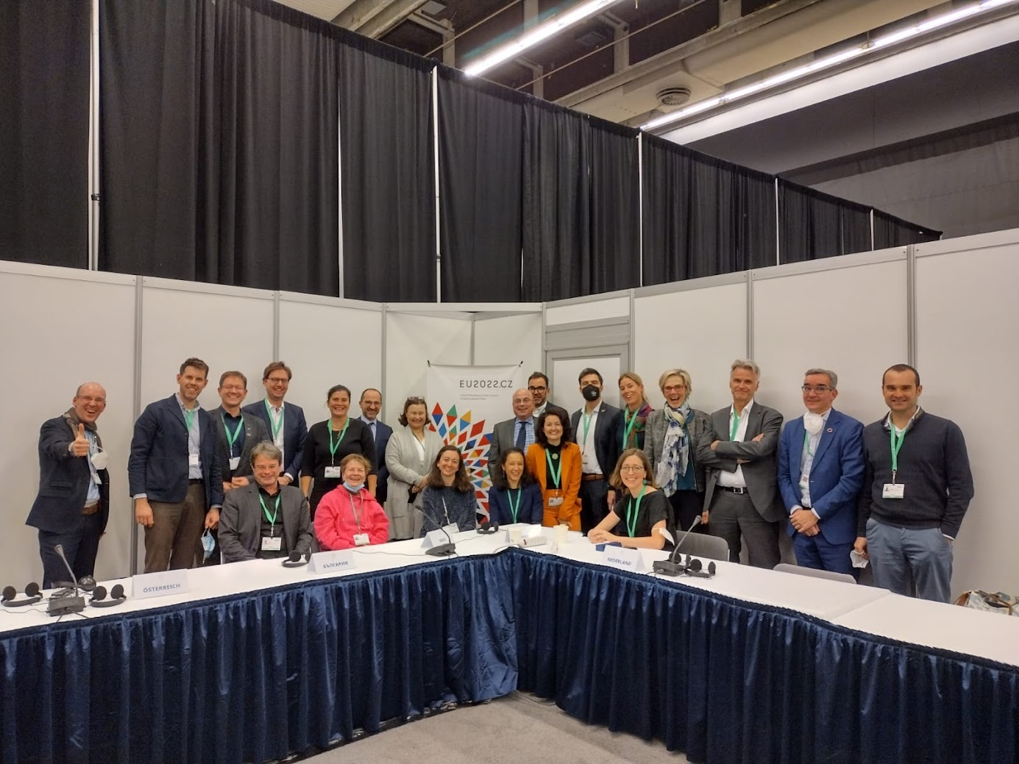
At the COP
Team:
High-Level Segment participants (Head of Delegation)
Chairs for EU coordination meetings
Assistants
Lead Authors / Negotiators
Coordinators (general / for specific PPs)
Outreach
Logistics
IT support
Permanent Representation

Slide 12
Eliška Rolfová Ministry of the Environment of the Czech Republic e-mail: eliska.rolfova@mzp.cz
Thank you for your attention. Wishing you all the best for the upcoming Hungarian EU Presidency (and to the whole presidency Trio)!

