Slide 1
A researcher's inside experiences from global fora: IPBES assessments and CBD negotiations and technical expert groups
Zsolt Molnár (botanist, ethno-ecologist)
Centre for Ecological Research
Capacity Building Workshop for Hungarian, Romanian and Polish
experts and negotiators / 15-16 January 2024 / Budapest, Hungary

Slide 2
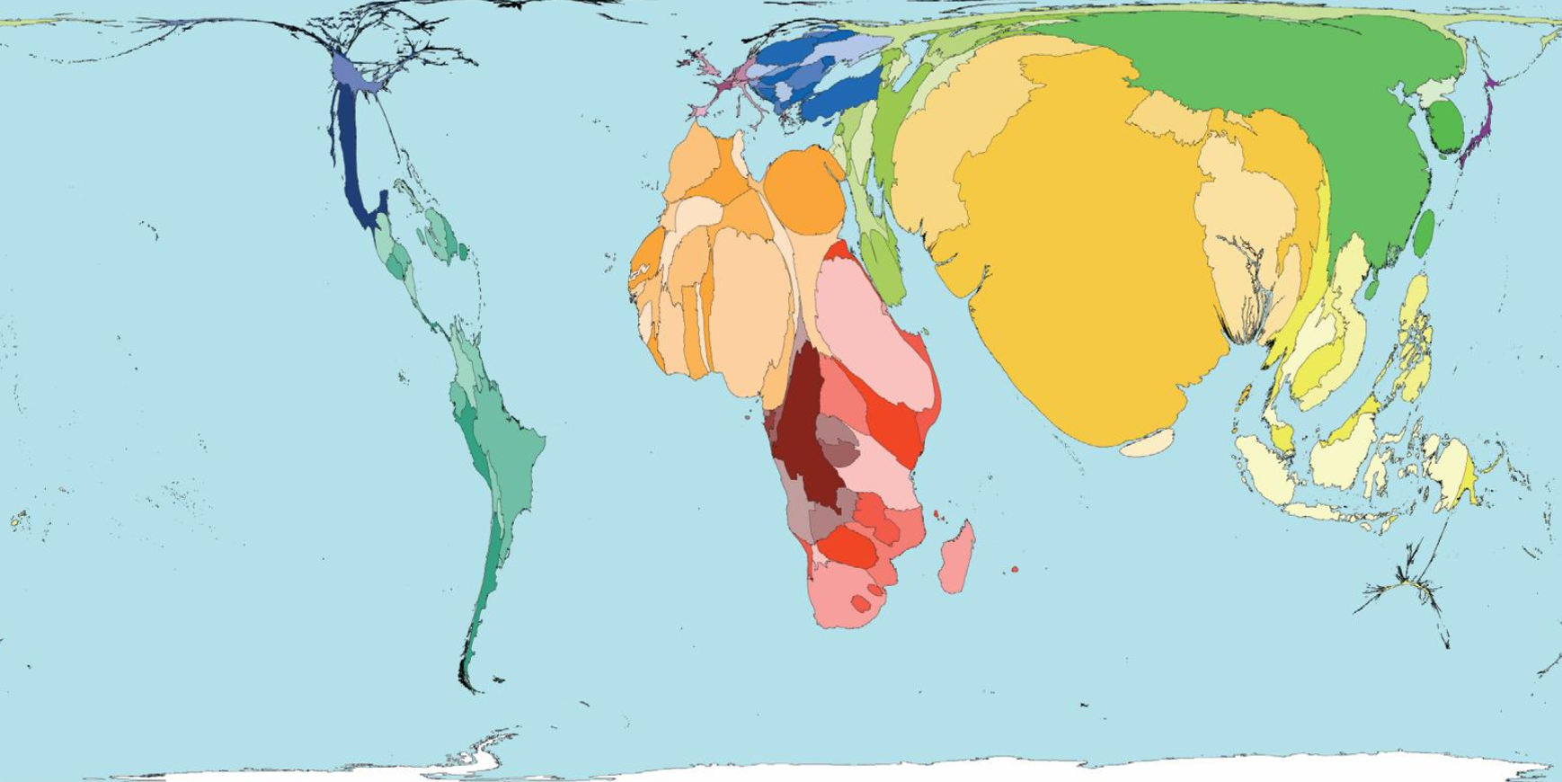

Slide 3
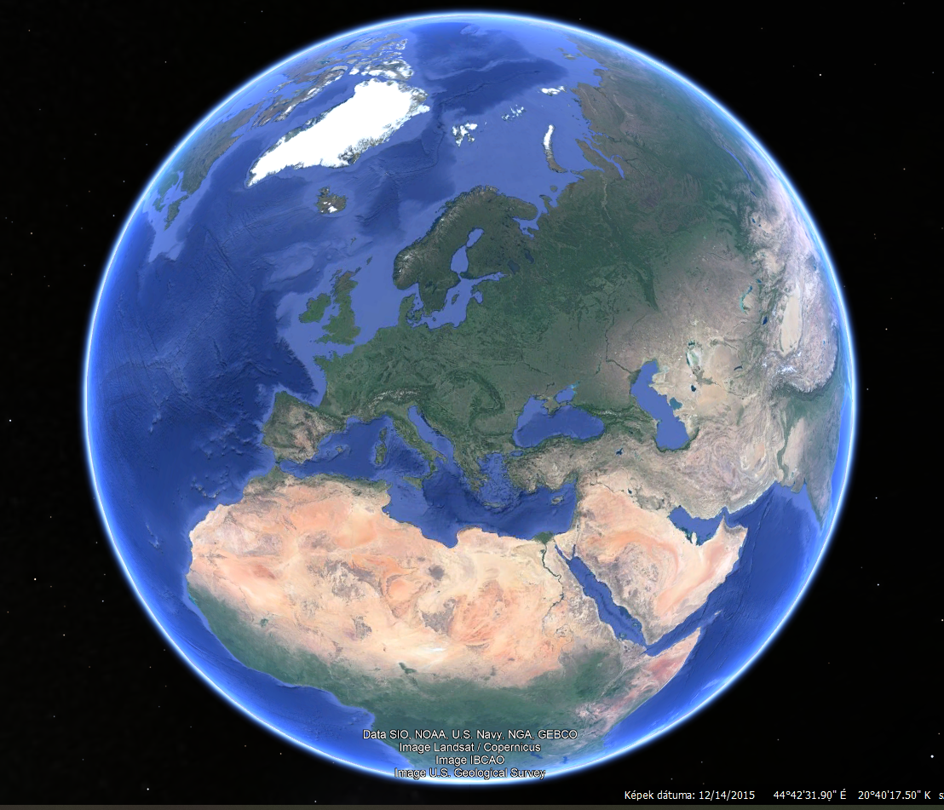

Slide 4
My participation in global fora
Indigenous and Local Knowledge Task Force of IPBES (2014-2023)
Lead author in the Europe and Central-Asia Assessment, head of the ILK liason group
Coordinating lead author in the Global Assessment (Nature subchapter) (2016-2018)
IPBES expert at CBD COP14, Egypt
Independent expert in the AHTEG on indicators of the KMGBF (2023-2024)
Independent expert in the AHTEG on 8j and related provisions (traditional knowledge)
Expert member of the Hungarian delegation at various IPBES and CBD meetings

Slide 5
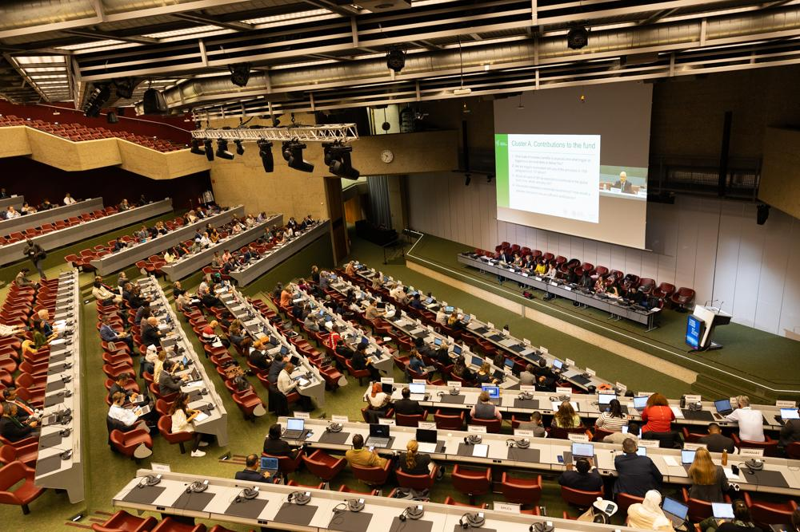
The plenaries

Slide 6
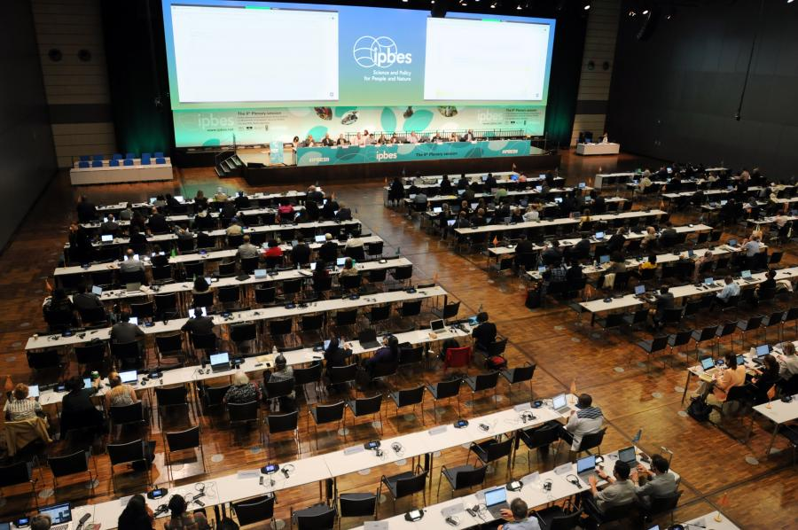
The plenaries

Slide 7
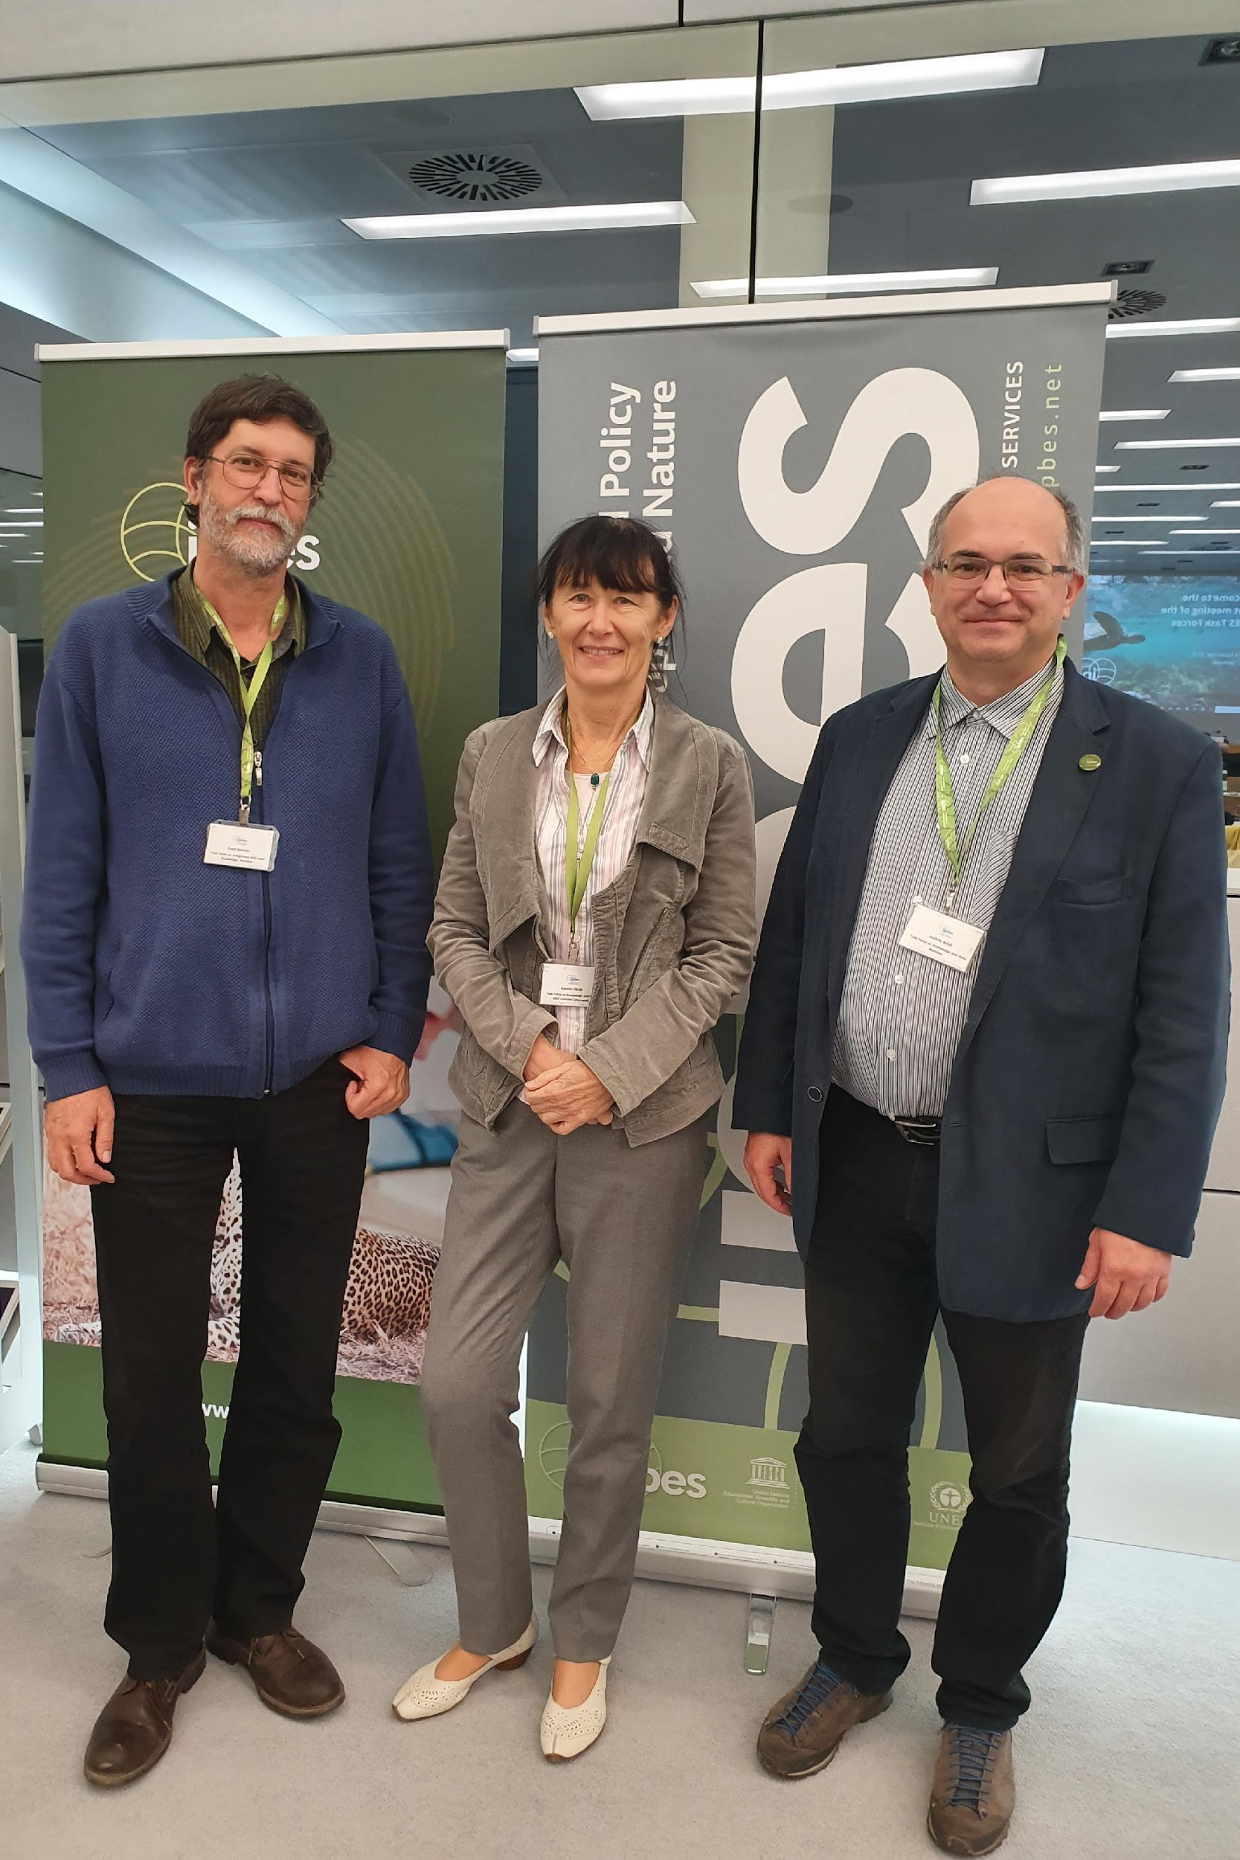
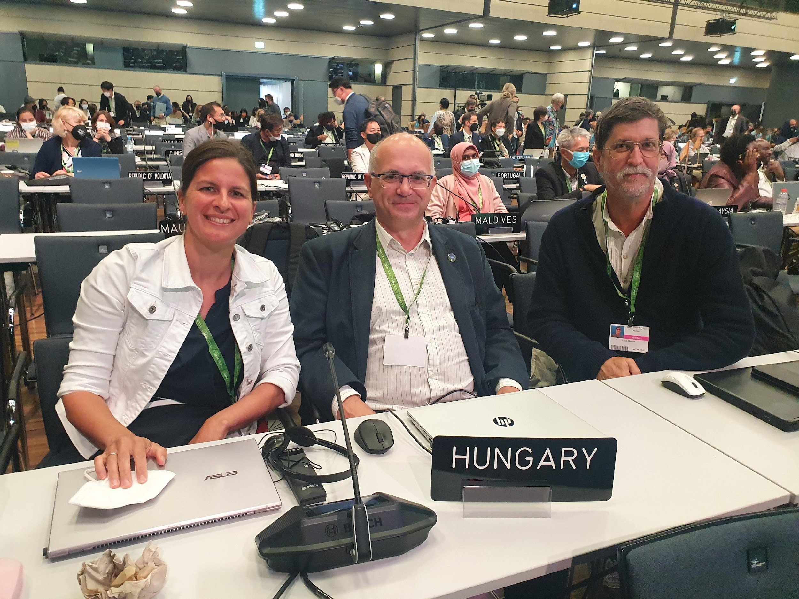
The plenaries

Slide 8
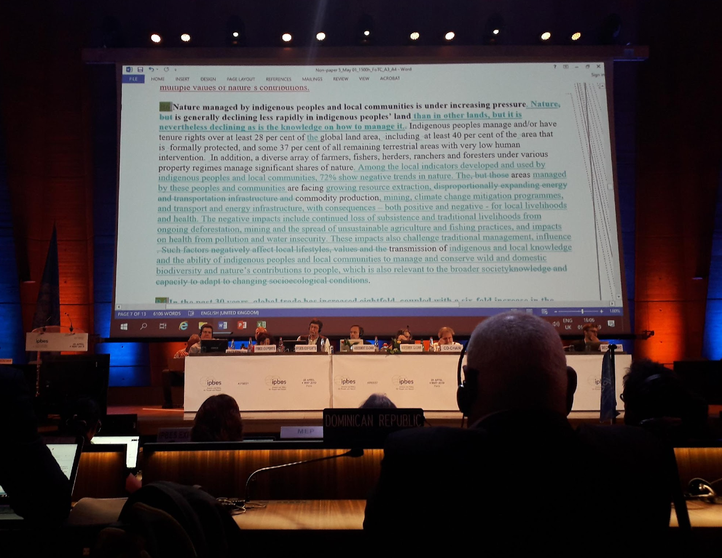
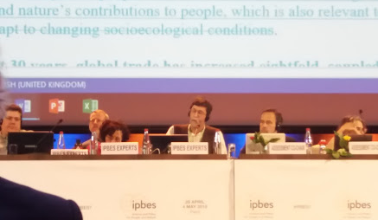
The plenaries
At 1:30am in Paris (Plenary discussion of the SPM of IPBES GA)

Slide 9
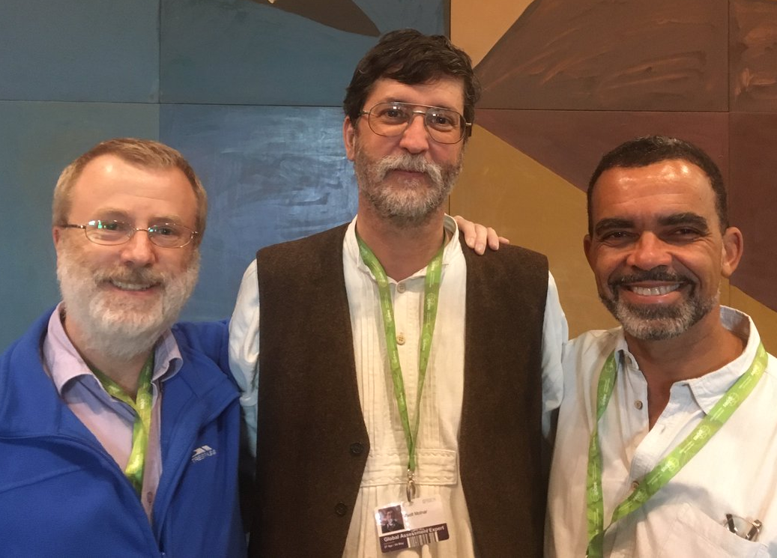
Great friendships, great colleagues
Andy Purvis
David Obura

Slide 10
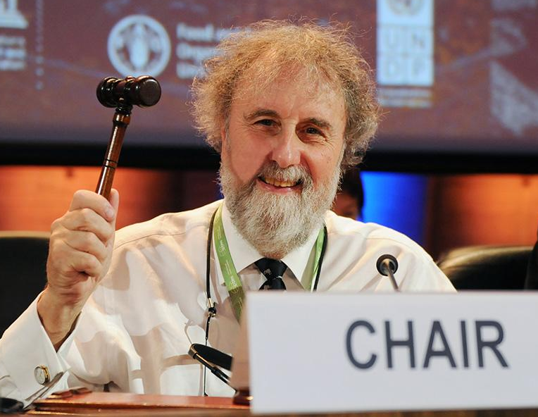
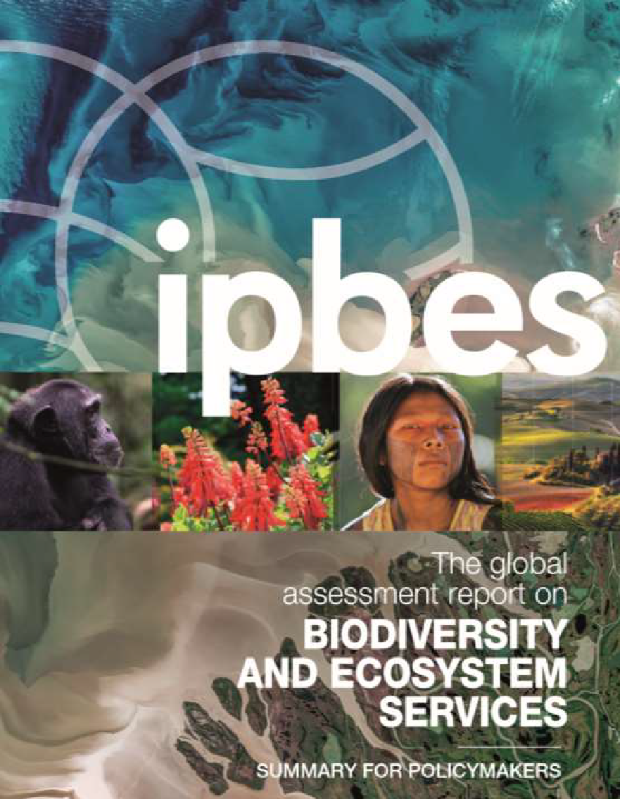
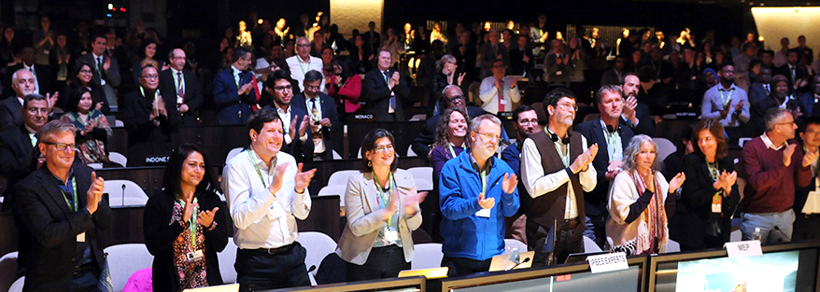

Slide 11
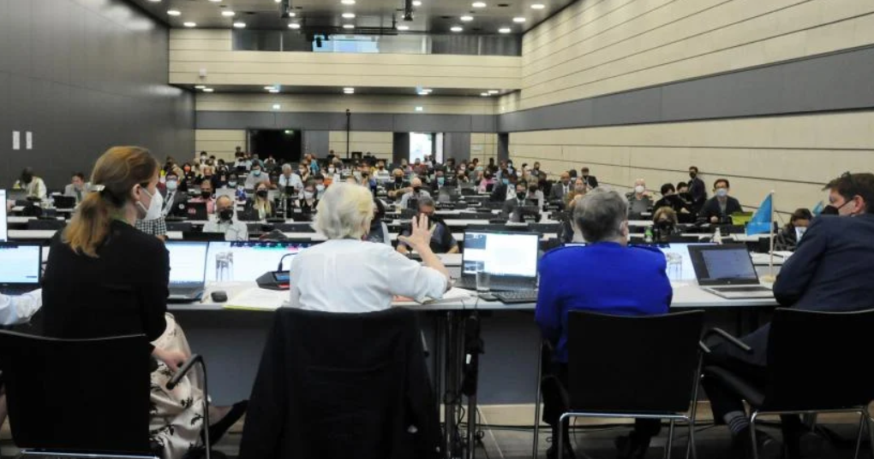
Contact groups

Slide 12
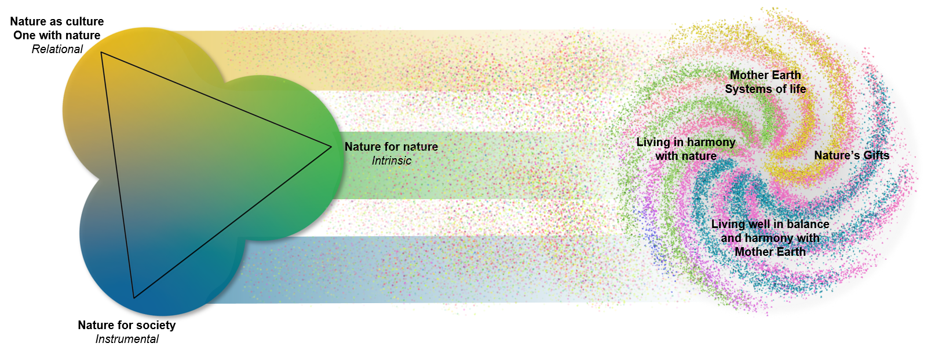
Contact group, working groups
Nature Futures Framework

Slide 13
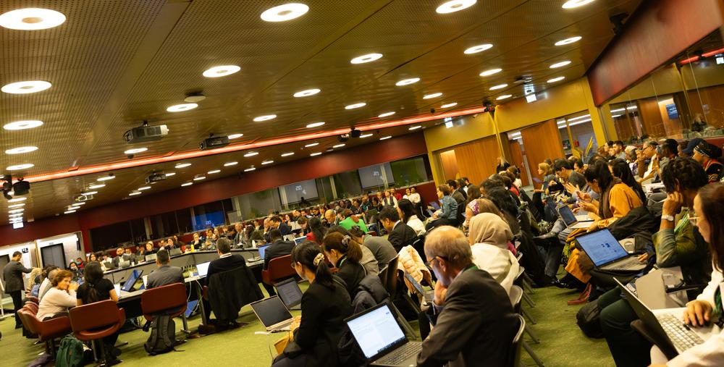
Contact groups

Slide 14
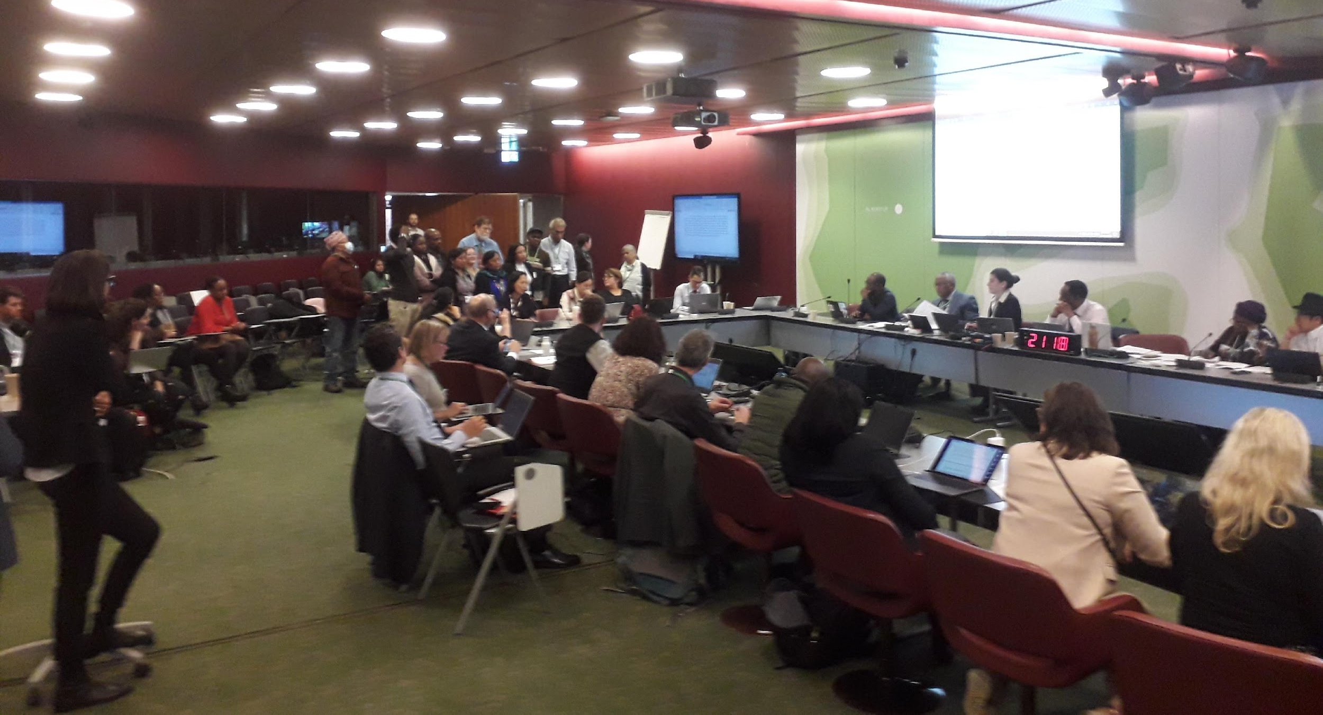
Contact groups

Slide 15
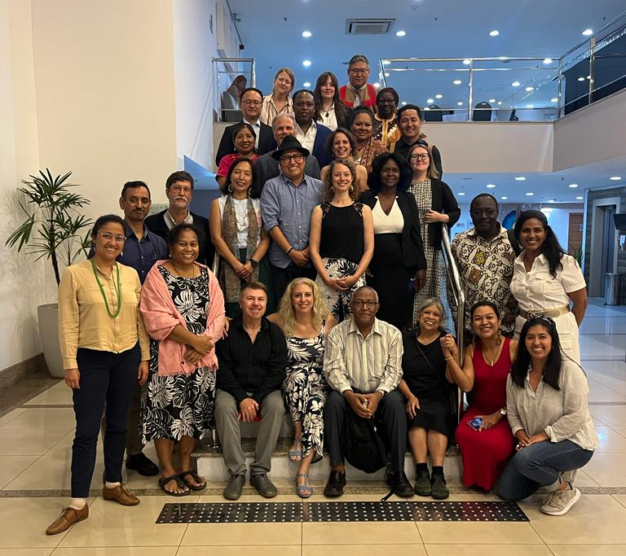
Expert groups (AHTEGs)

Slide 16
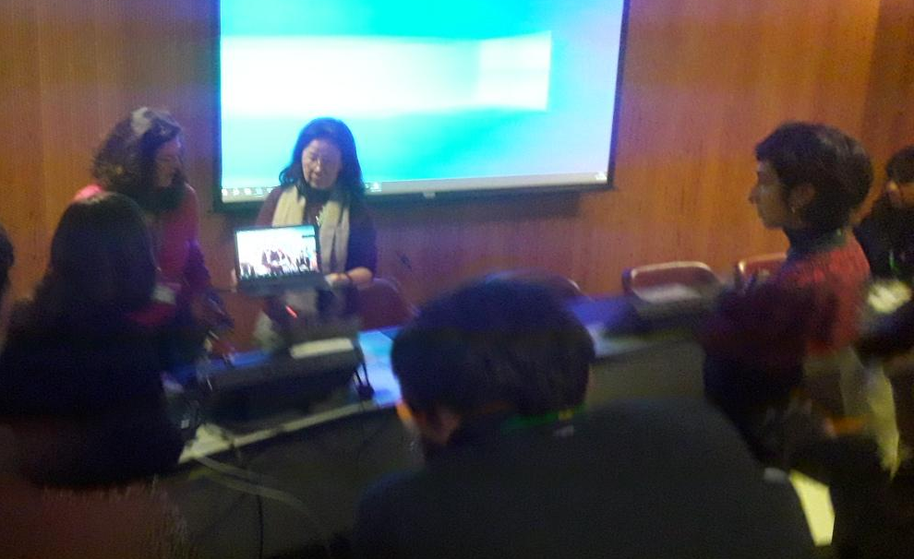
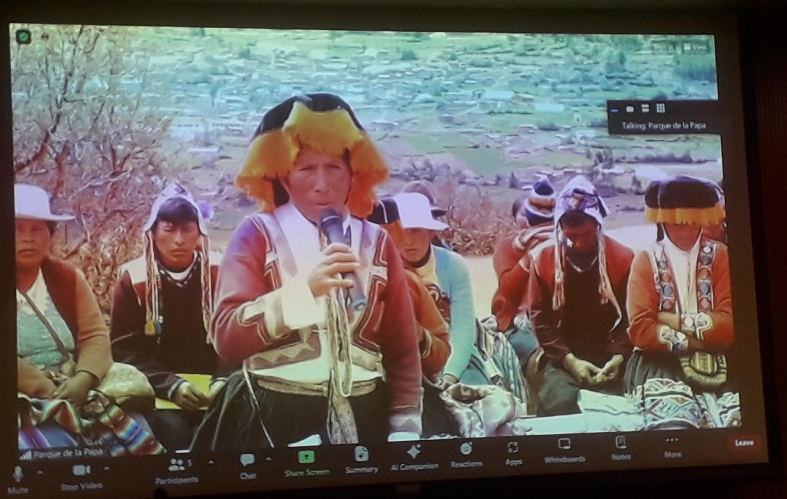
Side events

Slide 17
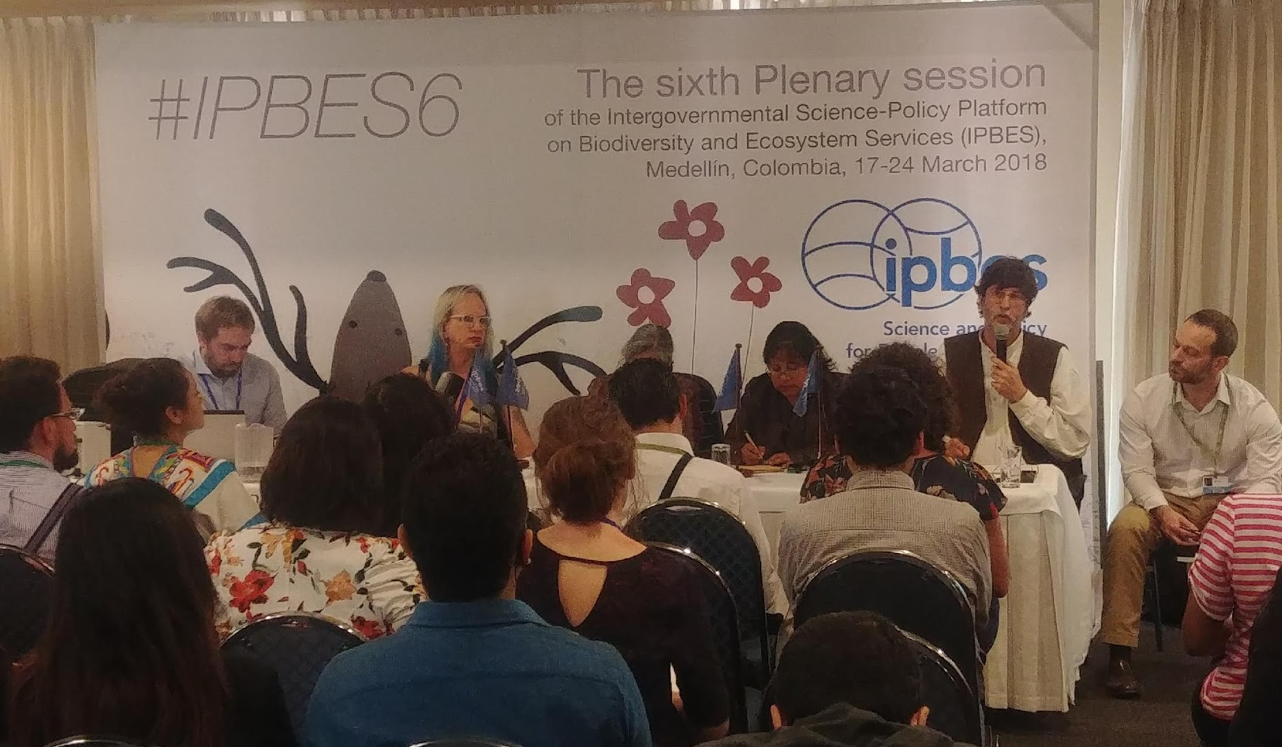
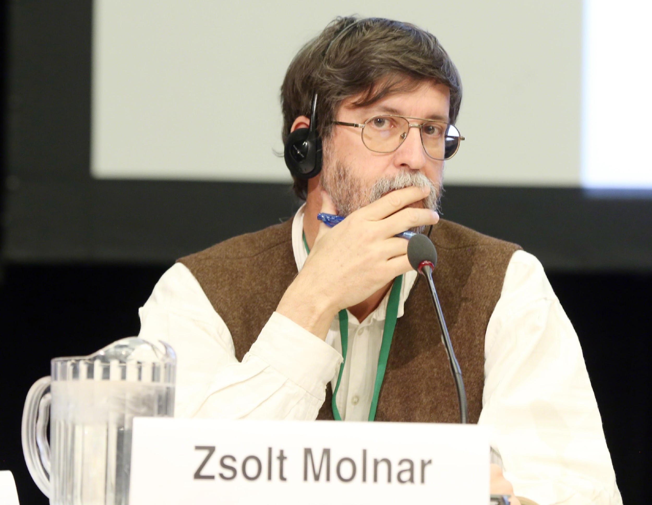
Side events

Slide 18
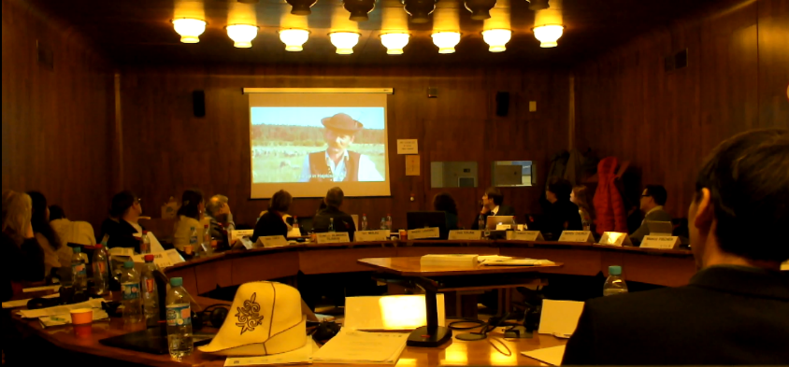
Dialogue workshop (Europe and Central Asia Assessment, Paris, 11-13. January 2016)
Knowledge co-production

Slide 19
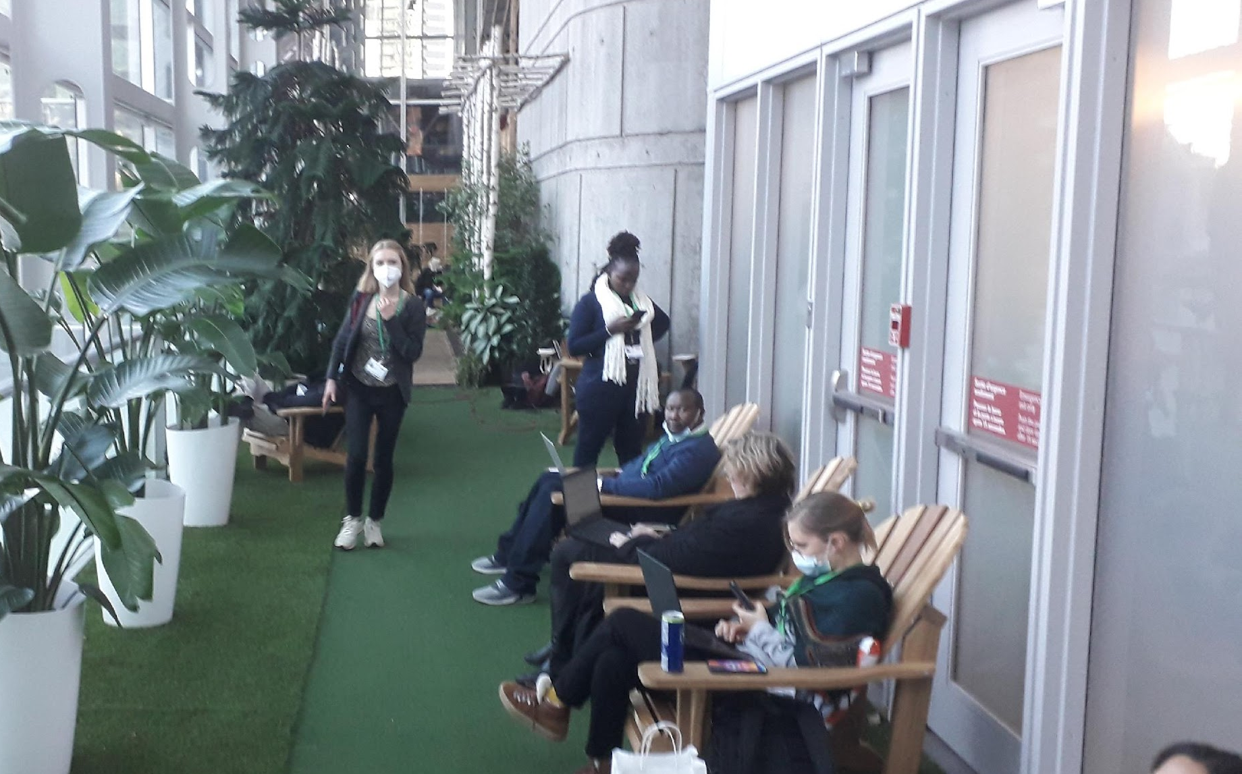
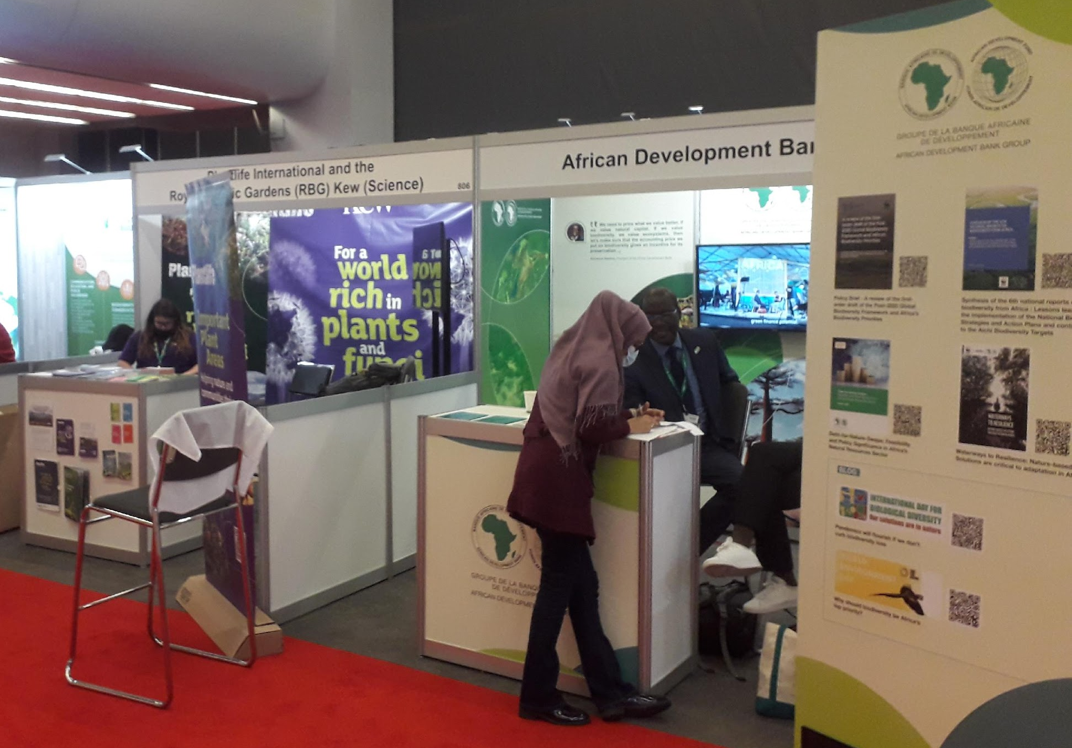
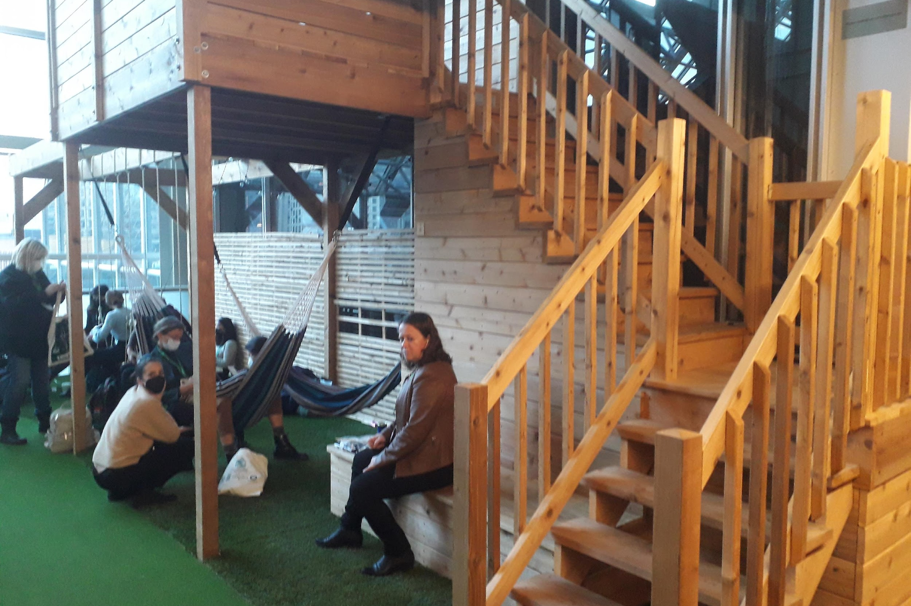
Corridors, coffee breaks, markets

Slide 20
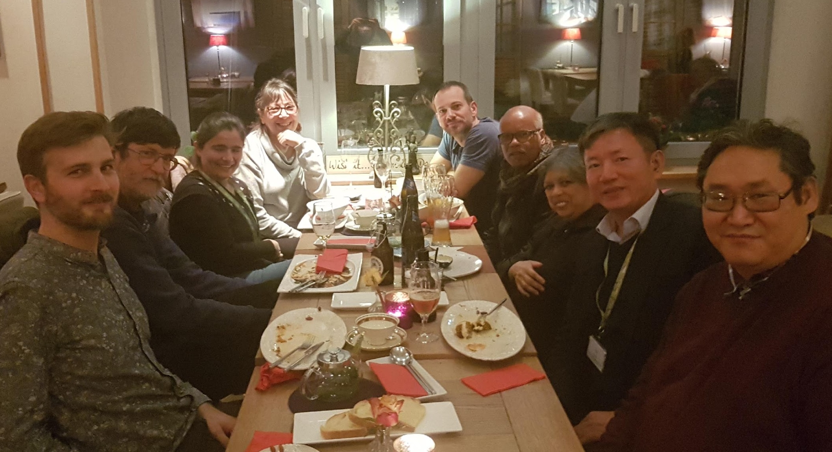
Evenings (if not spent in the contact group)

Slide 21
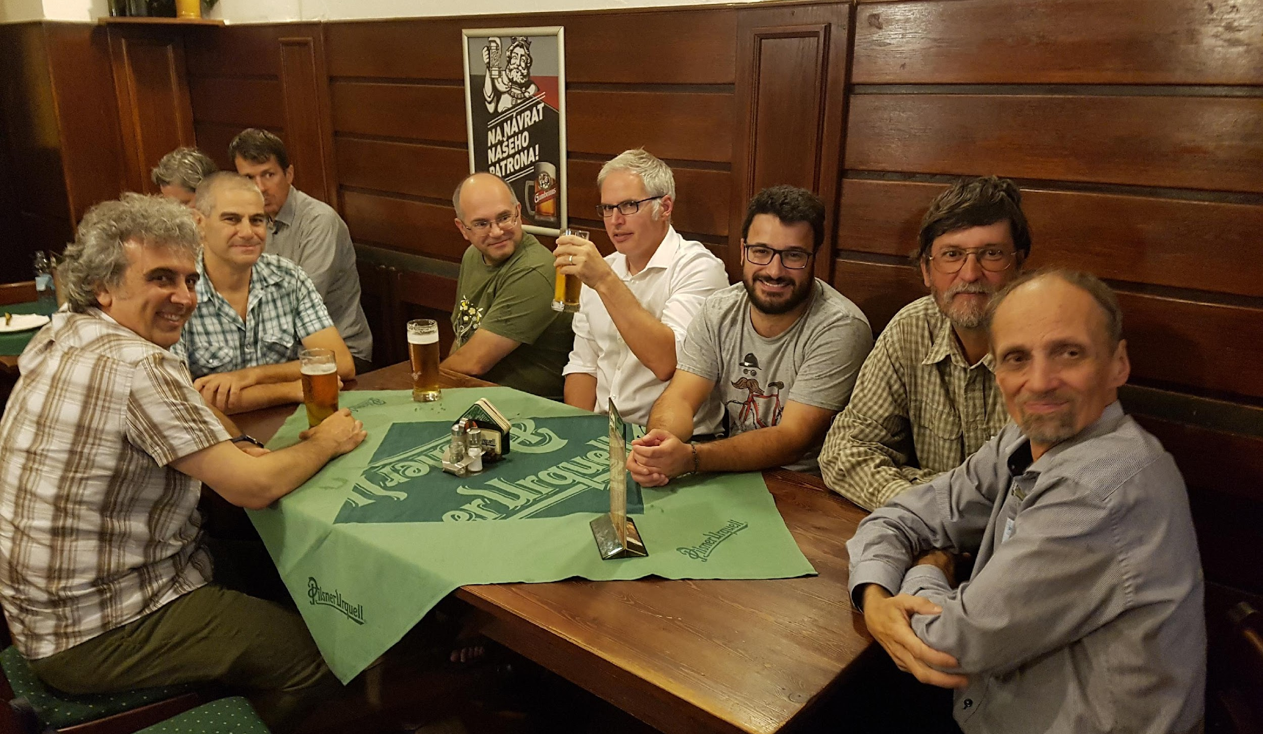
Evenings (if not spent in the contact group)

Slide 22
What we, scientists can contribute, what we can learn?
Science – Policy
Policy – Science

Slide 23
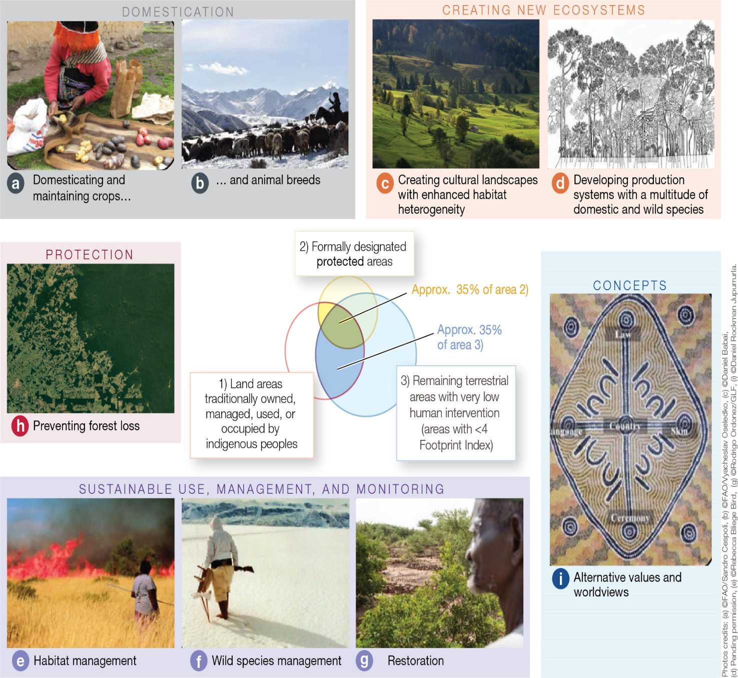
Contributions of Indigenous Peoples and Local Communities:
knowledge, innovations, practices, and institutions
Domestication
Creating new ecosytems
Protection
Concepts
Sustainable use, management and monitoring
IPBES (2019): Summary for policymakers of the global assessment report on biodiversity and ecosystem services of the Intergovernmental
Science-Policy Platform on Biodiversity and Ecosystem Services. (Díaz et al. (eds.). IPBES secretariat, Bonn, Germany. 56 pages.

Slide 24

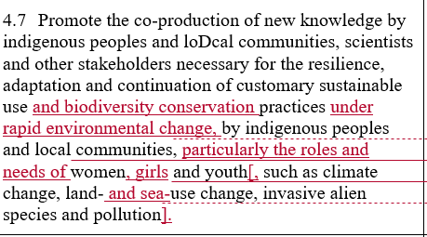
Traditional knowledge is adaptive
So some parts are not yet tested
Knowledge co-production with science can help speed up testing/adaptation
Promote the co-production of knowledge between indigenous peoples and local communities, scientists and other stakeholders towards the generation of new knowledge necessary for the resilient adaptation and continuation of customary sustainable use practices by indigenous peoples and local communities and the conservation of biodiversity under rapid environmental change.

Slide 25
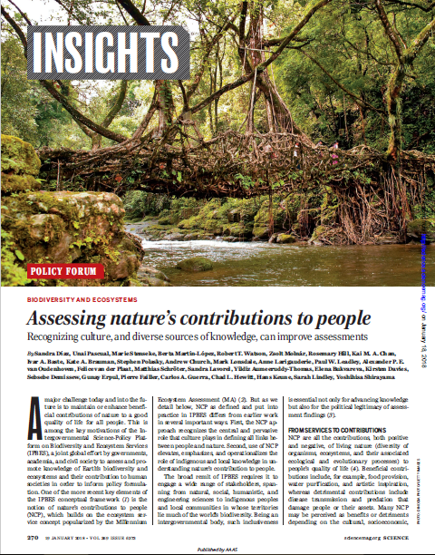
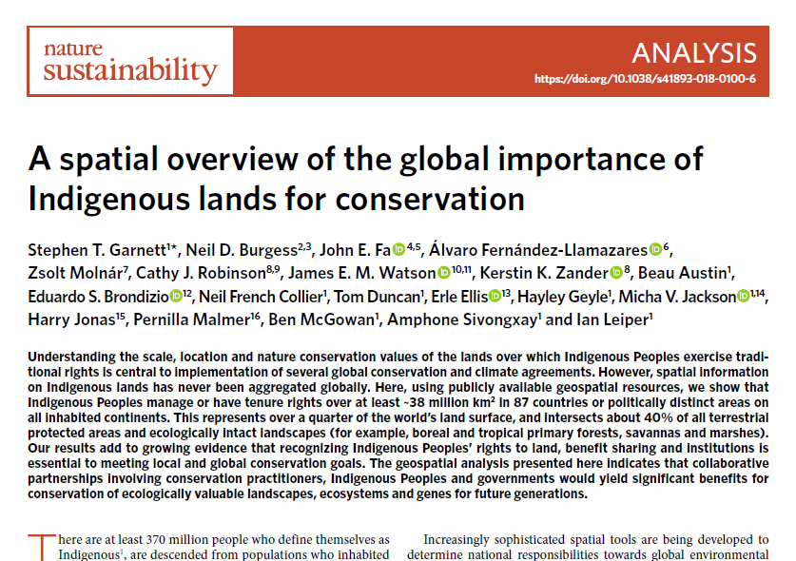

Slide 26
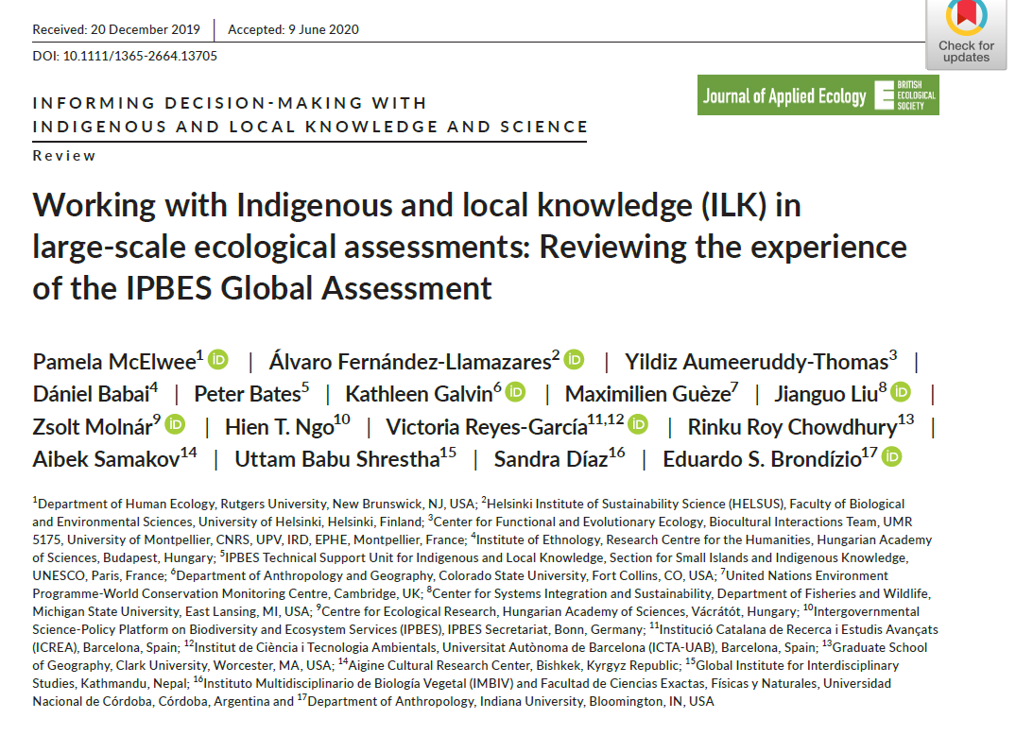
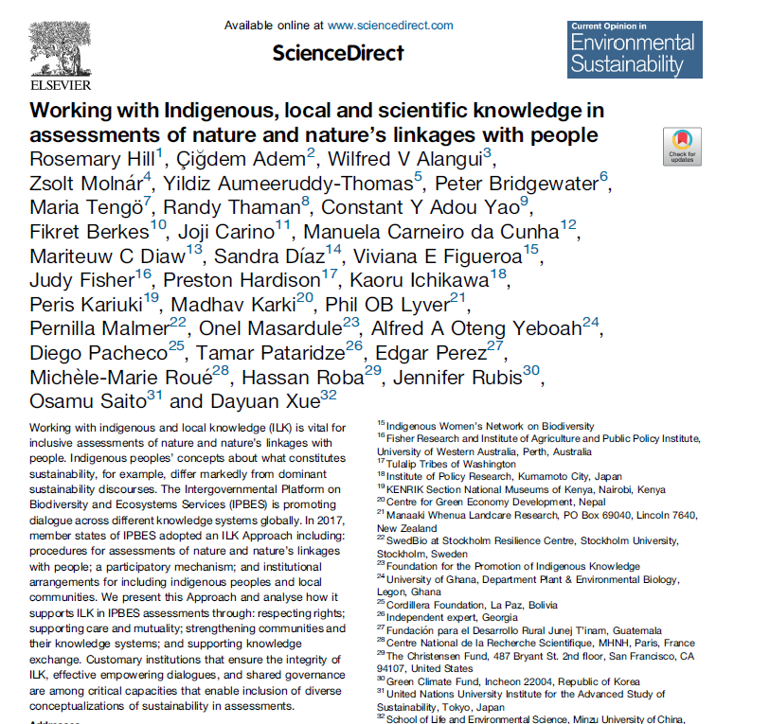

Slide 27
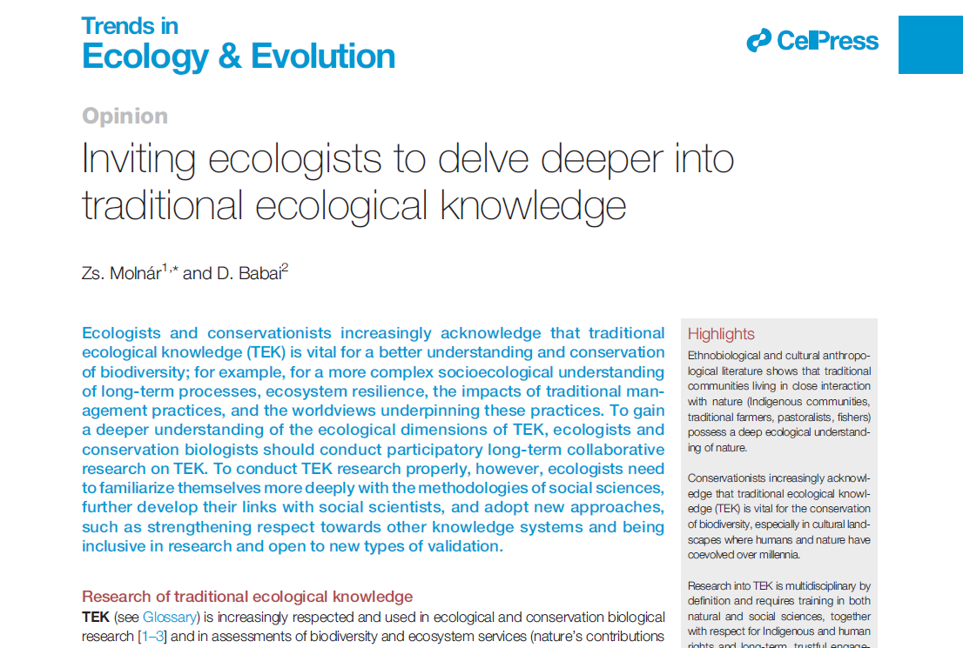
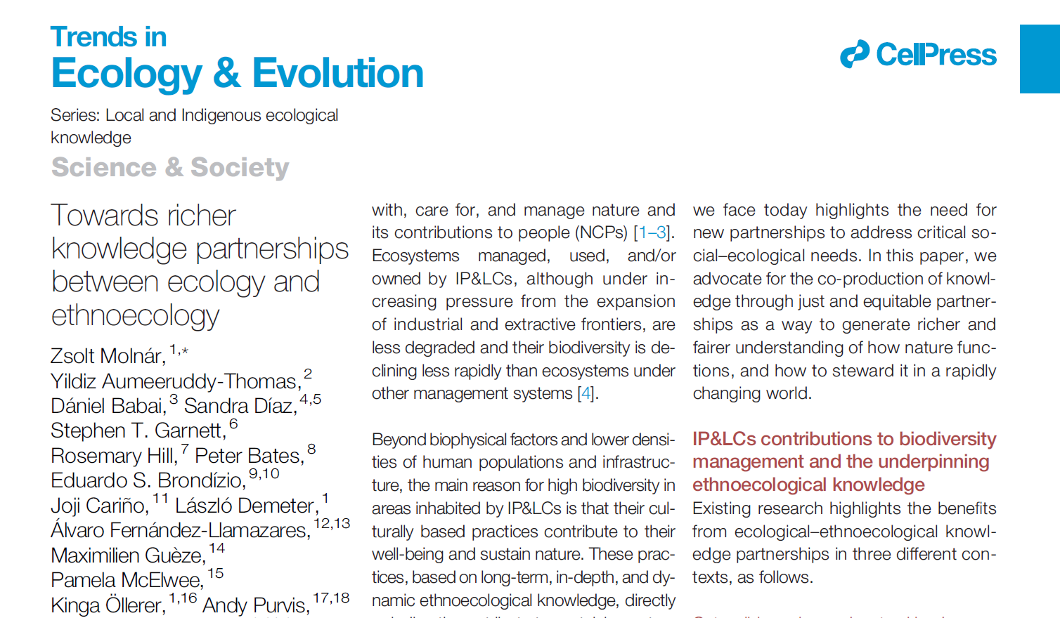

Slide 28
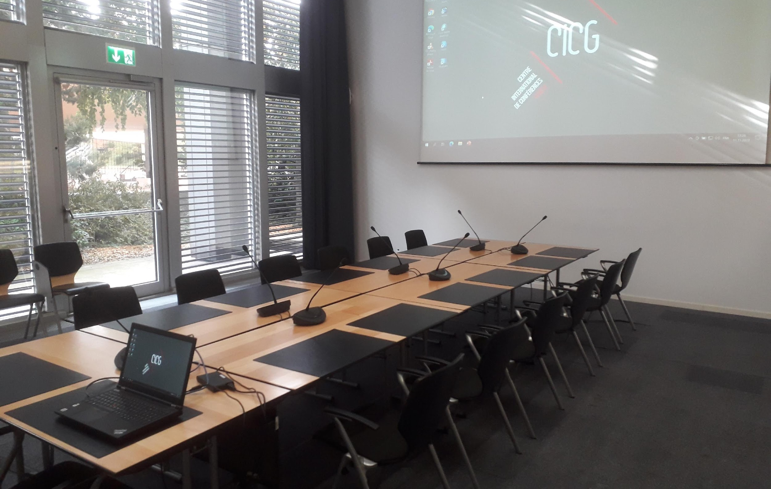
SPECIALITIES OF OUR REGION (Eastern EU member states)
Between East and West
Post-socialist countries
Not having a world language
Weak NGOs
Weak inter-country collaborations
Weak participation in most global fora
IP&LCs are poorly recognized
Biodiversity rich cultural landscapes with still many traditional land-use practices that are well studied

Slide 29
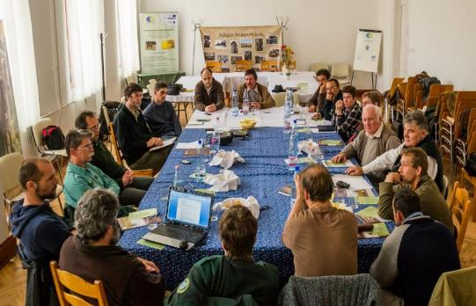
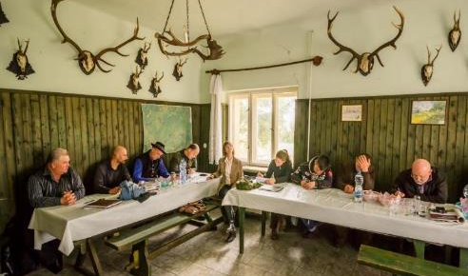
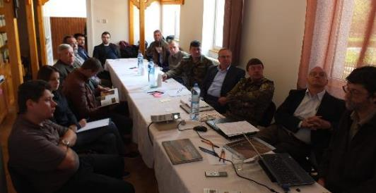
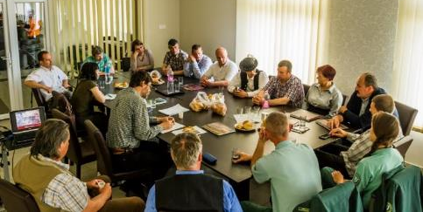
Local IPLC – conservationists/scientists follow-up formal meetings in Hungary/Ukraine in 2016
Hódmezővásárhely, March 10, 2016
Kunadacs, March 8, 2016
Hajdúböszörmény, May 9, 2016
Nagybereg, May 19, 2016 (Ukraine)

Slide 30
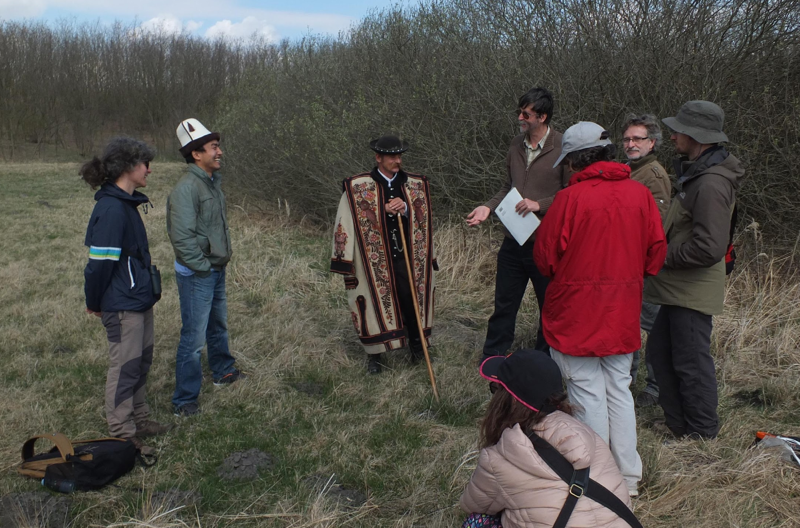
Visits of world-leading scientists to traditional knowledge holders (e.g. Sandra Díaz, Rosemary Hill)

Slide 31
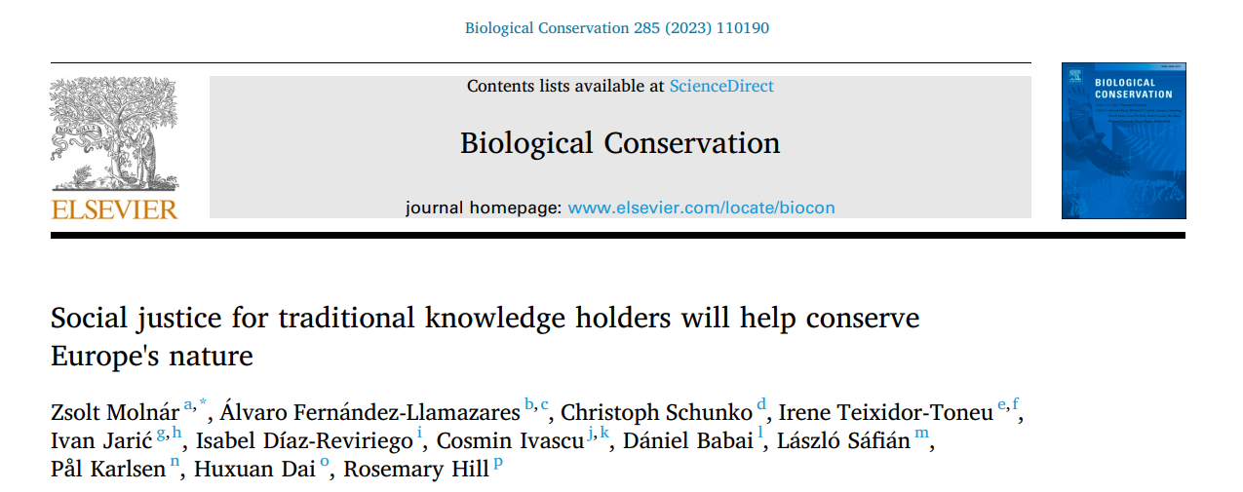
IP&LCs in our region: mostly traditional knowledge holders (herders, farmers etc.)
Strong inner-colonization by the urban population, decision makers etc.
Poor networking between local traditional communities
Social injustices inflicted on traditional knowledge holders both by EU, national goverments, even NGOs

Slide 32
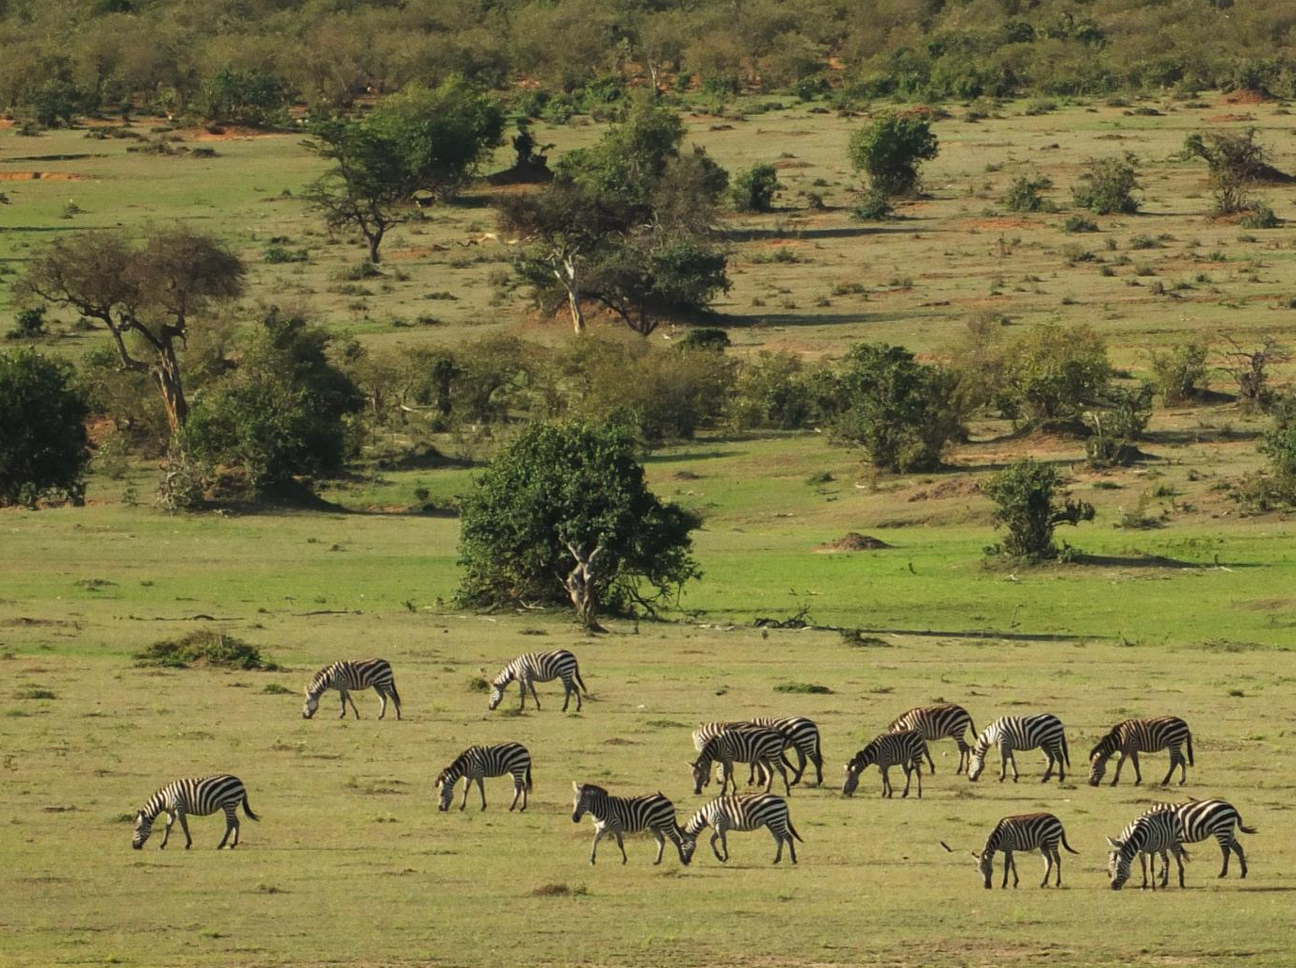
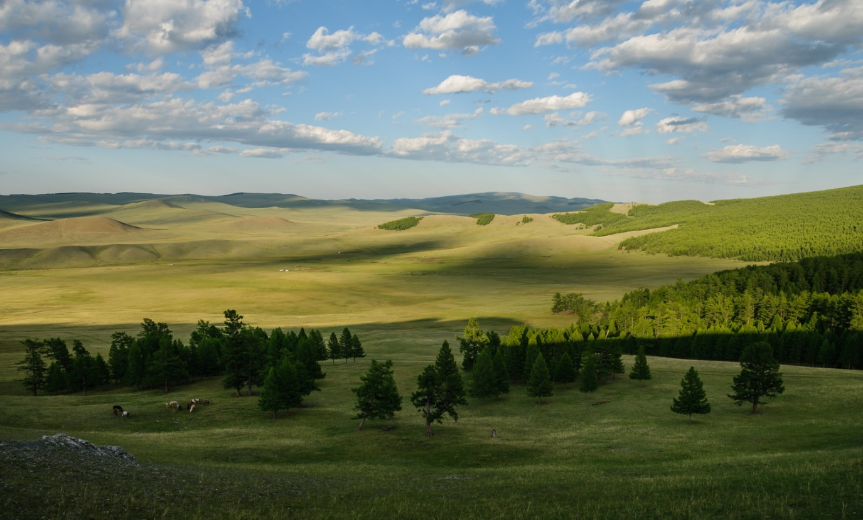
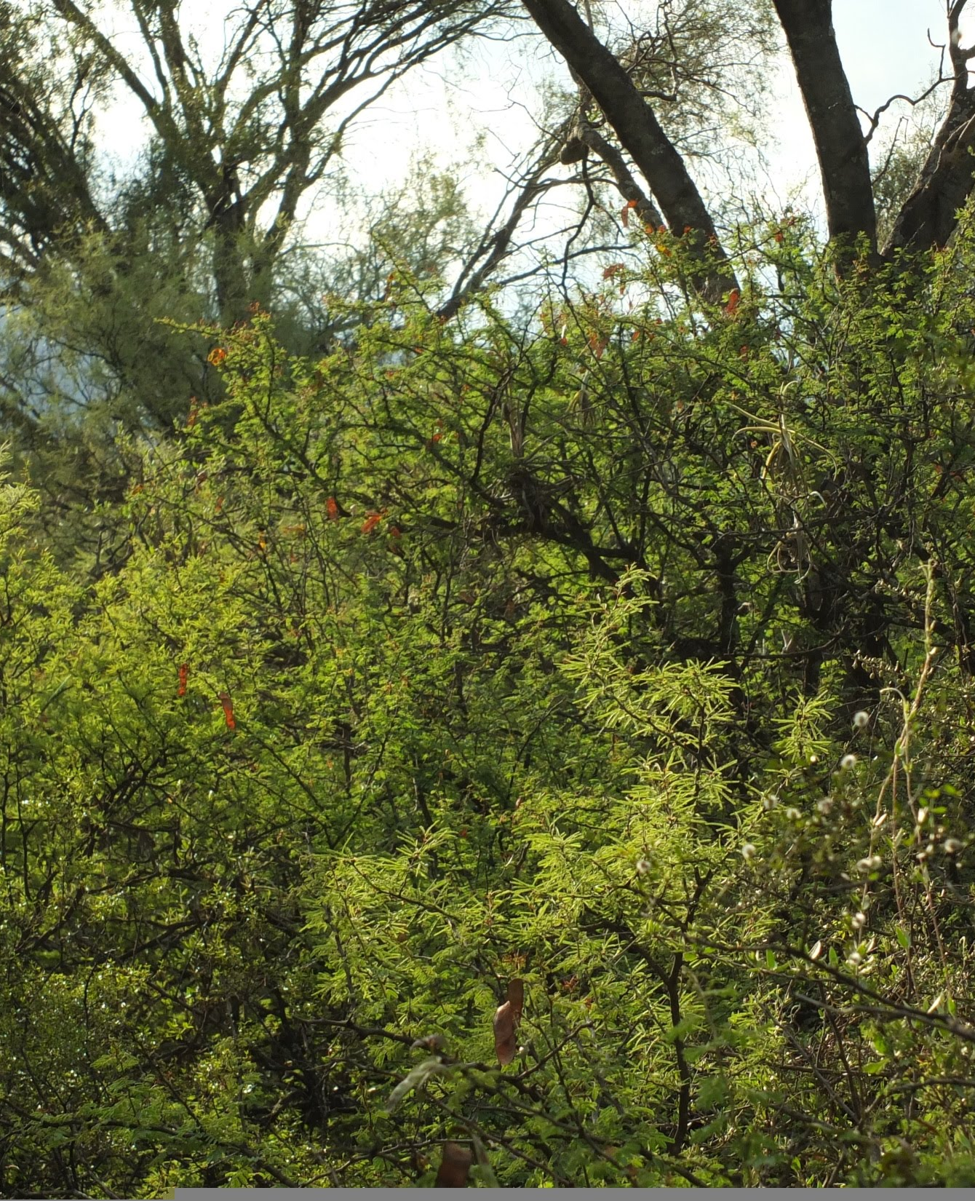

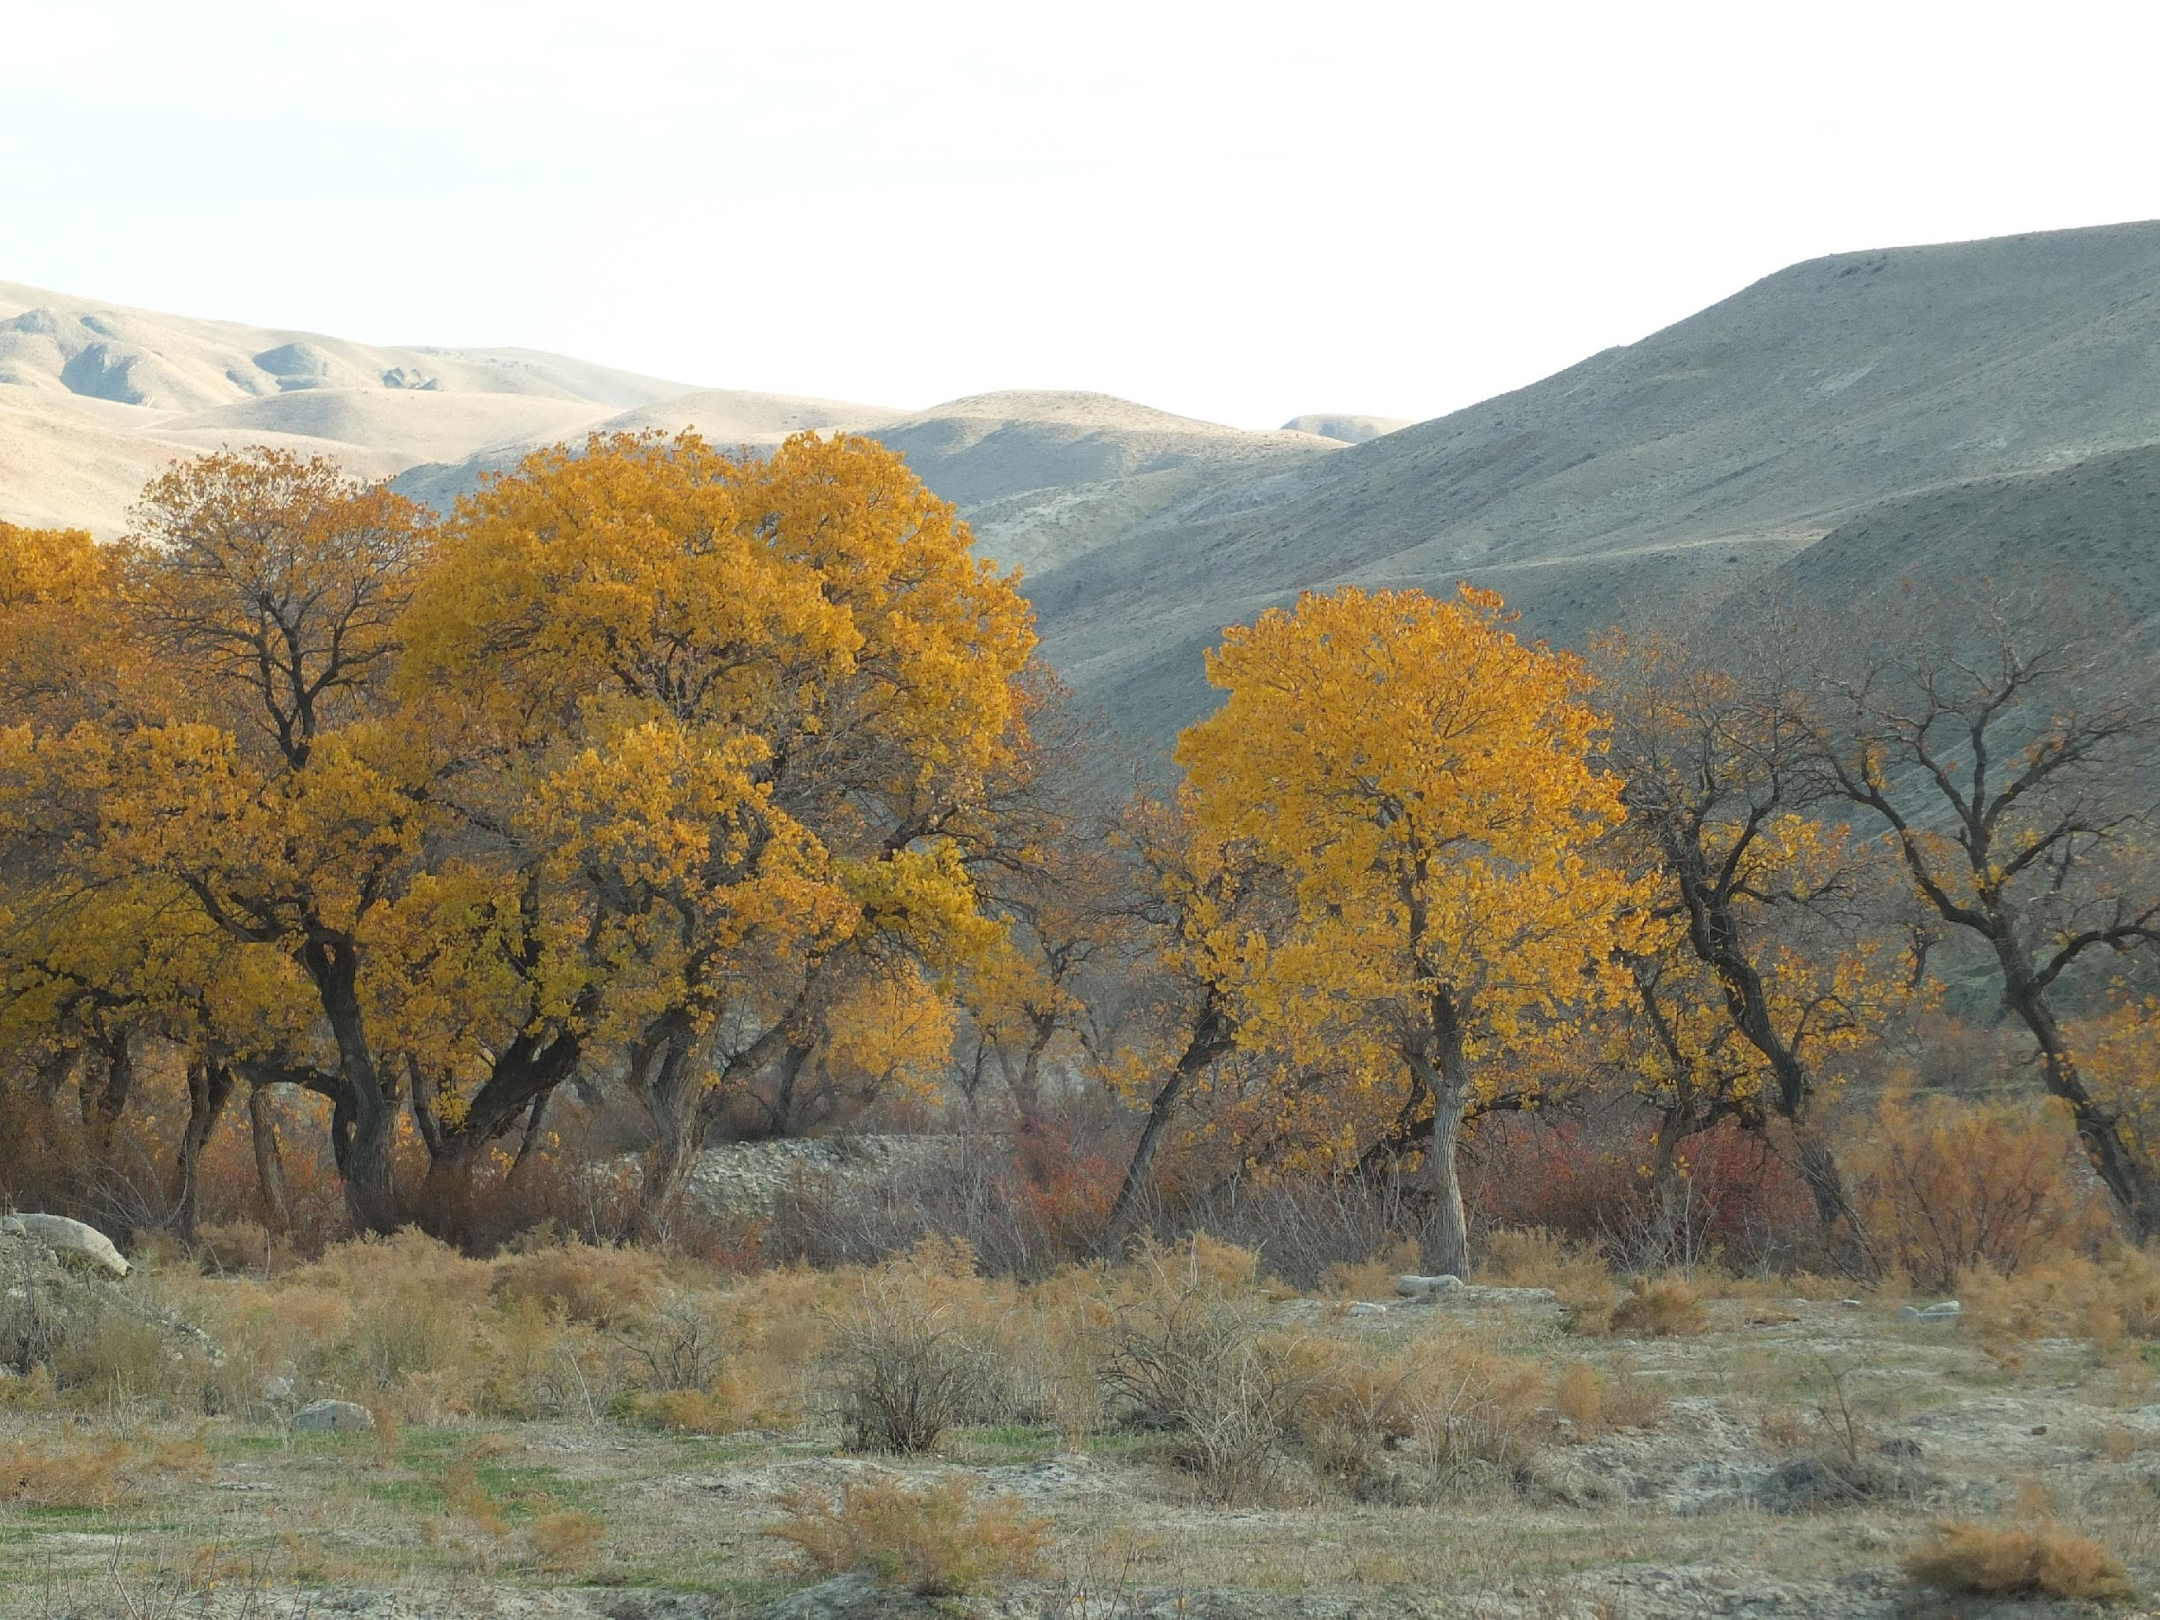
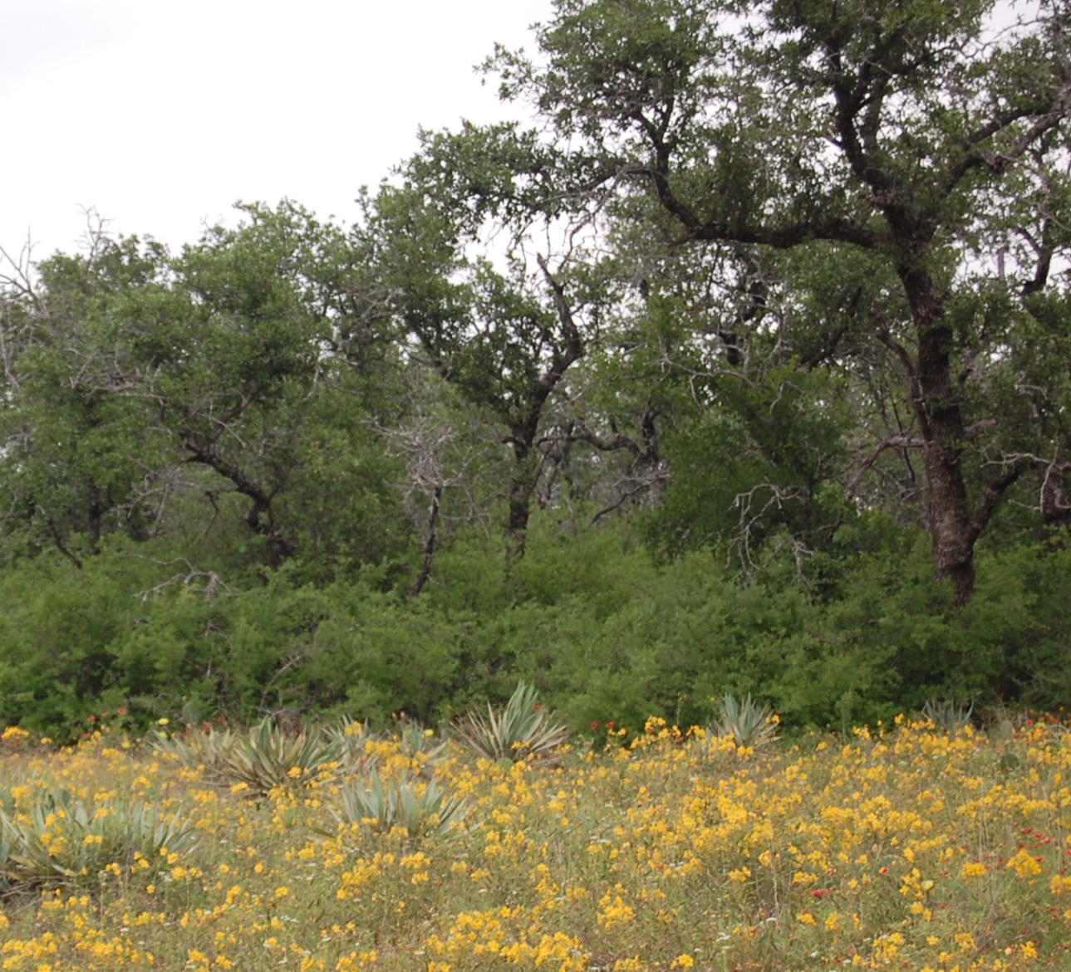
Kenya
Visiting landscapes with vegetation relevant to understand our region
Mongolia
Texas
Russia
Iran
Argentina

Slide 33
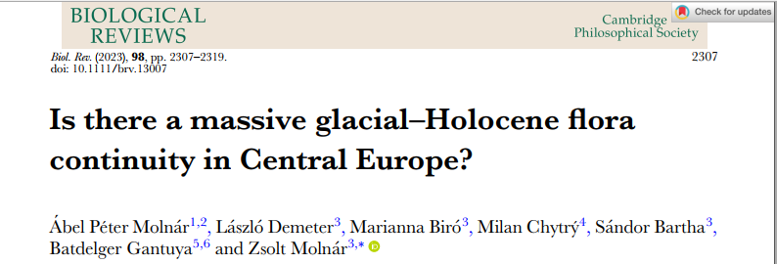
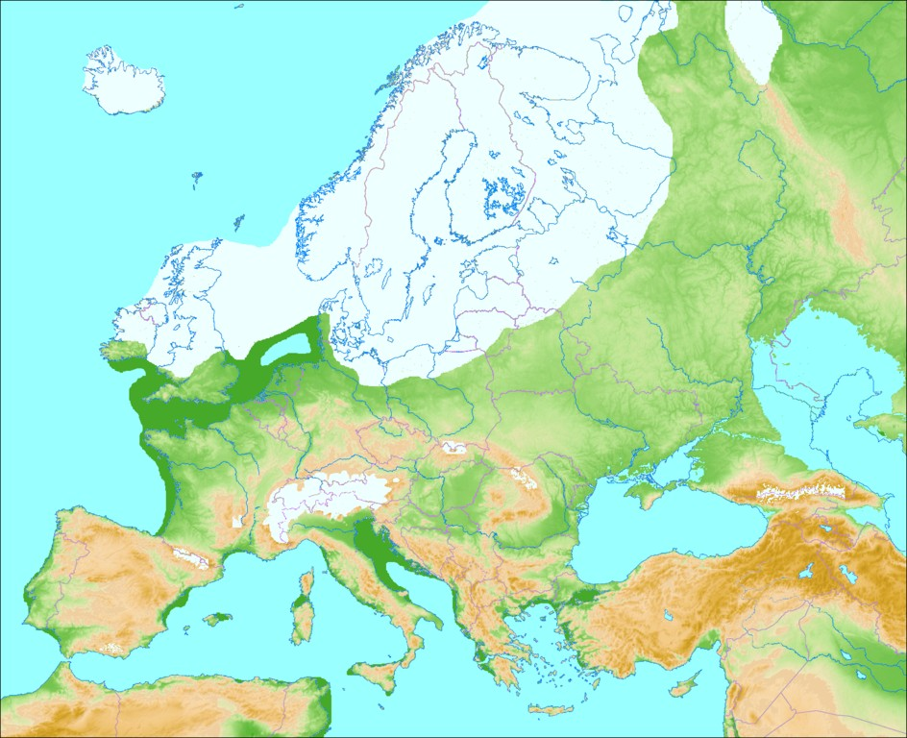
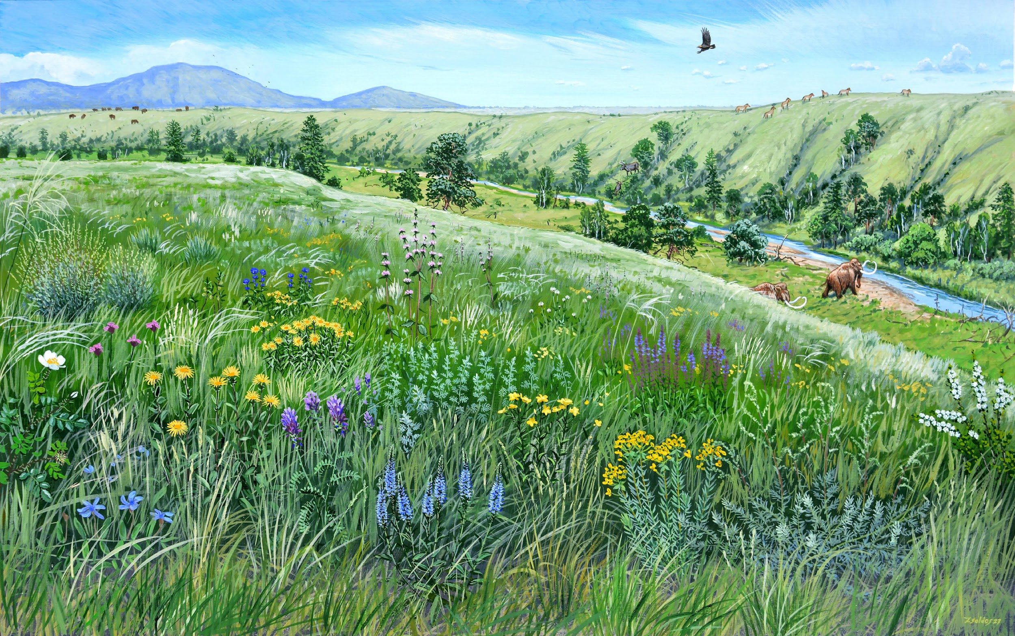
Young flora/vegetation
Old flora/vegetation
(older than the Würm glacial)
Very old flora/vegetation

Slide 34


My grandchildren’ future?

