Slide 1
KM-GBF indicators from an ecologist’s point of view
Joachim Töpper
Norwegian Institute for Nature Research
Capacity Building Workshop for Hungarian, Romanian and Polish
experts and negotiators / 15-16 January 2024 / Budapest, Hungary

Slide 2
https://www.uib.no/en/cesam/159846/cheat-sheet-kunming-montréal-global-biodiversity-framework

Slide 3
Monitoring framework: - indicators - data - methodology - capacity
Headline indicators
“a minimum set of high-level indicators, which capture the overall scope of the goals and targets of the KM-GBF”
Component indicators
“a list of optional indicators that, together with the headline indicators, capture the overall scope of the goals and targets”
Complementary indicators
“a list of optional indicators for thematic or in-depth analysis of each goal and target”
Binary indicators
“global indicators based on responses to yes/no questions to be included in the national reporting template. They will provide a count of the number of countries having undertaken specified activities”
see www.cbd.int/doc/decisions/cop-15/cop-15-dec-05-en.pdf
and www.post-2020indicators.org

Slide 4
Monitoring framework: - indicators - data - methodology - capacity
Publicly available
Metadata available
Peer-reviewed basis
Maintained data collection
Relevant and sensitive
Aligned with other intergovernmental processes, where possible

Slide 5
Monitoring framework: - indicators - data - methodology - capacity
Underlying methodology for every indicator
Uncertainty
Aggregation
Standardization / Scaling

Slide 6
Monitoring framework: - indicators - data - methodology - capacity
Some indicators are more easily operationable than others
Methodology
Data
Some countries have a better starting position than others
Expertise
Resources
Capacity building
Indicator design
Data collection

Slide 7
Indicator status: (Headline indicators) 1. Methods not yet developed, and a process needs to be established to develop these 2. Methods not yet developed, but a process is underway to develop them, led by one or more organisations, to develop them 3. Methods developed (or partially developed) and tested/piloted, but data not yet widely available (and/or collection not yet underway). (Indicator/,Methodology maintained by an organization(s)) 4. Methods established, data being compiled, and indicator operational in at least some countries, but further investment in methods ongoing and/or further (data collection required). 5. Methods established, data being compiled and accessible, and indicator operational for most/all countries.
Source: Annex 1 in Report from AHTEG’s 3rd meeting (Montreal, Canada, 3–6 October 2023)
https://www.cbd.int/doc/c/f22d/ab58/236acdd54779ab58b97aecf1/ind-ahteg-2023-03-02-en.pdf
?...to be first discussed by the Expert Group on Financial Reporting which was established in notification 2023-067

Slide 8
Headline indicators related to Goal A (condition of nature) and Targets 1-8 (condition of nature & nature management)
A.1 & 1.2 Red List of Ecosystems (4)
A.2 & 1.3 Extent of natural ecosystems (3)
A.3 & 4.1 Red List index (5 SDG)
A.4 & 4.2 The proportion of populations within species with a genetically effective population size > 500 (3-4)
1.1 Percent of land and seas covered by biodiversity-inclusive spatial plans (1)
2.2 Area under restoration (2-3)
3.1 Coverage of protected areas and OECMS (4-5)
5.1 Proportion of fish stocks within biologically sustainable levels (5 SDG)
6.1 Rate of invasive alien species establishment (3)
7.1 Index of coastal eutrophication potential (4 SDG)
7.2 Pesticide environment concentration (1)
Binary instead of headline indicator for
target 8 (reduce climate change impacts)
see www.post-2020indicators.org

Slide 9
Headline indicators related to Goal B (sustainable use) and Goal C (fair sharing) and Targets 9-13 (sustainable use and fair sharing)
B.1 & 11.1 Services provided by ecosystems (2)
C.1 & 13.1 Indicator on monetary benefits received (2)
C.2 & 13.2 Indicator on non-monetary benefits (2)
9.1 Benefits from the sustainable use of wild species (1)
9.2 Percentage of the population in traditional employment (3)
10.1 Proportion of agricultural area under productive and sustainable agriculture (4 SDG)
10.2 Progress towards sustainable forest management (5 SDG)
12.1 Average share of the built-up area of cities that is green/blue space for public use for all (4 SDG)
see www.post-2020indicators.org

Slide 10
Headline indicators related to Goal D (act) and Targets 14-23 (implementation)
D.1 & 19.1 International public funding, including official development assistance (ODA) for conservation and sustainable use of biodiversity and ecosystems (?)
D.2 & 19.2 Domestic public funding on conservation and sustainable use of biodiversity and ecosystems (?)
D.3 & 19.3 Private funding (domestic and international) on conservation and sustainable use of biodiversity and ecosystems (?)
15.1 Number of companies reporting on disclosures of risks, dependencies and impacts on biodiversity (1)
18.1 Positive incentives in place to promote biodiversity conservation and sustainable use (?)
18.2 Value of subsidies and other incentives harmful to biodiversity, that have been eliminated, phased out or reformed (?)
21.1 Indicator on biodiversity information for monitoring the global biodiversity framework (2)
Binary instead of headline indicators for targets 14, 16, 17, 20, 22, and 23
see www.post-2020indicators.org

Slide 11
Binary indicators
Goal/target | Global indicator derived from binary reporting
B | Number of countries with national constitution or legislation recognizing and implementing and monitoring a right to a healthy environment
1 | Number of countries using terrestrial and marine spatial planning to identify areas of high biodiversity importance in national development planning
6 | Number of countries adopting relevant national legislation and adequately resourcing the prevention or control of invasive alien species
8 | Number of countries with nationally determined contributions, long-term strategies, national adaptation plans and adaptation communications that reflect biodiversity
9 | Number of countries with legal instruments to regulate the use of and trade in wild species, and respecting customary sustainable use by indigenous peoples and local communities
12 | Number of countries with urban sustainability plans referring to green and/or blue spatial management
13 / C | Number of countries that have operational legislative, administrative or policy frameworks which relate to Target 13
14 | Number of countries with national targets for integrating biodiversity values into policies, regulations, planning, development processes, poverty reduction strategies and accounts at all levels, ensuring that biodiversity values are mainstreamed across all sectors and integrated into assessments of environmental impacts
15 | Number of countries taking legal, administrative or policy measures to ensure that Target 15 is achieved
16 | Number of countries developing, adopting or implementing policy instruments aimed at supporting the shift to sustainable consumption and production (Sustainable Development Goal indicator 12.1.1)
17 | Number of countries with capacity and measures in place related to Target 17
22 | Number of countries recognizing the legal rights of indigenous peoples and local communities, environmental human rights defenders, women, youth and persons with disabilities with respect to their traditional territories, cultures and practices
23 | Number of countries where the legal framework (including customary law) guarantees women’s equal rights to land ownership and/or control
Suggestion from AHTEG on binary indicators:
www.cbd.int/doc/c/fc2f/9f66/ffaa283c75eb50b24cc80aa1/ind-ahteg-2023-02-03-en.pdf
Note:
New wording and one more suggestion for target 20 in
www.cbd.int/doc/c/f22d/ab58/236acdd54779ab58b97aecf1/ind-ahteg-2023-03-02-en.pdf

Slide 12
Let’s take a closer look at some of the headline indicators
Joachim taking a close look…

Slide 13
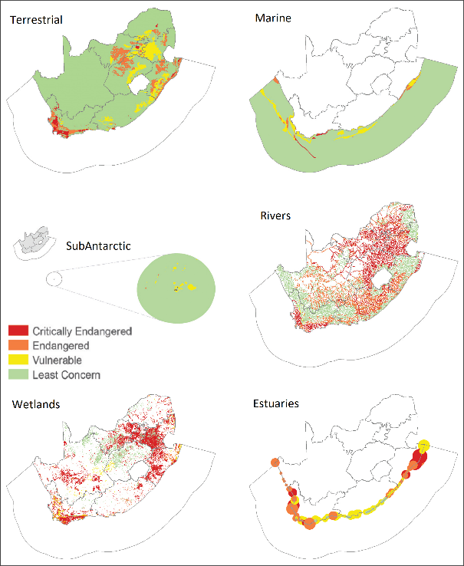
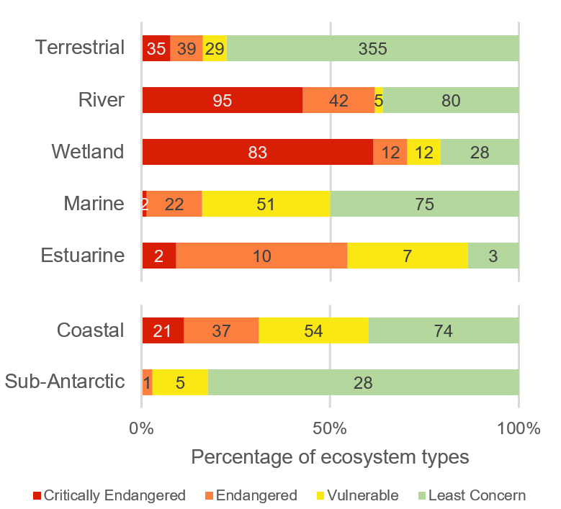
Red List of Ecosystems
Red List of Ecosystems assessments for South Africa, from the National Biodiversity Assessment in 2018

Slide 14
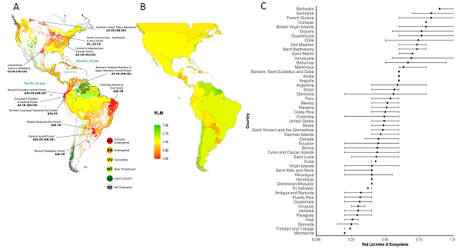
Red List of Ecosystems
The Red List Index of ecosystems (RLIe) summarises risk or threat status across sets of ecosystem types, based on the proportion of ecosystems in each Red List risk category (Rowland et al. 2020).
A) Ferrer-Paris et al. 2019
doi.org/10.1111/conl.12623
B & C) adapted from Rowland et al. 2020, doi.org/10.1111/conl.12680

Slide 15
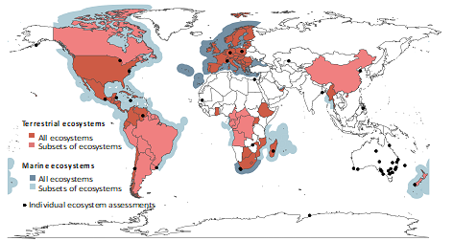
Red List of Ecosystems
Global availability?
www.post-2020indicators.org/metadata/headline/A-1

Slide 16
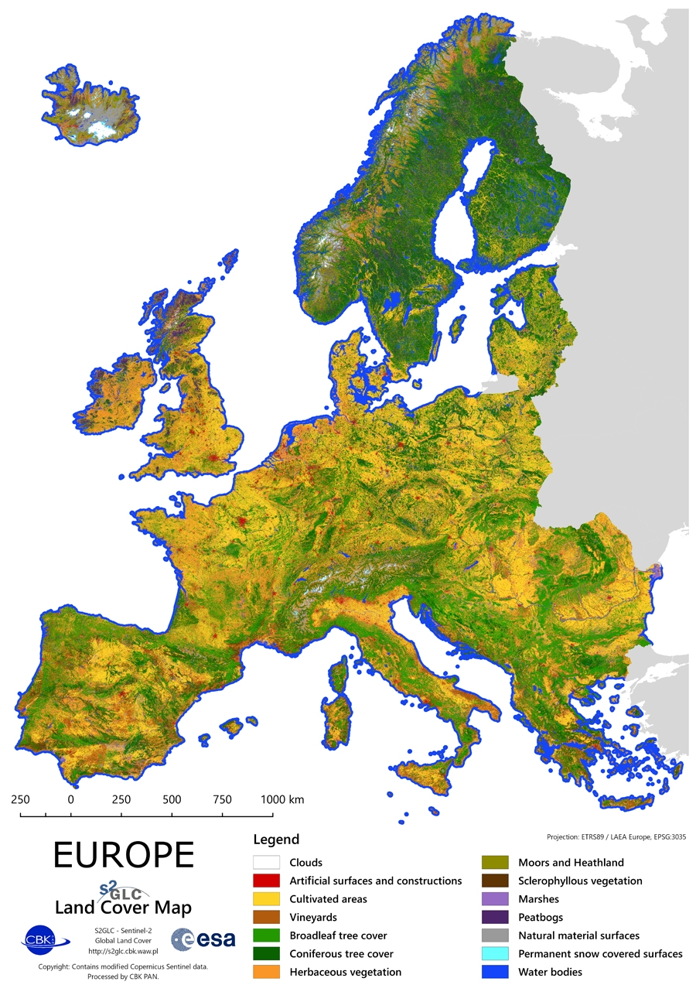
Extent of natural ecosystems

Slide 17
Extent of natural ecosystems
Crucial for biodiversity:
Need to take stock of habitats
Ecosystem map (not land cover) - Field mapping - Earth observation - Modelling

Slide 18
Extent of natural ecosystems
Annex 1 in Report from AHTEG’s 3rd meeting (Montreal, Canada, 3–6 October 2023)
https://www.cbd.int/doc/c/f22d/ab58/236acdd54779ab58b97aecf1/ind-ahteg-2023-03-02-en.pdf

Slide 19
Red List of Ecosystems
Red List of Ecosystems assessments for South Africa, from the National Biodiversity Assessment in 2018

Slide 20
Coverage of protected areas and other effective area-based conservation measures
Coverage alone insufficient
Effectiveness & representativity important
by Key Biodiversity Area
by Ecosystem type
www.protectedplanet.net

Slide 21
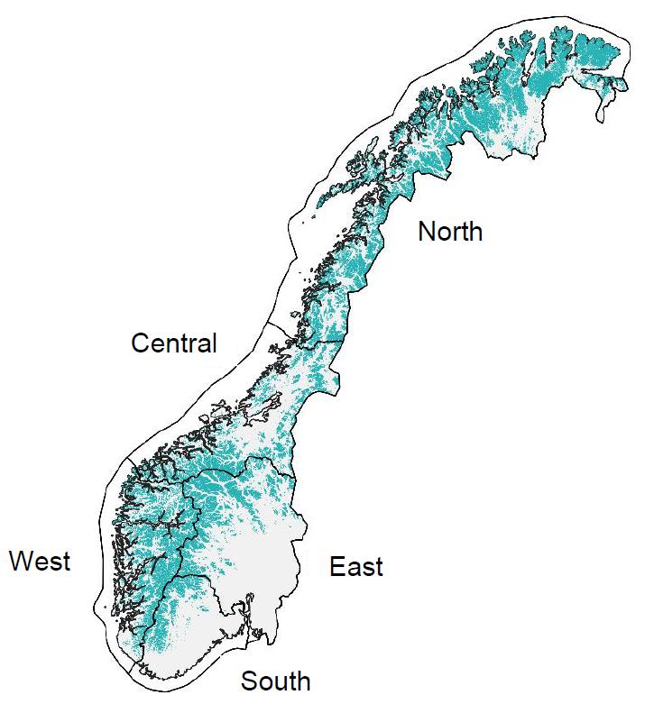
Coverage of protected areas and other effective area-based conservation measures Norway
Arctic/alpine ecosystems
www.protectedplanet.net

Slide 22
Ecological condition in Norway
Arctic/alpine ecosystems
Framstad, E., Kolstad, A. L., Nybø, S., Töpper, J. & Vandvik, V. 2022. The condition of forest and mountain ecosystems in Norway. Assessment by the IBECA method. NINA Report 2100. Norwegian Institute for Nature Research.

Slide 23
Ecological condition in Norway
Framstad, E., Kolstad, A. L., Nybø, S., Töpper, J. & Vandvik, V. 2022. The condition of forest and mountain ecosystems in Norway. Assessment by the IBECA method. NINA Report 2100. Norwegian Institute for Nature Research.

Slide 24
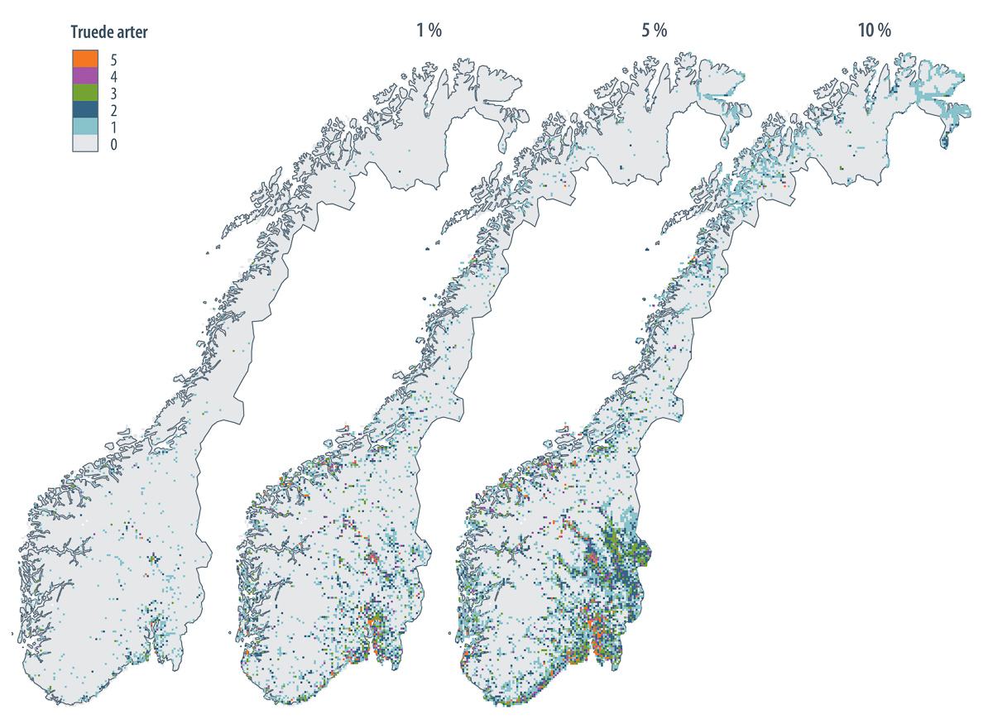
Hotspots for threatened species in Norway
Olsen et al. 2020. Geographical distribution of threatened insects and arachnoids, fungi, lichens and bryophytes: modelling of hotspots. NINA Report 1727. Norwegian Institute for Nature Research.
www.protectedplanet.net

Slide 25
Coverage of protected areas and other effective area-based conservation measures Norway
Arctic/alpine ecosystems
www.protectedplanet.net

Slide 26
Coverage of protected areas and other effective area-based conservation measures So, what’s really crucial for this indicator to be meaningful is:
Representativity
Are the different types of ecoystems in a country covered well enough?
Effectiveness
Are Key Biodiversity Areas covered

Slide 27
Transferrable to all indicators
Support the national knowledge base for indicators
Ensure representativity
Ensure effectiveness
Ensure sensitivity
Support the global capacities for indicator implementation

Slide 28
Global capacity?
CO-OP4CBD and UNEP-WCMC are conducting a European/Global survey on national capacities for implementing the monitoring framework (January/February)
Results will be presented to AHTEG on indicators (March) which will give recommendations to SBSTTA

Slide 29
Monitoring framework / indicator topics at COP16?
Missing/underdeveloped indicators
Binary indicators
Global capacity for implementation
Resources for global implementation
Simplification vs. usefulness
Representativity
Effectiveness
Sensitivity

Slide 30
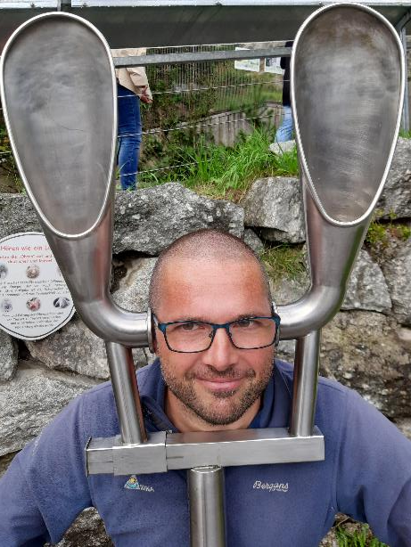
Thank you for your attention!
Joachim Töpper
joachim.topper@nina.no
www.coop4cbd.eu
Follow COOP4CBD

