Slide 1
The Road to Cali
Dr. Aleksandar Rankovic
Lecturer at Sciences Po
18 March 2024 - CO-OP4CBD Regional Training for Central and Eastern European Countries

Slide 2








Slide 3
Three phases in developing international instruments on biodiversity (Jardin, 2010):
Sectoral approach (70s):
    World Heritage Convention (1972)
    Convention on Wetlands of International Importance (Ramsar, 1971)
    UNESCO World Network of Biosphere Reserves (1972)
    Convention on International Trade in Endangered Species of Wild Fauna and Flora (CITES, 1973)
    Convention on the Conservation of Migratory Species of Wild Animals (CMS, 1983)
Generic approach (90s):
    Convention on Biological Diversity (CBD, 1992)
Science-policy interaction (2000s):
    IPBES (launched in 2012)

Slide 4

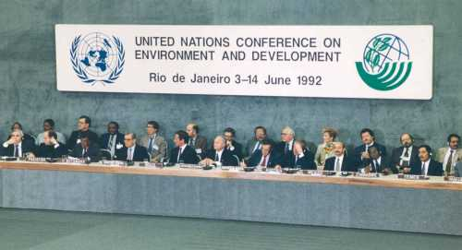
One of the three conventions adopted at the Rio Earth Summit of 1992 (“Rio Conventions”, with climate and desertification)
Three main objectives (Art. 1):
    the conservation of biological diversity;
    the sustainable use of its components; and
    the fair and equitable sharing of the benefits arising out of the utilization of genetic resources.

Slide 5
Art. 2:
"Biological diversity" means the variability among living organisms from all sources including, inter alia, terrestrial, marine and other aquatic ecosystems and the ecological complexes of which they are part; this includes diversity within species, between species and of ecosystems.
E.g., “nature” and its diversity – life on Earth.

Slide 6


Next... 2030? ☹

Slide 7
Strategic Plan 2002-2010
Next... 2030? ☹
Strategic Plan 2011-2020
Post-2020 framework, COP15!

Slide 8
Strategic Plan 2002-2010
Next... 2030? ☹
Strategic Plan 2011-2020
Post-2020 framework, COP15!

Slide 9
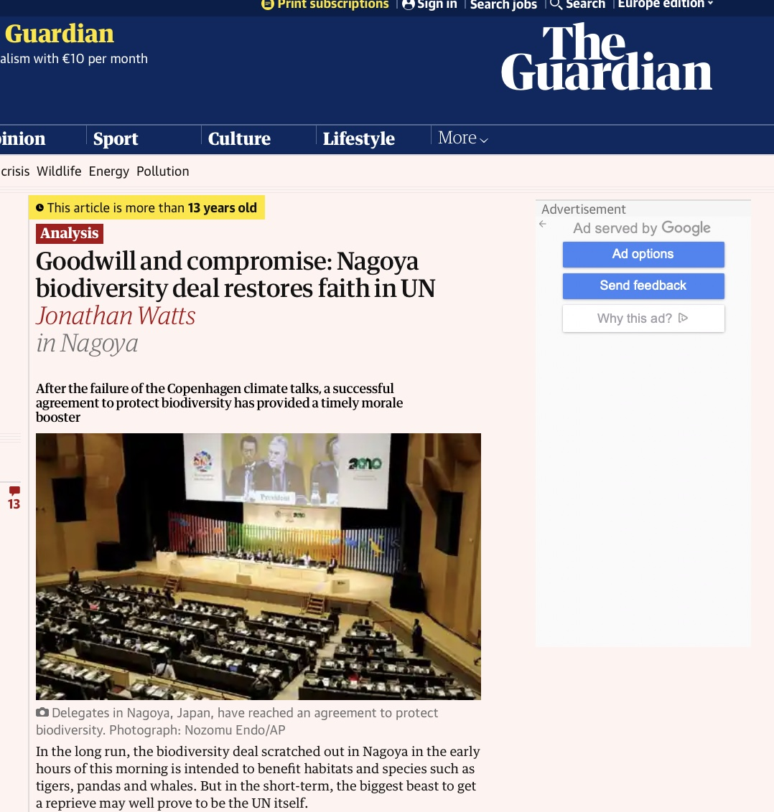

Slide 10
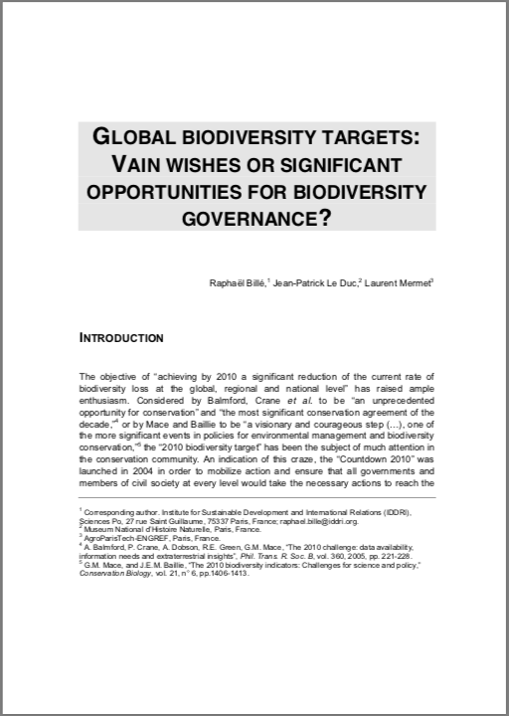
“Responsibility dilemma” (Billé et al. 2010)
Those who are the most responsible for biodiversity loss are the least accountable; those who are the least responsible are the most accountable.
➔ Optical illusion on “who is failing”

Slide 11
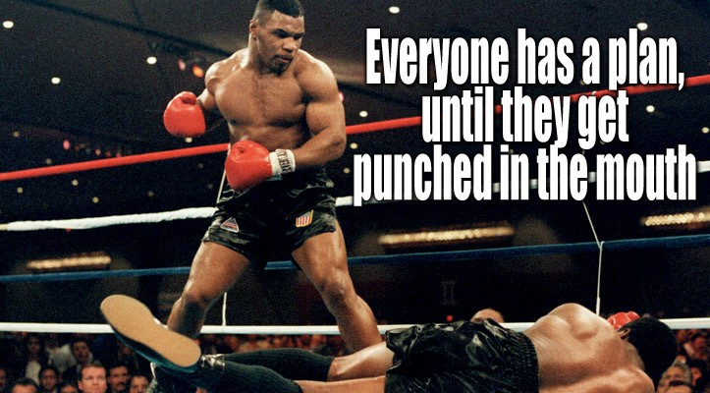

Slide 12






“A framework for all” / mainstreaming

Slide 13
Mobilization
Transparency and responsibility
Means of implementation
Targets

Slide 14
COP15 “package” (non-exhaustive!)
Decision 15/4: Kunming-Montreal Global Biodiversity Framework
Decision 15/5: Monitoring framework for the Kunming-Montreal Global Biodiversity Framework
Decision 15/6: Mechanisms for planning, monitoring, reporting and review
Decision 15/7: Resource mobilization
Decision 15/8: Capacity-building and development and technical and scientific cooperation
Decision 15/9: Digital sequence information on genetic resources

Slide 15
At COP16
Global analysis of NBSAPs
Unlocking finance
Mobilization
Transparency and responsibility
Means of implementation
Targets
Finishing the monitoring framework
New coalitions?

Slide 16
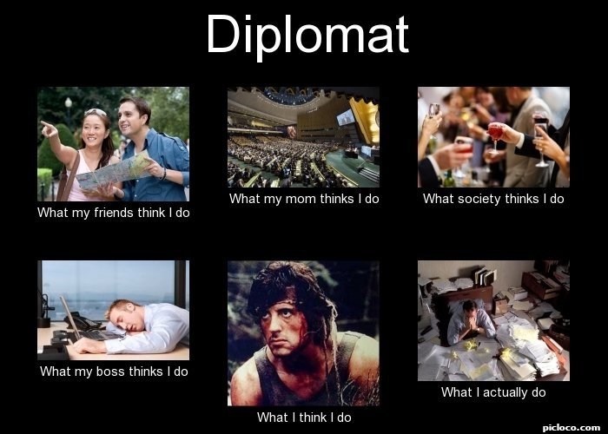
Managing our expectations, and giving support ☺

Slide 17
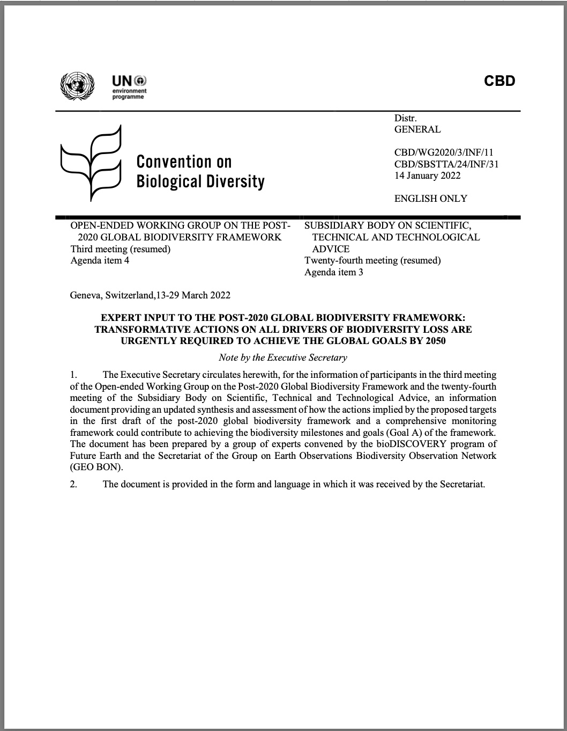
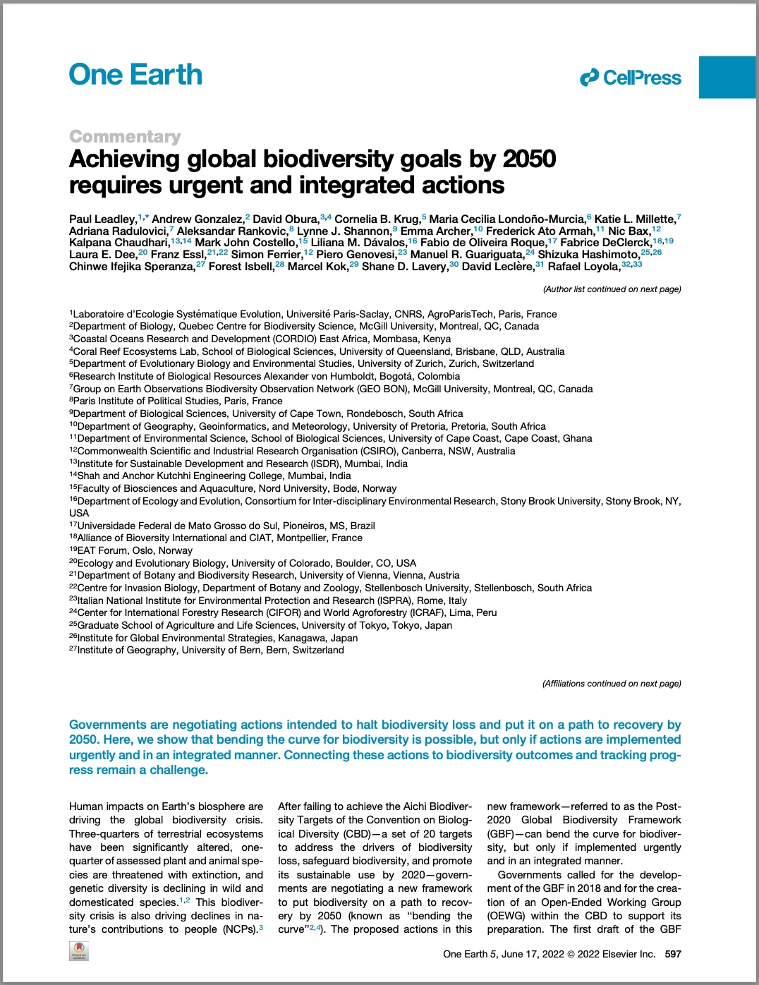

Slide 18
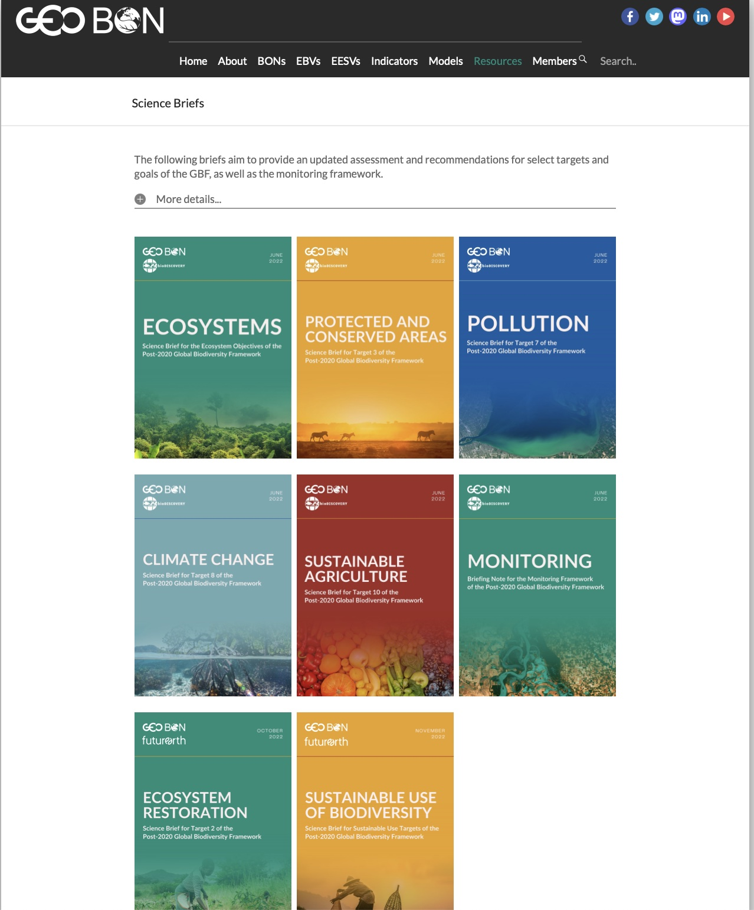

Slide 19
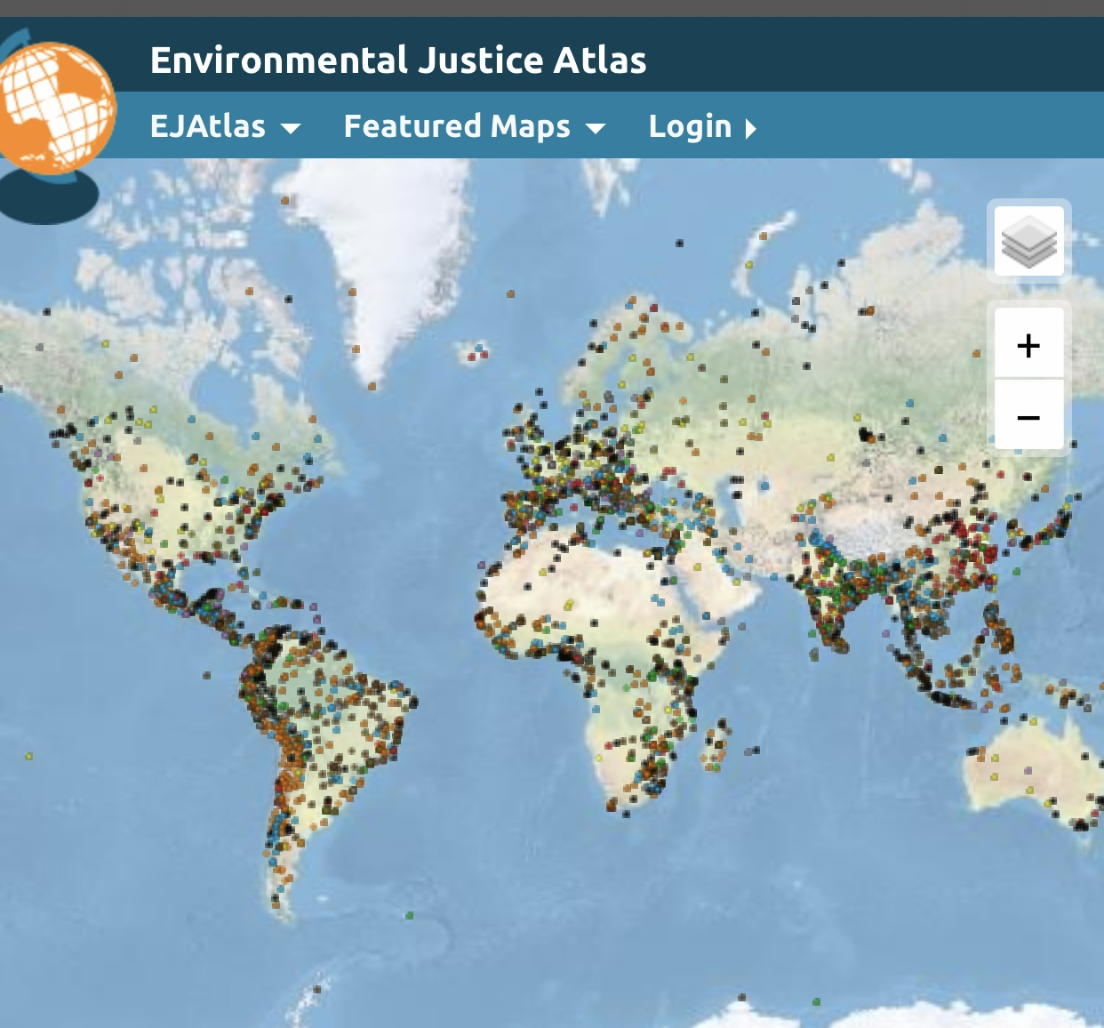

Slide 20
THANK YOU!
aleksandar.rankovic@sciencespo.fr
Twitter: @AleksRankovic

