Slide 1

Insights regarding EU Coordination
The main challenges of COP16
Hendrik Segers
Coordinator Belgian CBD NFP, CBD SBSTTA NFP
CO-OP4CBD Regional Training for Central and Eastern European Countries
18-19 March 2024 / Paris, France

Slide 2

Insights regarding EU Coordination
The main challenges of COP16
Agenda
The EU way
CEE (regional group) consultations
An educated guess…

Slide 3
CBD COP 16 / CP COP-MOP 11 / NP COP-MOP 5
Agenda
Intersessional work and agenda
Decided at CBD COP 15 / CP COP-MOP 10 / NP COP MOP 4 (December 2022)
Previous meetings:
SBSTTA 25 – 15-19 October 2023 (+ Resumed CBD COP + Protocol MOPs, 19 – 20 October 2023)
1st meeting of AHOEWG on BS from use of DSI – November 2023 (prepared during IAG meetings)
12th meeting of AHOEWG on Art. 8(j) – November 2023

Slide 4
CBD COP 16 / CP COP-MOP 11 / NP COP-MOP 5
Agenda
Preparatory process:
Previous meetings:
AHTEGs:
                Indicators for the KM GBF (to date: 5 meetings),
                Synthetic Biology (MAHTEG, 2 meetings,
                New PoW on art. 8(j)
                Risk Assessment (2 meetings)
Advisory Committee on RESMOB (Sept 2023)
… and IACs, IAGs, webinars, workshops, online forums, liaison group meetings, dialogues, technical expert group meetings,…

Slide 5
CBD COP 16 / CP COP-MOP 11 / NP COP-MOP 5
Agenda
Preparatory process:
Upcoming meetings:
6th meeting of the AHTEGs on Indicators for the KM GBF
SBSTTA 26 – 13-18 May 2024
SBI 4 – 21-29 May 2024
SBI 5 – 16-18 October 2024
2nd meeting of AHOEWG on BS from use of DSI – 12-16 August 2024 (prepared during IAG meetings)
Advisory Committee on RESMOB
… and other meetings

Slide 6
CBD COP 16 / CP COP-MOP 11 / NP COP-MOP 5
Agenda
Key Agenda items of CBD COP 16 – from SBSTTA 25:
Facilitating the implementation of the Kunming-Montreal Global Biodiversity Framework and the monitoring of its progress
        Monitoring framework for the Kunming-Montreal Global Biodiversity Framework;
        Mechanisms for planning, monitoring, reporting and review;
        Approaches to identifying scientific and technical needs to support the implementation of the Framework, including its implication for the programmes of work of the Convention;
        Plant conservation.
Findings from the assessments by the Intergovernmental Science-Policy Platform on Biodiversity and Ecosystem Services and the Intergovernmental Panel on Climate Change and their implications for the work undertaken under the Convention.
Invasive alien species.
Sustainable wildlife management.
Biodiversity and climate change.

Slide 7
CBD COP 16 / CP COP-MOP 11 / NP COP-MOP 5
Agenda
Key Agenda items of CBD COP 16 – from SBSTTA 26:
Monitoring framework for the Kunming-Montreal Global Biodiversity Framework.
Scientific and technical needs to support the implementation of the Kunming-Montreal Global Biodiversity Framework.
Synthetic biology.
Risk assessment and risk management.
Detection and identification of living modified organisms.
Marine and coastal biodiversity:
(a) Further work on ecologically or biologically significant marine areas;
(b) Conservation and sustainable use of marine and coastal biodiversity.
Biodiversity and health ?.

Slide 8
CBD COP 16 / CP COP-MOP 11 / NP COP-MOP 5
Agenda
Key Agenda items of CBD COP 16 – from SBI 4:
Review of implementation: progress in national target setting and the updating of national biodiversity strategies and action plans.
Mechanisms for planning, monitoring, reporting and review.
Resource mobilization and financial mechanism:
(a) Resource mobilization;
(b) Financial mechanism.
Capacity-building and development, technical and scientific cooperation, clearing-house mechanism and knowledge management under the Convention and its Protocols:
Communication.
Cooperation with other conventions and international organizations.
Review of the effectiveness of the processes under the Convention and its Protocols.
Assessment and review of the effectiveness of the Nagoya Protocol (Article 31).
Long-term strategic approach to mainstreaming.
Review of the programmes of work of the Convention.
Multi-year programme of work of the Conference of the Parties
Administrative and budgetary matters.

Slide 9

CBD COP 16 / CP COP-MOP 11 / NP COP-MOP 5
Agenda
DSI

Slide 10
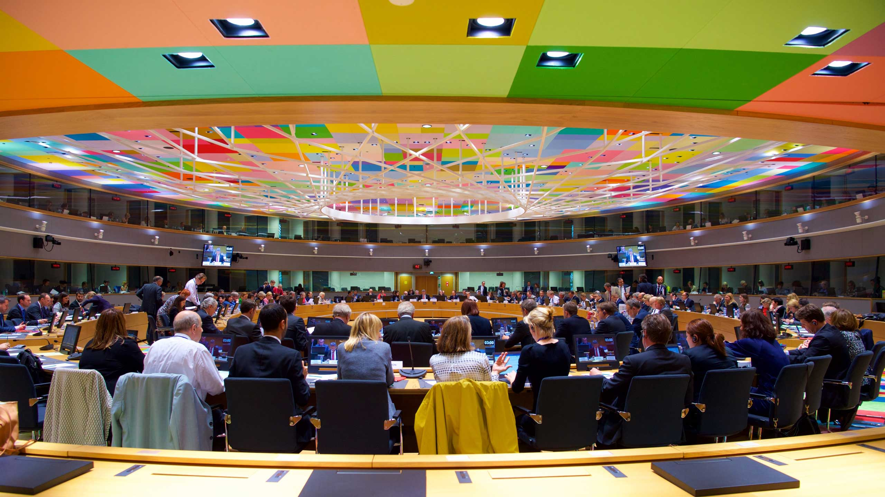
CBD COP 16 / CP COP-MOP 11 / NP COP-MOP 5 the EU way
Working paper: coordinated positions
Decision-making pecking order:
Council Conclusions
WPIEI biodiversity
(Informal expert consultations)

Slide 11

CBD COP 16 / CP COP-MOP 11 / NP COP-MOP 5
CEE (regional group) consultations
Notes:
Dificult to reach consensus in this group due to conflict
CEE existance is being questioned, EU members generally sidelined by non EU
Low expectations, difficulty to designate representatives

Slide 12


Thank you for your attention!
hsegers@naturalsciences.be
www.coop4cbd.eu
Follow COOP4CBD

