Slide 1

Objectives and main international biodiversity events during
the upcoming Hungarian EU Presidency
Biodiversity and Gene Conservation Department,
Ministry of Agriculture, Hungary
CO-OP4CBD Regional Training for CEE Countries
18-19 March 2024, Paris
1

Slide 2
International biodiversity-related tasks
High-profile international events:
6 biodiversity-related international decision-making meetings in the second half of 2024
Coordination tasks, preparation of EU+MS positions & representation on the spot
2

Slide 3
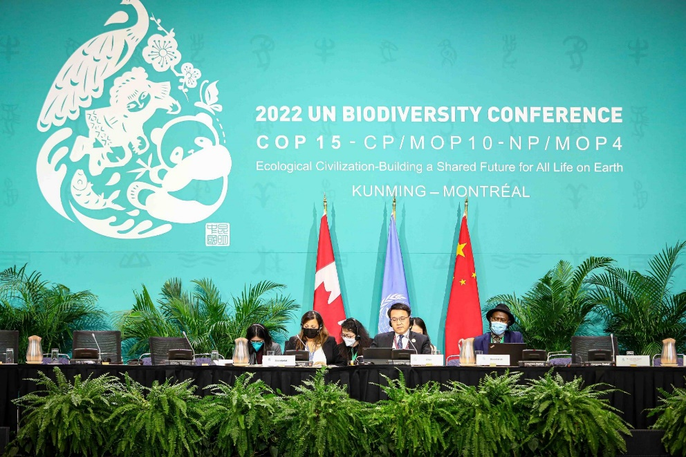
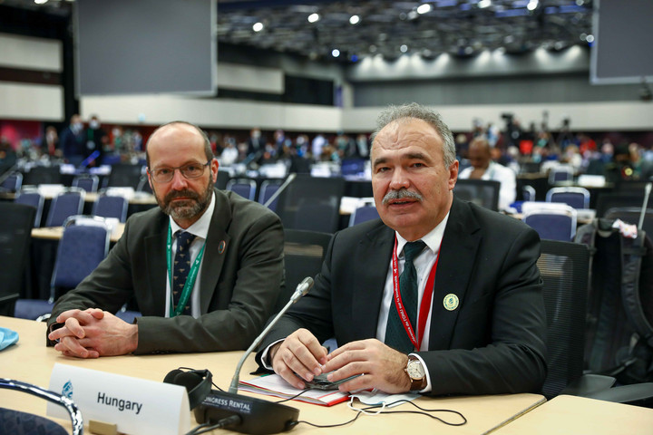
United Nations Biodiversity Conference
Colombia, 21 October – 1 November 2024
During which 3 parallel decision-making body meetings:
  CBD: COP16
  Cartagena Protocol: CP/MOP11
  Nagoya Protocol: NP/MOP5
Event at ministerial level (high-level segment)
3

Slide 4

UN Biodiversity Conference – Main tasks of the HU PRES
Council conclusions (to be adopted at the ENV Council in October 2024 before COP16) – issues requiring political guidance
EU+MS position papers – detailed PPs on each agenda items
Coordinating and representing the EU+MS on the spot
4

Slide 5

I.) Decision-making body of the CBD: COP16
  Our priority:
  support the implementation of the Kunming-Montreal Global Biodiversity Framework
  help moving towards reaching meaningful outcome at COP16:
    Monitoring framework of the KM-GBF
    & Planning monitoring, reporting and review
    Resource mobilization
    Digital Sequence Information on Genetic Resources
    Biodiversity and climate change etc.
5

Slide 6
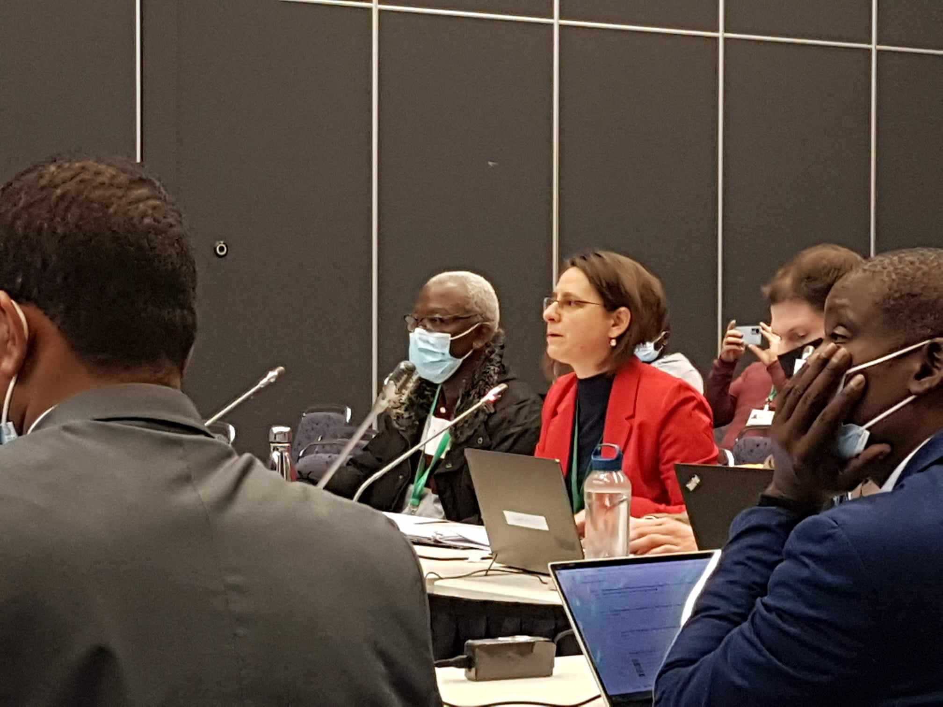
II.) Cartagena Protocol MOP11
  Adoption of decisions on biosafety, the regulation of genetically modified organisms.
  environmental risk assessment of GMOs
  detection and identification of GMOs
  the social and economic impact of GMOs
  evaluation and review issues
  developing indicators for the global monitoring framework
6

Slide 7
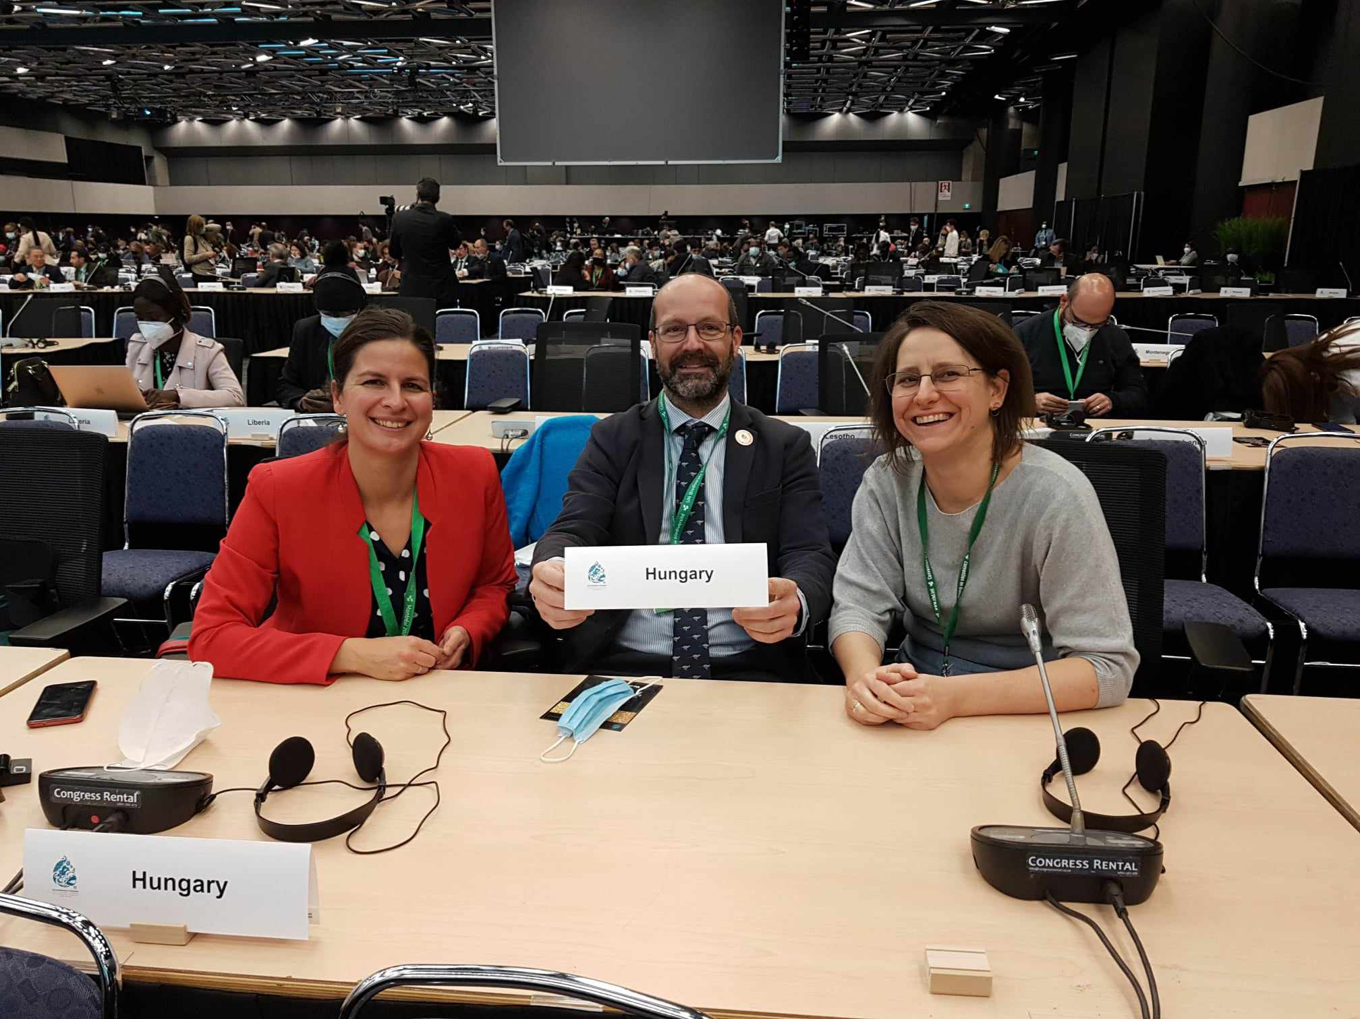
III.) Nagoya Protocol MOP5
  Decisions on access to genetic resources and the fair and equitable sharing of the benefits arising from their use:
  Enhancing the implementation of the Nagoya Protocol in the context of the GBF
  Monitoring and reporting
  Review of effectiveness of the Nagoya Protocol
  Links with DSI, etc.
7

Slide 8
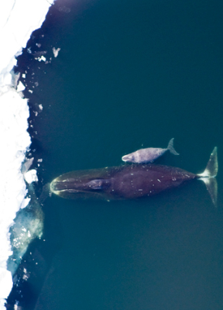
The 69th meeting of the International Whaling Commission
IWC69: Lima, Peru, 23-27 September 2024
Main topics:
Major debate on the definition of quorum
Proposal for the South Atlantic Whale Sanctuary might reoccur
Renewal of Aboriginal Subsistence Whaling (ASW) quotas (every 6 years, most recently in 2018)
8

Slide 9

44th Standing Committee Meeting of the Bern Convention
(SC44)
Strasbourg, 2-6 December 2024
Main topics:
adoption of an amending protocol to ensure the financial stability of the Convention (introduction of a compulsory membership fee)
50 MS + EU
Etc.
9

Slide 10
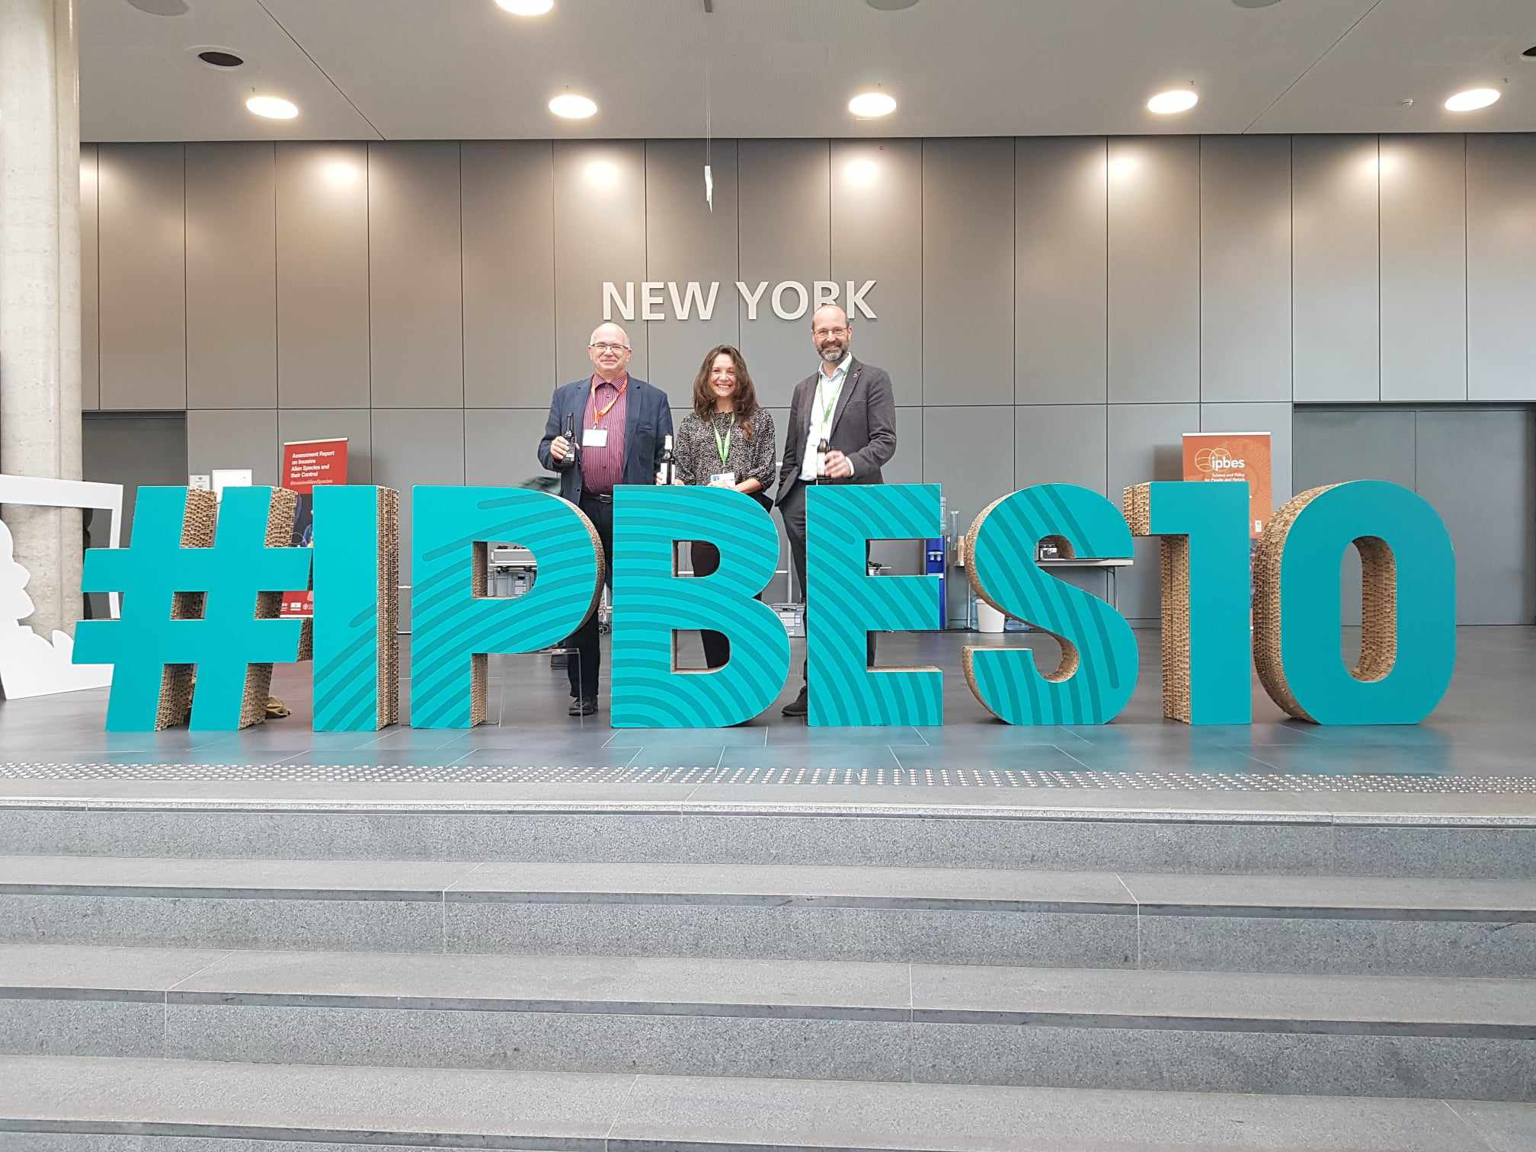
IPBES 11th Plenary
Windhoek, Namibia, 10-16 December 2024
  Main topics:
  Adoption of two comprehensive global assessments:
  Nexus assessment: links between biodiversity, water and food security and health
  Transformative change assessment: assessing and comparing visions and methods to ensure the sustainability of our planet
10

Slide 11

Thank you for your kind attention!
For more info click on Hungary’s CBD CHM: www.biodiv.hu
biodiv@am.gov.hu

