Slide 1
Discussing how the scientific mechanisms of the CBD work. CBD mechanisms, processes and conduct of business
Pierre SPIELEWOY
Muséum National d’Histoire Naturelle (France)
CO-OP4CD Central and Eastern European Countries Regional Training Session
Paris, Jardin des Plantes, 18 and 19 March 2024

Slide 2
I/ CBD Organization

Slide 3
I/ CBD organization
Take part in the COP, and give mandates to the CBD Bodies
COP
Parties (States)
If needed, established temporary or open-ended expert or working groups with specific mandate
Mandates the Subsidary Bodies
Group of experts
Subsidiary Bodies
Subsidiary Bodies can consider the outcome of expert (group) work.

Slide 4
I/ CBD organization
Conference of Parties =
The supreme governing body for the Convention. It is the highest decision-making body. The COP is responsible for reviewing the implementation of the Convention and any related legal instruments. It has the power to make, within its mandate*, the decisions necessary to promote the effective implementation of the Convention
The biodiversity process revolves around the biennial meetings of the COP (or COP-MOPs). These sessions bring together Parties to the Convention and Parties to the Protocols, as well as observer States and organizations, the media, and the general public represented by various civil society and non-governmental organizations. The meetings have mostly taken place outside of the seat of the Secretariat hosted by different country Parties
Secretariat Guidance
Notes:
Art. 23 of the Convention

Slide 5
I/ CBD organization
Subsidiary bodies =
The Subsidiary Body for Scientific, Technical and Technological Advice (SBSTTA): is the only subsidiary body established under the Convention. It provides the COP and, as appropriate, its other subsidiary bodies with timely information and advice on scientific, technical and technological matters relating to the implementation of the Convention.
The Subsidiary Body on Implementation (SBI): was established by the decision of COP XII to replace the Ad Hoc Open-ended Working Group on Review of Implementation of the Convention. It is responsible, inter alia, to review relevant information on progress in the implementation of the Convention and assist the COP in preparing decisions on enhancing the implementation of the Convention, as appropriate.
The Ad Hoc Open-ended Working Group on Article 8(j) and Related Provisions: is established by a decision of the COP 4. It focuses on the implementation of Article 8(j) of the Convention on knowledge, innovations and practices of indigenous and local communities, and related provisions.
Secretariat Guidance
Notes:
COP XII/26

Slide 6
I/ CBD organization
ARTICLE 25 – SBSTTA
A subsidiary body for the provision of scientific, technical and technological advice is hereby established to provide the Conference of the Parties and, as appropriate, its other subsidiary bodies with timely advice relating to the implementation of this Convention. This body shall be open to participation by all Parties and shall be multidisciplinary. It shall comprise government representatives competent in the relevant field of expertise. It shall report regularly to the Conference of the Parties on all aspects of its work

Slide 7
I/ CBD organization
ARTICLE 25 - SBSTTA
2. Under the authority of and in accordance with guidelines laid down by the Conference of the Parties, and upon its request, this body shall:
(a) Provide scientific and technical assessments of the status of biological diversity;
(b) Prepare scientific and technical assessments of the effects of types of measures taken in accordance with the provisions of this Convention;
(c) Identify innovative, efficient and state-of-the-art technologies and know-how relating to the conservation and sustainable use of biological diversity and advise on the ways and means of promoting development and/or transferring such technologies;
(d) Provide advice on scientific programmes and international cooperation in research and development related to conservation and sustainable use of biological diversity; and
(e) Respond to scientific, technical, technological and methodological questions that the Conference of the Parties and its subsidiary bodies may put to the body.

Slide 8
I/ CBD organization
Group of Experts
A limited number of ad hoc technical expert groups on specific priority issues on the programme of work of the Conference of the Parties may be established under the guidance of the Conference of the Parties, as required, for a limited duration, to provide scientific and technical advice and assessments. The establishment of such ad hoc technical expert groups would be guided by the following elements:
The ad hoc technical expert groups should draw on the existing knowledge and competence available within, and liaise with as appropriate, international, regional and national organizations, including non-governmental organizations and the scientific community, as well as indigenous and local community organizations and the private sector, in fields relevant to this Convention;
The Executive Secretary, in consultation with the Bureau of the Subsidiary Body on Scientific, Technical and Technological Advice, will select scientific and technical experts from the nominations submitted by Parties for each ad hoc technical expert group. The ad hoc technical expert groups shall be composed of no more than fifteen experts* nominated by Parties competent in the relevant field of expertise, with due regard to geographical representation, gender balance and to the special conditions of developing countries, in particular the least-developed and small island developing States, and countries with economies in transition, as well as a limited number of experts from relevant organizations, depending on the subject matter. The number of experts from organizations shall not exceed the number of experts nominated by Parties;
The number of ad hoc technical expert groups active each year will be limited to the minimum necessary. In the establishment of such groups, Parties shall take into consideration the availability of extra-budgetary resources as determined by the Conference of the Parties;
Ad hoc technical expert groups will be encouraged to use innovative means of communication and to minimize the need for face-to-face meetings;
Reports produced by the ad hoc technical expert groups should, as a general rule, be submitted for peer review;
All efforts will be made to provide adequate voluntary financial assistance for the participation of experts, in the ad hoc technical expert groups, from developing countries and countries with economies in transition Parties.
SBSTTA Modus Operandi
Notes:
* See CBD 12/24: established an « extended » AHTEG with 5 to 8 experts nominated by each of the five regions, hence up to 40 experts. This set the precedent for flexibility for following AHTEGs

Slide 9
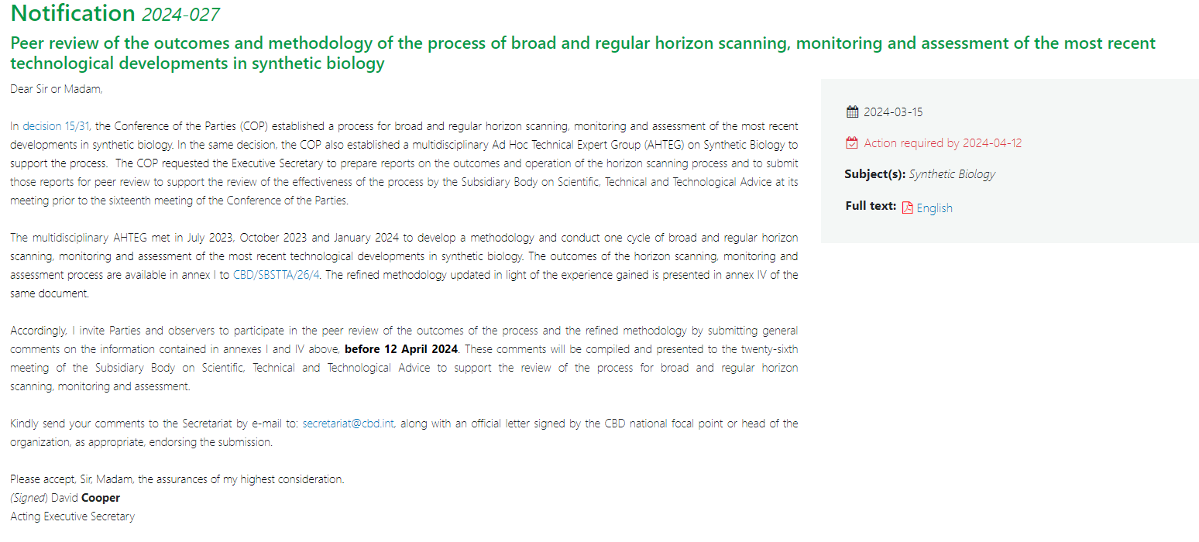
I/ CBD organization Peer review process

Slide 10
I/ CBD organization
Knowledges
Analysis and advice
Implementation
Decision making
Scientists and Experts Involvement
SBSTTA
COP
SBI
Group of Experts
Technical and scientific cooperation

Slide 11
II/ CBD main actors

Slide 12
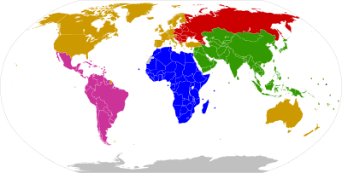
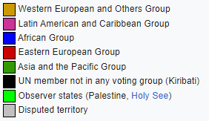
II/ CBD’s Main actors
States = PARTIES . Organized in « informal regional groups »
non-Parties: Holy See and USA

Slide 13
II/ CBD’s Main actors
Non-States actors = OBSERVERS
NGOs
IGOs
organized in Major groups
Experts (University & Scientific communities)
Indigenous Peoples and Local Communities
Companies (Business)
Parlementarians
Local Authorities
Youth
Women

Slide 14
III/ CBD Meetings conduct of business

Slide 15
III/ CBD Meetings conduct of business
1) CBD meeting terminology
Plenary : The plenary meetings of the COP, and the subsidiary bodies are the formal forums for opening of discussion and conclusion (SBs) or decision-making (COP) by Parties to the Convention and the Cartagena and Nagoya Protocols. Plenary meetings are open to participation by all Parties, observers organizations, the media and other participants registered for the CBD sessions
Working Groups : Working groups are set up when there are too many items on the agenda and two "plenary sessions" have to be held. It should be noted that no more than two working groups may be held in parallel, to enable smaller delegations to attend all the sessions.
Contact Group : Contacts groups are open-ended, and established to conduct negotiations on specific agenda items, with the aim of achieving an agreed outcome. They are established by the COP, open-ended subsidiary bodies, or in-session working groups, based on a proposal by the President, Chair of the subsidiary body or the in-session working group, or a Party
Friends of the Chair : convened by presiding officers to advance negotiations on particularly difficult and politically sensitive issues. A limited number of Parties are invited to participate in these closed meetings usually chaired by the presiding officer. Only invited delegates attend, no formal rules are applied, and the conduct of business is entirely at the discretion of the chair.
Secretariat Guidance
Notes:
Proceedings and documents for Plenary and WGs are translated simultaneously in all 6 UN languages, CGs and FoCs are in English only. There’s no parallel meetings to the Plenary, WGs can have 2 meetings in plenary, CGs idem.

Slide 16
III/ CBD Meetings conduct of business
2) CBD meeting rules of procedure :
CHAIR
STATES
STATES
OBSERVERS

Slide 17
III/ CBD Meetings conduct of business
No one may speak at a session of the Conference of the Parties without having previously obtained the permission of the President. Subject to rules 32, 33, 34 and 36, the President shall call upon speakers in the order in which they signify their desire to speak. The Secretariat shall maintain a list of speakers. The President may call a speaker to order if the speaker's remarks are not relevant to the subject under discussion.
The Conference of the Parties may, on a proposal from the President or from any Party, limit the time allowed to each speaker and the number of times each representative may speak on a question. Before a decision is taken, two representatives may speak in favour of and two against a proposal to set such limits. When the debate is limited and a speaker exceeds the allotted time, the President shall call the speaker to order without delay.
2) CBD meeting rules of procedure : PARTIES
RULES OF PROCEDURE FOR MEETINGS OF THE CONFERENCE OF THE PARTIES TO THE CONVENTION ON BIOLOGICAL DIVERSITY (Annex to Decision I/1 as amended by Decision V/20, section I)

Slide 18
III/ CBD Meetings conduct of business
Rule 39
1. Except as provided for in paragraph 2 of this rule, each Party shall have one vote.
2. Regional economic integration organizations, in matters within their competence, shall exercise their right to vote with a number of votes equal to the number of their member States which are Parties. Such organizations shall not exercise their right to vote if their member States exercise theirs, and vice versa.
2) CBD meeting rules of procedure : PARTIES
RULES OF PROCEDURE FOR MEETINGS OF THE CONFERENCE OF THE PARTIES TO THE CONVENTION ON BIOLOGICAL DIVERSITY (Annex to Decision I/1 as amended by Decision V/20, section I)

Slide 19
III/ CBD Meetings conduct of business
Rule 40
[1. The Parties shall make every effort to reach agreement on all matters of substance by consensus. If all efforts to reach consensus have been exhausted and no agreement reached, the decision [, except a decision under paragraph 1 or 2 of article 21 of the Convention] shall, as a last resort, be taken by a two-thirds majority vote of the Parties present and voting, unless otherwise provided by the Convention, the financial rules referred to in paragraph 3 of article 23 of the Convention, or the present rules of procedure. [Decisions of the Parties under paragraphs 1 and 2 of article 21 of the Convention shall be taken by consensus.]]
2. Decisions of the Conference of the Parties on matters of procedure shall be taken by a majority vote of the Parties present and voting.
3. If the question arises whether a matter is one of procedural or substantive nature, the President shall rule on the question. An appeal against this ruling shall be put to the vote immediately and the President's ruling shall stand unless overruled by a majority of the Parties present and voting.
4. If on matters other than elections a vote is equally divided, a second vote shall be taken. If this vote is also equally divided, the proposal shall be regarded as rejected.
5. For the purposes of these rules, the phrase "Parties present and voting" means Parties present at the session at which voting takes place and casting an affirmative or negative vote. Parties abstaining from voting shall be considered as not voting.
2) CBD meeting rules of procedure : PARTIES
RULES OF PROCEDURE FOR MEETINGS OF THE CONFERENCE OF THE PARTIES TO THE CONVENTION ON BIOLOGICAL DIVERSITY (Annex to Decision I/1 as amended by Decision V/20, section I)

Slide 20
III/ CBD Meetings conduct of business
2) CBD meeting rules of procedure : OBSERVERS
The participation of observer representatives in the proceedings of meetings is
governed by rules 7 and 29 of the rules of procedure.
Observers have a number of ways to participate in the meeting by (a) making short and concise verbal statements upon the invitation of the chair or contact group convenor; (b) holding pre-scheduled side events; (c) holding pre-scheduled press conferences; (d) making available relevant information materials; and (e) setting-up by pre-arrangement displays such as exhibitions and posters.
Meetings designated by the chair or contact group convenor as CLOSED are not
open to observers.
Secretariat of the Convention on Biological Diversity, “guidelines on conduct expected of participants in cbd processes”

Slide 21
III/ CBD Meetings conduct of business
2) CBD meeting rules of procedure : OBSERVERS
Rule 7
1. The Secretariat shall notify any body or agency, whether governmental or non-governmental, qualified in fields relating to the conservation and sustainable use of biological diversity, which has informed the Secretariat of its wish to be represented, of meetings of the Conference of the Parties so that they may be represented as observers unless at least one third of the Parties present at the meeting object.
2. Such observers may, upon invitation of the President, participate without the right to vote in the proceedings of any meeting in matters of direct concern to the body or agency they represent unless at least one third of the Parties present at the meeting object.
RULES OF PROCEDURE FOR MEETINGS OF THE CONFERENCE OF THE PARTIES TO THE CONVENTION ON BIOLOGICAL DIVERSITY (Annex to Decision I/1 as amended by Decision V/20, section I)

Slide 22
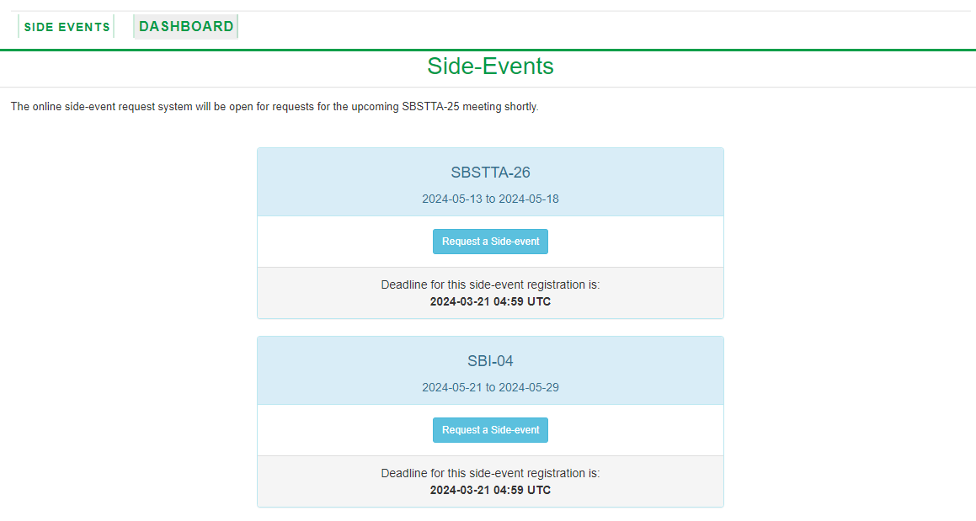
III/ CBD Meetings conduct of business
3) Side Events

Slide 23
IV/ CBD Meeting document

Slide 24
IV/ CBD Meetings Document
1) Document structure
Negotiation document | Official documents (outputs)
Non-paper : informal text proposal for negotiation purposes CRP = Conference Room Paper L = Limited distribution | DEC = Decision REC = Recommendation INF = Information

Slide 25
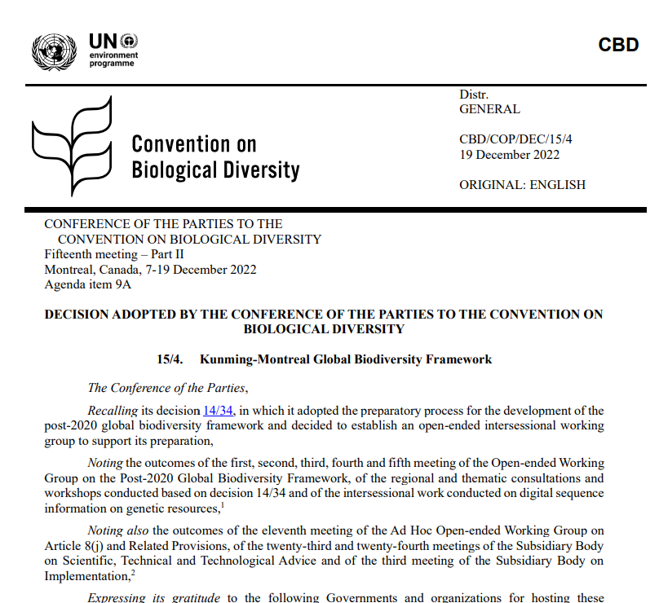
ID of the document + date
The id gives information:
“CBD”: who
“COP”: in which meeting
“DEC”: type of document ( here Ruling )
“15”: number of the meeting
“4”: number of the document
Meeting + date + number of the item in the agenda
Id of the decision
Who is speaking through the document
Preambular part: Context of the Decision

Slide 26
To conclude…

Slide 27
To conclude
As an expert :
You are susceptible to be involved in
A group of expert on a specific topic or a peer review process
In CBD meetings as an hand for the national delegations or as a observer
In side events : associated with Parties or with observers

Slide 28
Thank you for your attention!
Pierre Spielewoy
pierre.spielewoy@mnhn.fr
www.coop4cbd.eu
Follow COOP4CBD

Slide 29
Annex

Slide 30
IV/ Link between SBSTTA and IPBES
UNEP/CBD/COP/DEC/X/11 : The intention

Slide 31
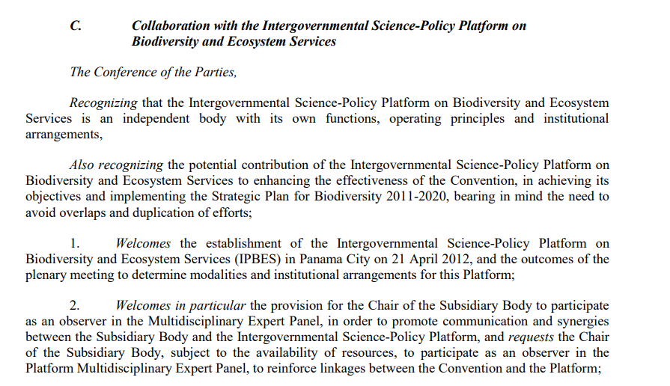
IV/ Link between SBSTTA and IPBES
UNEP/CBD/COP/DEC/XI/13 : The collaboration

Slide 32
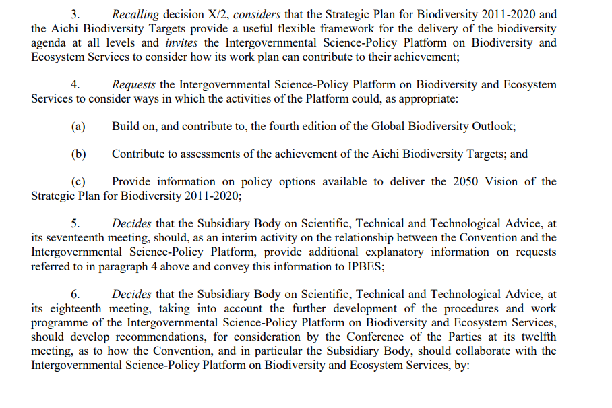
IV/ Link between SBSTTA and IPBES
UNEP/CBD/COP/DEC/XI/13 : The collaboration

Slide 33
IV/ Link between SBSTTA and IPBES
UNEP/CBD/COP/DEC/XI/13 : The collaboration

Slide 34
IV/ Link between SBSTTA and IPBES
To summarize :
1/ CBD and IPBES are independent processes (IPBES also serves other MEAs);
2/ COP proposes subjects for assessment to IPBES plenary, who decides which assessments will be undertaken;
3/ SBSTTA considers outcomes of IPBES assessments (basically SPMs) through its permanent mandate and recommends to COP.

