Slide 1


The KM-GBF monitoring framework –status & key messages
Joachim Töpper
Norwegian Institute for Nature Research
Han de Koeijer
RBINS, CHM focal point for Belgium
Online training session on SBSTTA26 topics / April 2nd 2024

Slide 2
History of Agenda item since SBSTTA 25
SBSTTA 25 document requests the AHTEG to:
Continue work, in particular advice to fill critical caps
Engage with biodiversity related Conventions and organisations
Binary indicators: provide advice on binary indicators wording
Revised metadata for each indicators, in particular those that don’t yet have methodology
Glossary of key terms for binary questions
Take into account work from WG 8j on 4 TK indicators

Slide 3
Work SBSTTA 25 towards SBSTTA 26
Working group 8J meeting that looked at 4 TK indicators : Recommendation WG8J-12/4
BERN III meeting that discussed implementation of the KM-GBF between MEAs and organisations
Online meeting of AHTEG
IAG-technical and scientific cooperation looked at indicators for Goal D and Target 20 and 21 and the Long-term Strategic framework for capacity building and development.
Financial reporting group meeting end of February, Istanbul, Turkiye, to discuss also indicators
EU expert group 22 February
AHTEG in-person meeting in March, Cambridge, UK

Slide 4
Documents for SBSTTA 26
Deliverables by AHTEG on 1st of April (James Williams)
For Negotiation
Advice – incl
Draft Decision
INF14
  Metadata (headlines & binary)
  Aggregation methodology for binary indicators
  Approach to Section C
  Glossary
INF19 to follow (mid-April)
  Capacity Building
  Gap Analysis
  Global Biodiversity Observation Systems
Other INF documents
  Reports of studies (TK, Finance, ABS …)
  Appendix I: list of all indicators
  Appendix II: status of headline indicators
  Appendix III: gaps
  Supplement I: Binary wording suggestions
1st week of April
  SBSTTA26/2
  INF14
  Notification for Parties to collate views

Slide 5
AHTEG Outputs (1)
CBD/SBSTTA/26/2 which has three Annexes and one Appendix:
Annex I: List of headline, binary, component and complementary indicators*
Annex II: Summary of the status of each headline indicator
Annex III: Summary of research and knowledge gaps
Appendix I: Advice on the wording of the binary questions
CBD/SBSTTA/25/2, which became CBD/SBSTTA/25/REC/1
  and its Annexed list of binary indicator questions
* This list includes a revised list of component and complementary indicators as well as proposed wording changes to the headline indicators (wording changes are proposed for technical reasons on the basis of the methodological work as described in the metadata). It also includes recommended disaggregations of the headline indicators.

Slide 6
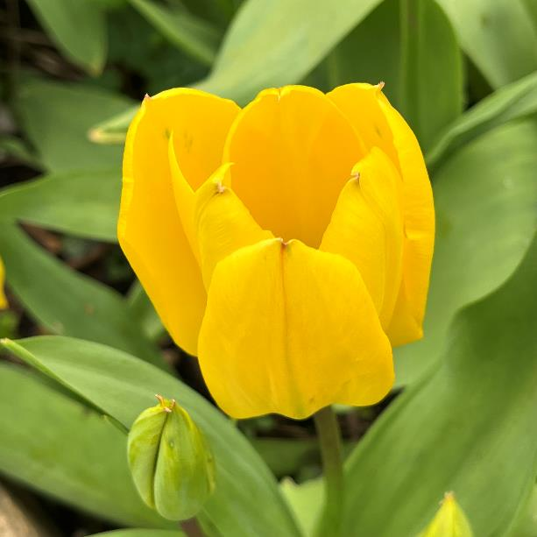
AHTEG Outputs (2)
CBD/SBSTTA/26/INF/14
Section 1: Metadata for each headline and binary indicator
Section 2: Taking section C of the Framework into account when implementing the monitoring framework, including guidance on monitoring people and biodiversity and ecosystem approaches
Section 3: Overarching guidance on using the monitoring framework
CBD/SBSTTA/26/INF/19
Section 4: Gaps and opportunities to improve the implementation and future development of the monitoring framework (to be provided mid-April)

Slide 7
Status of Headline Indicators
Status code | Indicators | Status explanation
1 | 1.1*, 9.1* | Methods not yet developed, and a process needs to be established to develop these
2 | C1*, C2*, D3*, 15.1*, 21.1 | Methods not yet developed, but a process is underway, led by one or more organisations, to develop them
3# | B1*, 7.2*, 9.2*, 18.2 | Methods developed (or partially developed) and tested/piloted, but data not yet widely available (and/or collection not yet underway).
4# | A1, A2, A4, D2, 2.1*, 6.1, 7.1, 18.1 | Methods established, data being compiled, and indicator operational in at least some countries, but further investment in methods ongoing and/or further (data collection required).
5# | A3, D1, 3.1, 5.1, 10.1, 10.2, 12.1 | Methods established, data being compiled and accessible, and indicator operational for most/all countries.
#Indicator / Methodology maintained by one or more organizations

Slide 8
Related agenda items at SBI-4
Review of implementation: progress in national target setting and the updating of national biodiversity strategies and action plans
Mechanism for planning, monitoring, reporting and review:
  Preparations for an open-ended forum for voluntary country review
  Monitoring framework and procedures for the global review of progress in the implementation of the Kunming-Montreal Global Biodiversity-Framework
  Finalization of the reporting templates (with indicators)
Technical and scientific cooperation (TSC):
  selection of regional and/or sub-regional tsc centers
  Capacity building and development long term strategic Framework (indicators for review)
Knowledge management : Knowledge management component of the KM-GBF
NBSAP and indicators during side events?

Slide 9
Compilation of views from parties
Meta data for each indicator
Explanatory information on binary indicators questions
Guidance methodologies for global indicators
Glossary of key terms
Vilm meeting (8-11 April) will need input from scientist/parties on these questions

Slide 10
Monitoring framework current status
& important issues

Slide 11
Indicator status Oct. 2023:
(Headline indicators)
1. Methods not yet developed, and a process needs to be established to develop these
2. Methods not yet developed, but a process is underway to develop them, led by one or more organisations, to develop them
3. Methods developed (or partially developed) and tested/piloted, but data not yet widely available (and/or collection not yet underway). (Indicator/,Methodology maintained by an organization(s))
4. Methods established, data being compiled, and indicator operational in at least some countries, but further investment in methods ongoing and/or further (data collection required).
5. Methods established, data being compiled and accessible, and indicator operational for most/all countries.
Source: Annex 1 in Report from AHTEG’s 3rd meeting (Montreal, Canada, 3–6 October 2023)
https://www.cbd.int/doc/c/f22d/ab58/236acdd54779ab58b97aecf1/ind-ahteg-2023-03-02-en.pdf
?...to be first discussed by the Expert Group on Financial Reporting which was established in notification 2023-067

Slide 12
Indicator status March 2024:
(Headline indicators)
1. Methods not yet developed, and a process needs to be established to develop these
2. Methods not yet developed, but a process is underway to develop them, led by one or more organisations, to develop them
3. Methods developed (or partially developed) and tested/piloted, but data not yet widely available (and/or collection not yet underway). (Indicator/,Methodology maintained by an organization(s))
4. Methods established, data being compiled, and indicator operational in at least some countries, but further investment in methods ongoing and/or further (data collection required).
5. Methods established, data being compiled and accessible, and indicator operational for most/all countries.
Source: Annex 2 in Report from the AHTEG’s 6th meeting
(Cambridge, UK, March 2024)

Slide 13
Headline indicators related to
Goal A (condition of nature) and
Targets 1-8 (condition of nature & nature management)
Bold numbers indicate change since Oct. 2023
A.1 & 1.2 Red List of Ecosystems (4)
A.2 & 1.3 Extent of natural ecosystems (3, 4)
A.3 & 4.1 Red List index (5 SDG)
A.4 & 4.2 The proportion of populations within species with a genetically effective population size > 500 (3-4)
1.1 Percent of land and seas covered by biodiversity-inclusive spatial plans (1)
2.2 Area under restoration (2-3, 4)
3.1 Coverage of protected areas and OECMS (4-5)
5.1 Proportion of fish stocks within biologically sustainable levels (5 SDG)
6.1 Rate of invasive alien species establishment (3, 4)
7.1 Index of coastal eutrophication potential (4 SDG)
7.2 Pesticide environment concentration (1, 3)
Binary instead of headline indicator for
target 8 (reduce climate change impacts)
see www.post-2020indicators.org

Slide 14
Headline indicators related to
Goal B (sustainable use) and
Goal C (fair sharing) and
Targets 9-13 (sustainable use and fair sharing)
Bold numbers indicate change since Oct. 2023
B.1 & 11.1 Services provided by ecosystems (2, 3)
C.1 & 13.1 Indicator on monetary benefits received (2)
C.2 & 13.2 Indicator on non-monetary benefits (2)
9.1 Benefits from the sustainable use of wild species (1)
9.2 Percentage of the population in traditional employment (3)
10.1 Proportion of agricultural area under productive and sustainable agriculture (4 SDG)
10.2 Progress towards sustainable forest management (5 SDG)
12.1 Average share of the built-up area of cities that is green/blue space for public use for all (4, 5 SDG)
see www.post-2020indicators.org

Slide 15
Headline indicators related to
Goal D (act) and
Targets 14-23 (implementation)
Bold numbers indicate change since Oct. 2023
D.1 & 19.1 International public funding, including official development assistance (ODA) for conservation and sustainable use of biodiversity and ecosystems (?, 5)
D.2 & 19.2 Domestic public funding on conservation and sustainable use of biodiversity and ecosystems (?, 4)
D.3 & 19.3 Private funding (domestic and international) on conservation and sustainable use of biodiversity and ecosystems (?, 2)
15.1 Number of companies reporting on disclosures of risks, dependencies and impacts on biodiversity (1, 2)
18.1 Positive incentives in place to promote biodiversity conservation and sustainable use (?, 4)
18.2 Value of subsidies and other incentives harmful to biodiversity, that have been eliminated, phased out or reformed (?, 3)
21.1 Indicator on biodiversity information for monitoring the global biodiversity framework (2)
Binary instead of headline indicators for targets 14, 16, 17, 20, 22, and 23
see www.post-2020indicators.org

Slide 16
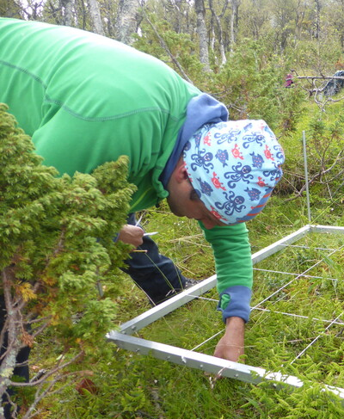
Let’s take a closer look at some of the headline indicators
Joachim taking a close look…

Slide 17
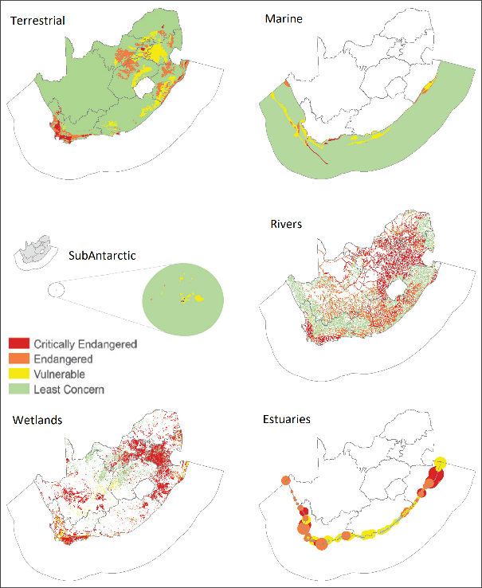
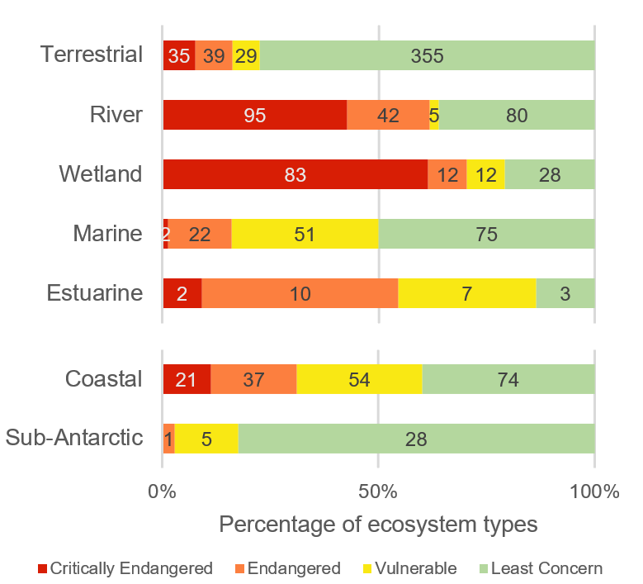
Red List of Ecosystems (A.1 & 1.2, [4])
Red List of Ecosystems assessments for South Africa, from the National Biodiversity Assessment in 2018

Slide 18
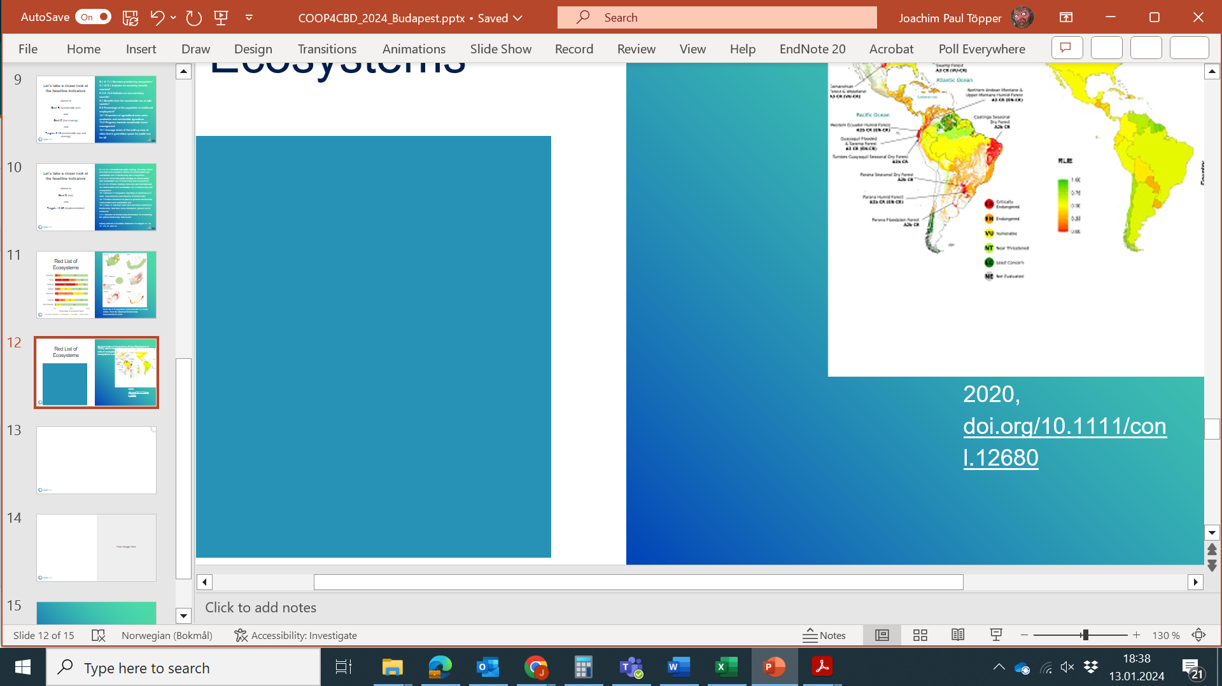
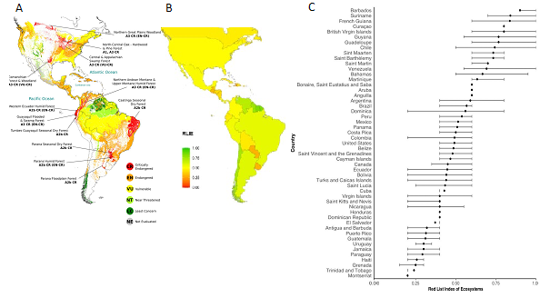
Red List of Ecosystems (A.1 & 1.2, [4])
The Red List Index of ecosystems (RLIe) summarises risk or threat status across sets of ecosystem types, based on the proportion of ecosystems in each Red List risk category (Rowland et al. 2020).
A) Ferrer-Paris et al. 2019
doi.org/10.1111/conl.12623
B & C) adapted from Rowland et al. 2020, doi.org/10.1111/conl.12680

Slide 19
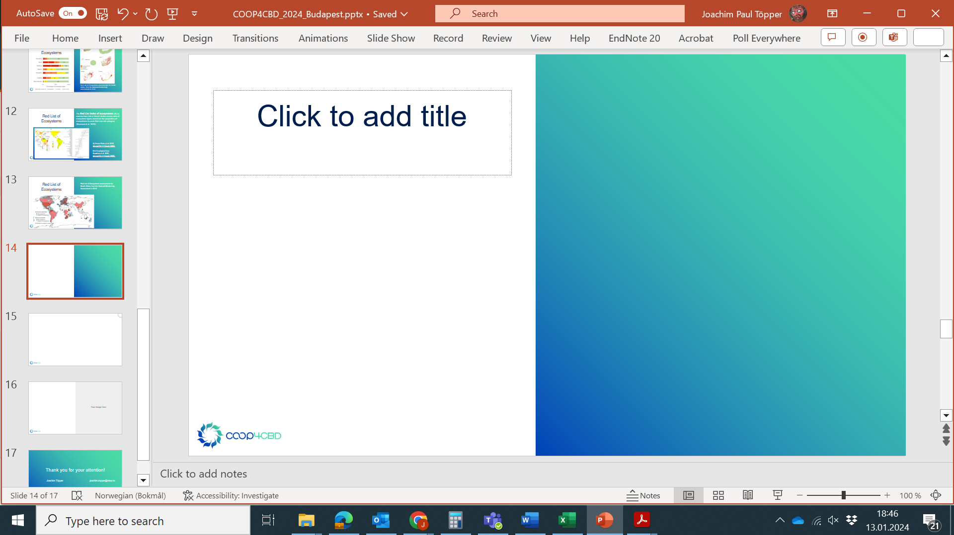
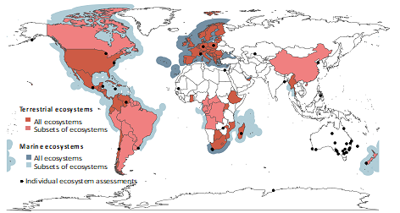
Red List of Ecosystems (A.1 & 1.2, [4])
Global availability?
www.post-2020indicators.org/metadata/headline/A-1

Slide 20
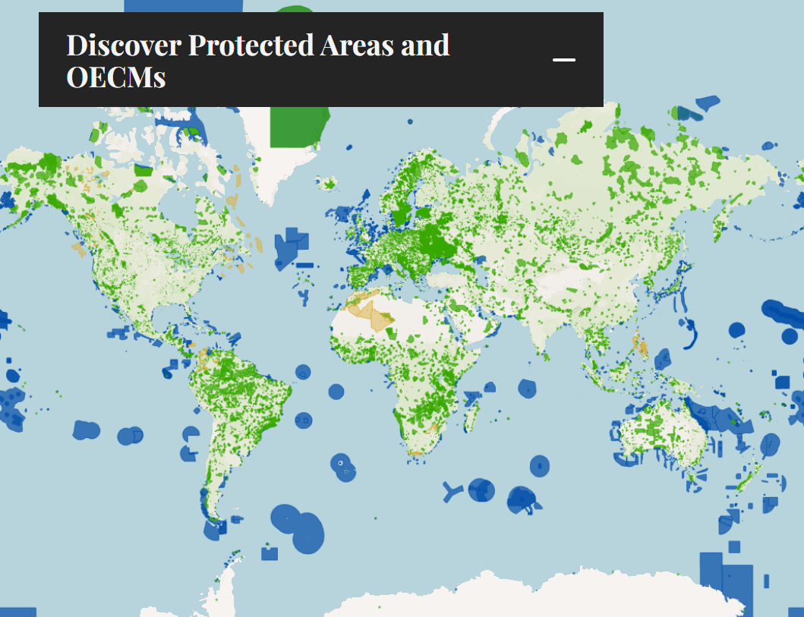
Coverage of protected areas and other effective area-based conservation measures (3.1, [4-5])
Coverage alone insufficient
Effectiveness & representativity important
cover key biodiversity areas
cover all ecosystem types
www.protectedplanet.net

Slide 21
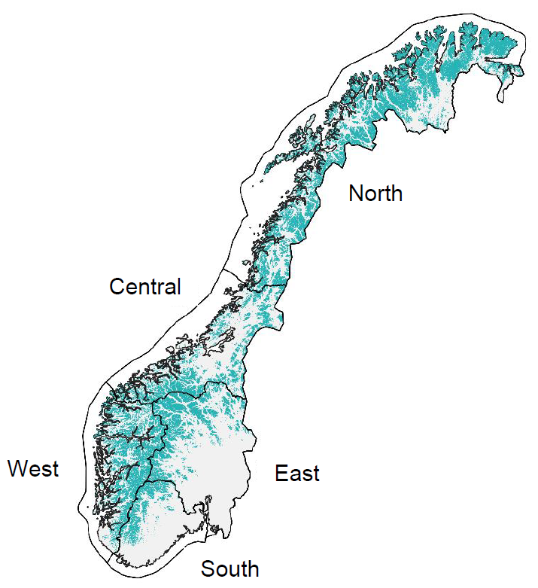
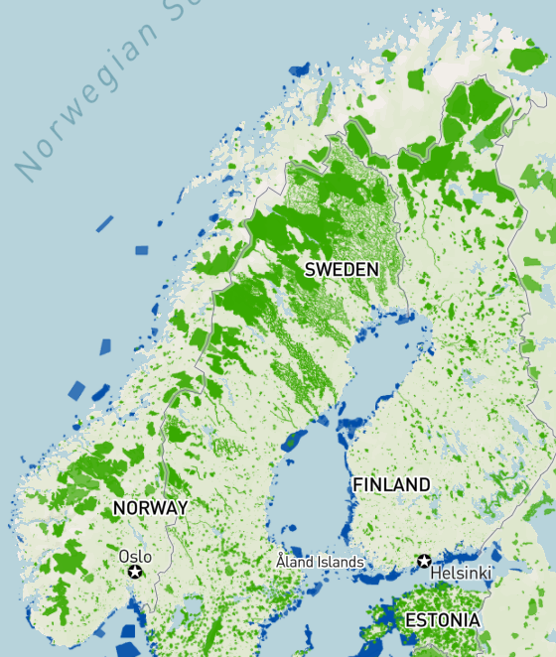
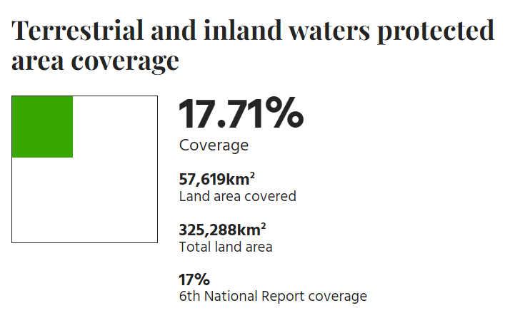
Coverage of protected areas and other effective area-based conservation measures (3.1, [4-5])
Norway
Arctic/alpine ecosystems
www.protectedplanet.net

Slide 22
Coverage of protected areas and other effective area-based conservation measures (3.1, [4-5])
Norway
Arctic/alpine ecosystems
Representative?
Effective?
www.protectedplanet.net

Slide 23
Coverage of protected areas and other effective area-based conservation measures
So, what’s really crucial for this indicator to be meaningful is:
Representativity
  Are the different types of ecoystems in a country covered well enough?
Effectiveness
  Are Key Biodiversity Areas covered

Slide 24
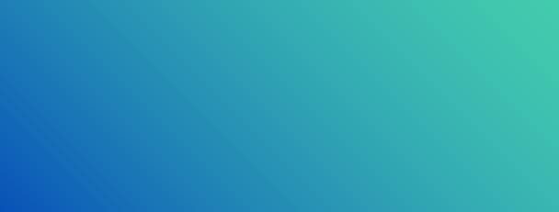
Transferrable to all indicators
Ensure representativity
  Across all nature
Ensure effectiveness
  Cover key biodiversity assets
Ensure sensitivity
  Indicator must be able to measure Goal/Target progress

Slide 25
Transferrable to all indicators
Ensure representativity
  Across all nature
Ensure effectiveness
  Cover key biodiversity assets
Ensure sensitivity
  Indicator must be able to measure Goal/Target progress

Slide 26
Binary indicators
Goal/target | Global indicator derived from binary reporting
B | Number of countries with national constitution or legislation recognizing and implementing and monitoring a right to a healthy environment
1 | Number of countries using terrestrial and marine spatial planning to identify areas of high biodiversity importance in national development planning
6 | Number of countries adopting relevant national legislation and adequately resourcing the prevention or control of invasive alien species
8 | Number of countries with nationally determined contributions, long-term strategies, national adaptation plans and adaptation communications that reflect biodiversity
9 | Number of countries with legal instruments to regulate the use of and trade in wild species, and respecting customary sustainable use by indigenous peoples and local communities
12 | Number of countries with urban sustainability plans referring to green and/or blue spatial management
13 / C | Number of countries that have operational legislative, administrative or policy frameworks which relate to Target 13
14 | Number of countries with national targets for integrating biodiversity values into policies, regulations, planning, development processes, poverty reduction strategies and accounts at all levels, ensuring that biodiversity values are mainstreamed across all sectors and integrated into assessments of environmental impacts
15 | Number of countries taking legal, administrative or policy measures to ensure that Target 15 is achieved
16 | Number of countries developing, adopting or implementing policy instruments aimed at supporting the shift to sustainable consumption and production (Sustainable Development Goal indicator 12.1.1)
17 | Number of countries with capacity and measures in place related to Target 17
22 | Number of countries recognizing the legal rights of indigenous peoples and local communities, environmental human rights defenders, women, youth and persons with disabilities with respect to their traditional territories, cultures and practices
23 | Number of countries where the legal framework (including customary law) guarantees women’s equal rights to land ownership and/or control
Suggestion from AHTEG on binary indicators:
www.cbd.int/doc/c/fc2f/9f66/ffaa283c75eb50b24cc80aa1/ind-ahteg-2023-02-03-en.pdf
Note:
New wording and one more suggestion for target 20 in
www.cbd.int/doc/c/f22d/ab58/236acdd54779ab58b97aecf1/ind-ahteg-2023-03-02-en.pdf

Slide 27
Binary indicators
Goal/target | Global indicator derived from binary reporting
B | Number of countries with national constitution or legislation recognizing and implementing and monitoring a right to a healthy environment
1 | Number of countries using terrestrial and marine spatial planning to identify areas of high biodiversity importance in national development planning
6 | Number of countries adopting relevant national legislation and adequately resourcing the prevention or control of invasive alien species
8 | Number of countries with nationally determined contributions, long-term strategies, national adaptation plans and adaptation communications that reflect biodiversity
9 | Number of countries with legal instruments to regulate the use of and trade in wild species, and respecting customary sustainable use by indigenous peoples and local communities
12 | Number of countries with urban sustainability plans referring to green and/or blue spatial management
13 / C | Number of countries that have operational legislative, administrative or policy frameworks which relate to Target 13
14 | Number of countries with national targets for integrating biodiversity values into policies, regulations, planning, development processes, poverty reduction strategies and accounts at all levels, ensuring that biodiversity values are mainstreamed across all sectors and integrated into assessments of environmental impacts
15 | Number of countries taking legal, administrative or policy measures to ensure that Target 15 is achieved
16 | Number of countries developing, adopting or implementing policy instruments aimed at supporting the shift to sustainable consumption and production (Sustainable Development Goal indicator 12.1.1)
17 | Number of countries with capacity and measures in place related to Target 17
22 | Number of countries recognizing the legal rights of indigenous peoples and local communities, environmental human rights defenders, women, youth and persons with disabilities with respect to their traditional territories, cultures and practices
23 | Number of countries where the legal framework (including customary law) guarantees women’s equal rights to land ownership and/or control
Suggestion from AHTEG on binary indicators:
www.cbd.int/doc/c/fc2f/9f66/ffaa283c75eb50b24cc80aa1/ind-ahteg-2023-02-03-en.pdf
Note:
New wording and one more suggestion for target 20 in
www.cbd.int/doc/c/f22d/ab58/236acdd54779ab58b97aecf1/ind-ahteg-2023-03-02-en.pdf

Slide 28
Binary indicators
Goal/target | Global indicator derived from binary reporting
B | Number of countries with national constitution or legislation recognizing and implementing and monitoring a right to a healthy environment
1 | Number of countries using terrestrial and marine spatial planning to identify areas of high biodiversity importance in national development planning
6 | Number of countries adopting relevant national legislation and adequately resourcing the prevention or control of invasive alien species
8 | Number of countries with nationally determined contributions, long-term strategies, national adaptation plans and adaptation communications that reflect biodiversity
9 | Number of countries with legal instruments to regulate the use of and trade in wild species, and respecting customary sustainable use by indigenous peoples and local communities
12 | Number of countries with urban sustainability plans referring to green and/or blue spatial management
13 / C | Number of countries that have operational legislative, administrative or policy frameworks which relate to Target 13
14 | Number of countries with national targets for integrating biodiversity values into policies, regulations, planning, development processes, poverty reduction strategies and accounts at all levels, ensuring that biodiversity values are mainstreamed across all sectors and integrated into assessments of environmental impacts
15 | Number of countries taking legal, administrative or policy measures to ensure that Target 15 is achieved
16 | Number of countries developing, adopting or implementing policy instruments aimed at supporting the shift to sustainable consumption and production (Sustainable Development Goal indicator 12.1.1)
17 | Number of countries with capacity and measures in place related to Target 17
22 | Number of countries recognizing the legal rights of indigenous peoples and local communities, environmental human rights defenders, women, youth and persons with disabilities with respect to their traditional territories, cultures and practices
23 | Number of countries where the legal framework (including customary law) guarantees women’s equal rights to land ownership and/or control
Suggestion from AHTEG on binary indicators:
www.cbd.int/doc/c/fc2f/9f66/ffaa283c75eb50b24cc80aa1/ind-ahteg-2023-02-03-en.pdf
Note:
New wording and one more suggestion for target 20 in
www.cbd.int/doc/c/f22d/ab58/236acdd54779ab58b97aecf1/ind-ahteg-2023-03-02-en.pdf
Has your country developed, adopted or implemented policy instruments aimed at supporting the shift to sustainable consumption and production?

Slide 29
Binary indicators
Goal/target | Global indicator derived from binary reporting
B | Number of countries with national constitution or legislation recognizing and implementing and monitoring a right to a healthy environment
1 | Number of countries using terrestrial and marine spatial planning to identify areas of high biodiversity importance in national development planning
6 | Number of countries adopting relevant national legislation and adequately resourcing the prevention or control of invasive alien species
8 | Number of countries with nationally determined contributions, long-term strategies, national adaptation plans and adaptation communications that reflect biodiversity
9 | Number of countries with legal instruments to regulate the use of and trade in wild species, and respecting customary sustainable use by indigenous peoples and local communities
12 | Number of countries with urban sustainability plans referring to green and/or blue spatial management
13 / C | Number of countries that have operational legislative, administrative or policy frameworks which relate to Target 13
14 | Number of countries with national targets for integrating biodiversity values into policies, regulations, planning, development processes, poverty reduction strategies and accounts at all levels, ensuring that biodiversity values are mainstreamed across all sectors and integrated into assessments of environmental impacts
15 | Number of countries taking legal, administrative or policy measures to ensure that Target 15 is achieved
16 | Number of countries developing, adopting or implementing policy instruments aimed at supporting the shift to sustainable consumption and production (Sustainable Development Goal indicator 12.1.1)
17 | Number of countries with capacity and measures in place related to Target 17
22 | Number of countries recognizing the legal rights of indigenous peoples and local communities, environmental human rights defenders, women, youth and persons with disabilities with respect to their traditional territories, cultures and practices
23 | Number of countries where the legal framework (including customary law) guarantees women’s equal rights to land ownership and/or control
Who would even be able to answer ‘no’ to this one?
Is this a sensitive indicator?
Does it actually measure progress for target 16?
Suggestion from AHTEG on binary indicators:
www.cbd.int/doc/c/fc2f/9f66/ffaa283c75eb50b24cc80aa1/ind-ahteg-2023-02-03-en.pdf
Note:
New wording and one more suggestion for target 20 in
www.cbd.int/doc/c/f22d/ab58/236acdd54779ab58b97aecf1/ind-ahteg-2023-03-02-en.pdf
Has your country developed, adopted or implemented policy instruments aimed at supporting the shift to sustainable consumption and production?

Slide 30

Monitoring framework / indicator topics at SBSTTA26 & COP16?
Missing/underdeveloped indicators
Binary indicators
Simplicity vs. usefulness
  Representativity
  Effectiveness
  Sensitivity
Global capacity for implementation
Resources for global implementation

Slide 31
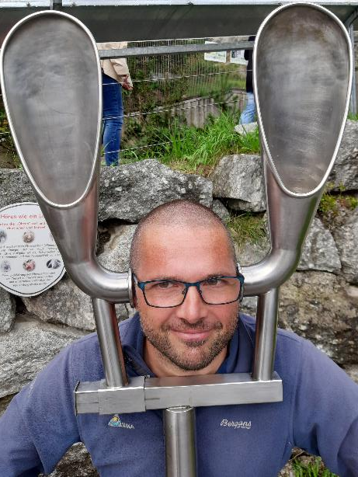



Thank you for your attention!
Han de Koeijer
joachim.topper@nina.no
www.coop4cbd.eu
Follow COOP4CBD
Joachim Töpper
hdekoeijer@naturalsciences.be

