Slide 1
Synthetic biology
Fanny Coppens, PhD
Sciensano
Belgian NFP for the Biosafety Clearing-House
Training session on SBSTTA 26 substantive agenda items / 2 April 2024

Slide 2
(Not quite a) definition
Synthetic biology is the application of science, technology and engineering to facilitate and accelerate the design, manufacture and/or modification of genetic materials in living organisms (EU Scientific Committees, 2014).
It involves redesigning organisms for useful purposes by engineering them to have new abilities (NIH).

Slide 3
(Not quite a) definition
CBD (COP-13 in 2016) adopted an operational definition, as a starting point for facilitating work under the Convention: “Synthetic biology is a further development and new dimension of modern biotechnology that combines science, technology, and engineering to facilitate and accelerate the understanding, design, redesign, manufacture and/or modification of genetic materials, living organisms and biological systems”

Slide 4
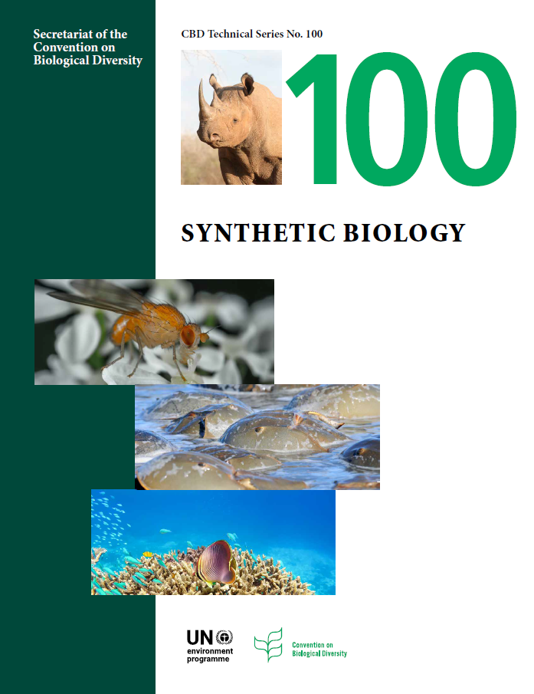
CBD Technical Series 100
Your image here
Synthetic Biology
www.cbd.int/ts
Published April 2022

Slide 5
Supporting technologies and tools
DNA synthesis
Next-generation / whole-genome sequencing
Genome editing: CRISPR/Cas
Engineered gene drives
AI and machine learning
Bio-bricks
...

Slide 6
Research areas
DNA- and RNA-based circuits
Protein engineering
Metabolic pathway engineering
Genome-level engineering
Protocell construction
Xenobiology
Cell-free systems

Slide 7
Applications
Unmanaged or wild
Semi-managed, managed or urban
Lab, industry

Slide 8
Applications
Unmanaged or wild
Semi-managed, managed or urban
Lab, industry
Wildlife conservation:
Gene drive control of invasive species
Extinction prevention
De-extinction

Slide 9
Applications
Unmanaged or wild
Semi-managed, managed or urban
Lab, industry
GE plants: heat or drought tolerant, better digestible, disease resistant, herbicide tolerant, decreased plant height
GE animals: hornless cattle, woolly sheep, chickens laying allergen-free eggs

Slide 10
Applications
Unmanaged or wild
Semi-managed, managed or urban
Lab, industry
Gene drive insects: reduction of the population of plant pests or vectors for diseases
Bioremediation: bacteria containing sensors and proteins that bind pollutants

Slide 11
Applications
Unmanaged or wild
Semi-managed, managed or urban
Lab, industry
Yeast with engineered metabolic pathways producing
medicines, vaccines
cosmetics, dyes, fragrances
wildlife products
food and ingredients

Slide 12
Also in the document: Potential impacts
Potential impacts on conservation and sustainable use of biodiversity
Social, economic and cultural concerns
General biosafety aspects

Slide 13
Also in the document: Governance and regulatory aspects
Current regulations
Self-regulation and moratoria
IP considerations
Potential implication of the CBD and Protocols
Other international processes

Slide 14
Thank you for your attention!
Fanny Coppens
fanny.coppens@sciensano.be
Coming soon www.coop4cbd.eu
Follow COOP4CBD

