Slide 1


Understanding CBD ‘Planning, Monitoring, Reporting and Review mechanisms’: what’s at stake?
Juliette Landry, Senior Research Fellow – International biodiversity governance
Institute for Sustainable Development and International Relations
(IDDRI)
Roos Immerzeel, Researcher – International biodiversity policy
The Netherlands Environmental Assessment Agency (PBL)
Training session / September 3rd 2025 / Online

Slide 2
Since 1992…
Key milestones
1992 - CBD adopted, with obligation to submit national reports (Article 26) and national biodiversity strategies and action plans (considered as the key mechanism to implement the CBD)
2002 - 2010 Biodiversity Target failed
2010 - Aichi Targets: no accountability framework, progress insufficient
2022 - Kunming-Montreal GBF: adoption of an enhanced transparency and accountability framework

Slide 3
Why this matters?
The “implementation gap” has been a persistent issue in the CBD as ambitious global targets were not matched by national action and implementation (Maljean-Dubois et al., 2022; Friedman et al., 2022; Petersson & Stoett, 2022; Smallwood et al., 2022).
Failure of the Aichi Targets: despite global progress reports (GBO-4; Secretariat of the CBD, 2014; Tittensor et al., 2014), no mechanisms or dialogues existed to trigger course corrections
Accountability is not an end in itself: review processes must help understand problems, identify solutions, and support strategy choices (Kramarz & Park, 2016)
A purpose-oriented review enables learning, course correction and a “ratcheting effect” to accelerate action while remaining facilitative and non-punitive (Landry et al., 2024)
Integrating diverse knowledge and actors into review processes enhances credibility, inclusivity, and the legitimacy of CBD governance (Tengö et al., 2014; Pascual et al., 2021).
Without robust accountability, ambitious biodiversity goals risk becoming aspirational only.

Slide 4
An enhanced accountability and transparency framework for the GBF
Adopted at COP15, Montreal (2022) ‘Mechanisms for planning, monitoring, reporting and review’
Structured reporting templates and deadlines for national reports (with indicators adopted in the monitoring framework decision)
National targets and NBSAPs (to be submitted by all Parties on the online reporting tool) with guidance in annex
Global Review process (first one in 2026 to culminate at COP17 and second one in 2030 at COP19) recognizing that “Parties may take the outcome of the global review into account in future revisions and implementation of their” NBSAPs
Other key mechanisms such as: further develop the “open-ended forum”, or “information on non-state actors commitments”

Slide 5
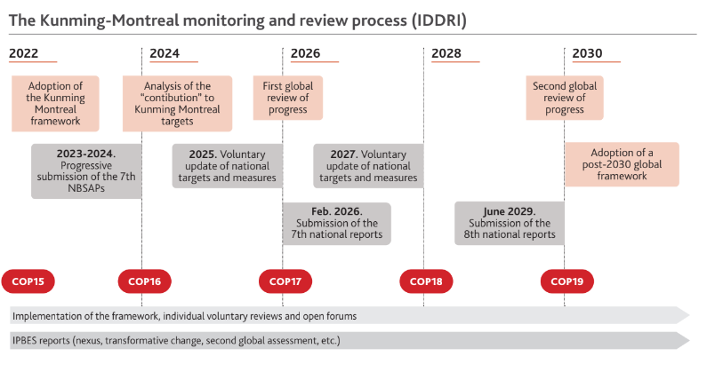
An enhanced accountability and transparency framework for the GBF

Slide 6
An enhanced accountability and transparency framework for the GBF
How it is supposed to work – building blocks
Planning - NBSAPs and national targets
Monitoring - indicators & data collection
Reporting - 7th National Reports (structured, comparable)
Review of “ambition” – the global analysis of national targets
Review - Global Review (collective assessment at COP17)
More in-depth review – the “voluntary peer review”
Dialogues among Parties - Pilot of the open-ended forum
Back to Planning - inform revision of NBSAPs & targets (voluntary)

Slide 7
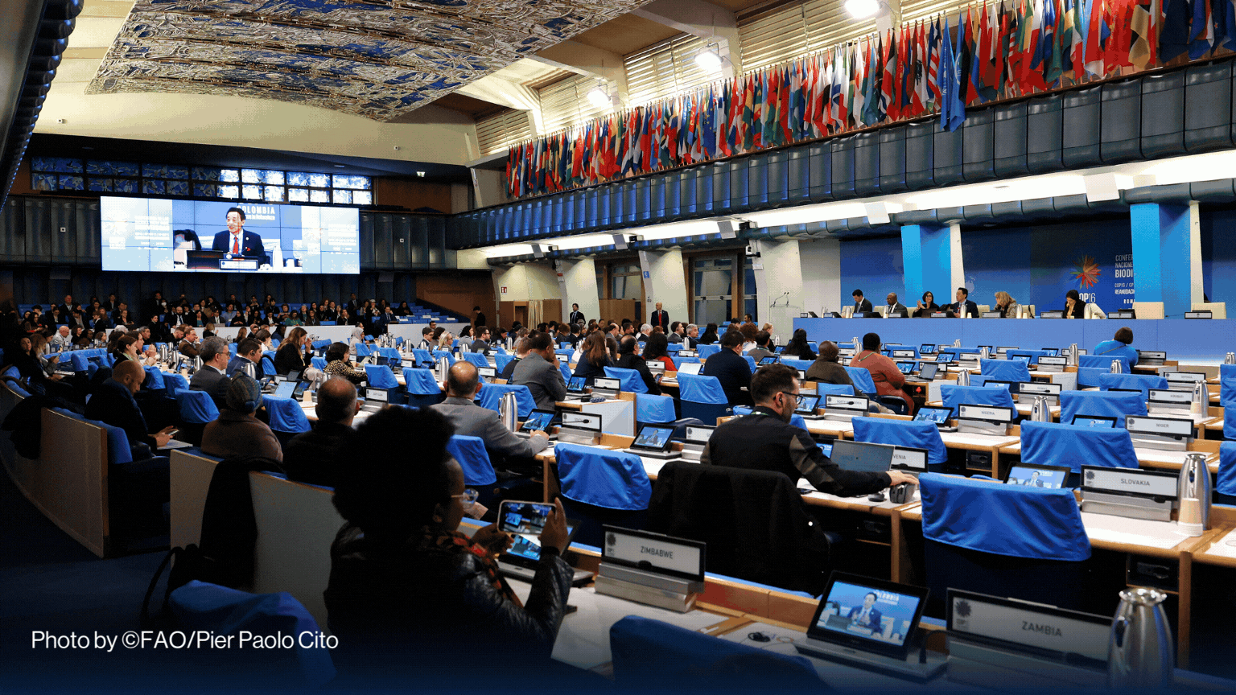
COP16: the first round of “reviews”
© Marieke Boon

Slide 8

COP16 (1): first ‘stocktake’ on the ambition
Submissions assessed: by COP16 (Cali), only 20 Parties had submitted revised National Biodiversity Strategies and Action Plans (NBSAPs) or 60 national targets
This left significant gaps in the global picture of ambition
Secretariat analysis presented:
  Initial global stocktake of ambition based on submitted targets and NBSAPs
  Highlighted discrepancies between national targets and what is needed to achieve GBF 2030 targets and 2050 goals
Political signal: Parties urged to accelerate submissions (especially ahead of the 7th National Reports (due Feb 2026))
Stocktake revealed the urgency of aligning national ambition with global biodiversity goals.

Slide 9

COP16 (2): the adoption of modalities for the first ‘Global Review’
Decision adopted (Rome, 2025): operational modalities for the Global Review
Core elements agreed:
  Inputs: 7th National Reports, information from Indigenous Peoples, local communities (IPLCs), and other non-state actors, scientific and technical assessments (e.g. IPBES, other assessments)
  Process: establishment of an Ad hoc Scientific and Technical Advisory Group (AHSTAG) to guide the outline and drafting of the global report, supervised by SBSTTA and then SBI
  Outputs: a global report assessing collective progress
  Consideration of dialogues (technical, regional, open-ended forum) to complement the technical assessment report
  Objective: to provide an evidence-based assessment that can inform COP17 decisions
Tight timeline: drafting of the global report (Feb-May 2026) and consideration of the assessment (Summer 2026 )

Slide 10
COP16 (2): the adoption of modalities for the first ‘Global Review’
Challenges:
Scope of the GR: will it be limited to a technical compilation of data, or evolve into a political assessment with recommendations?
Lack of clarity on how conclusions will translate into concrete COP decisions
Level of analysis: tension between a global synthesis and the need for regional/national relevance
Parties worry about avoiding prescriptiveness while still producing actionable outcomes
Inclusion of non-state actors: IPLCs, civil society, and private sector contributions are invited, but criteria for legitimacy and integration remain undefined
Dialogues: COP16 acknowledged potential formats (for the “technical dialogue”). But modalities on who participates, how inputs are used, and how outcomes are captured are still pending (+ budget)
Follow-up after COP17: will the Global Review trigger a ratcheting effect (stepping up ambition and implementation)? Or risk becoming a one-off report with limited political uptake, like the Aichi experience?

Slide 11
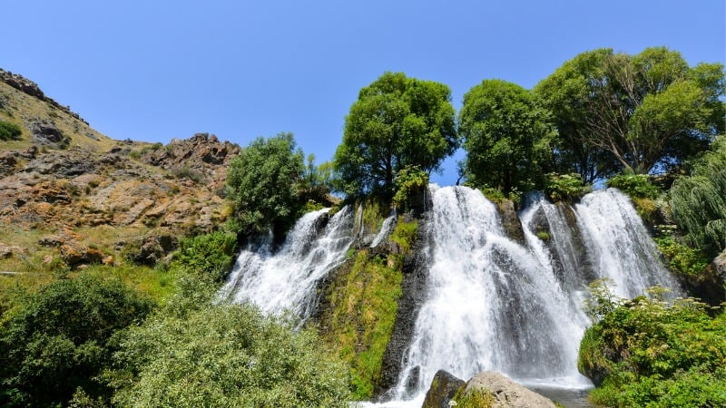
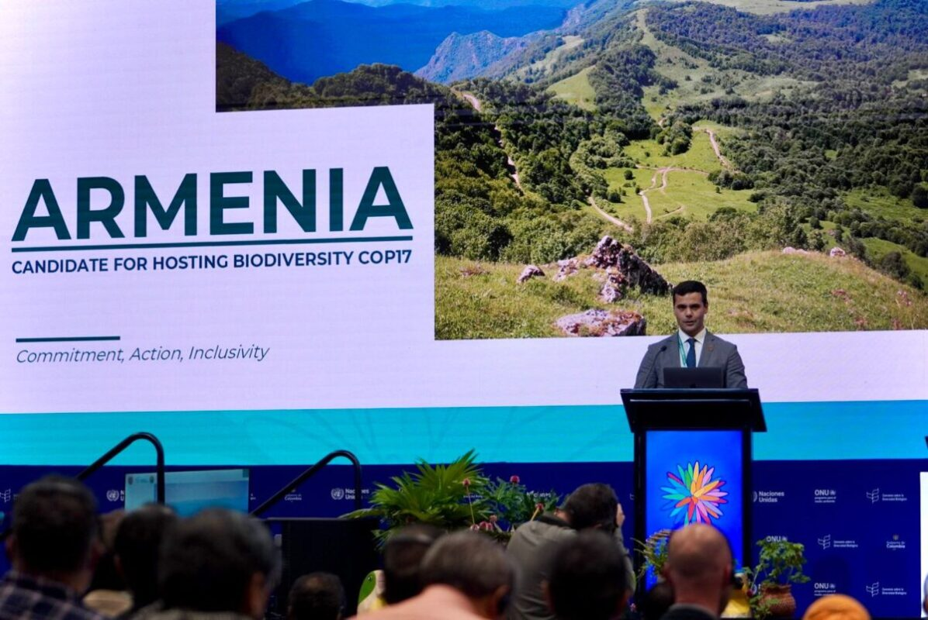
Towards COP17’s landmark “Global Review”
© Marieke Boon

Slide 12
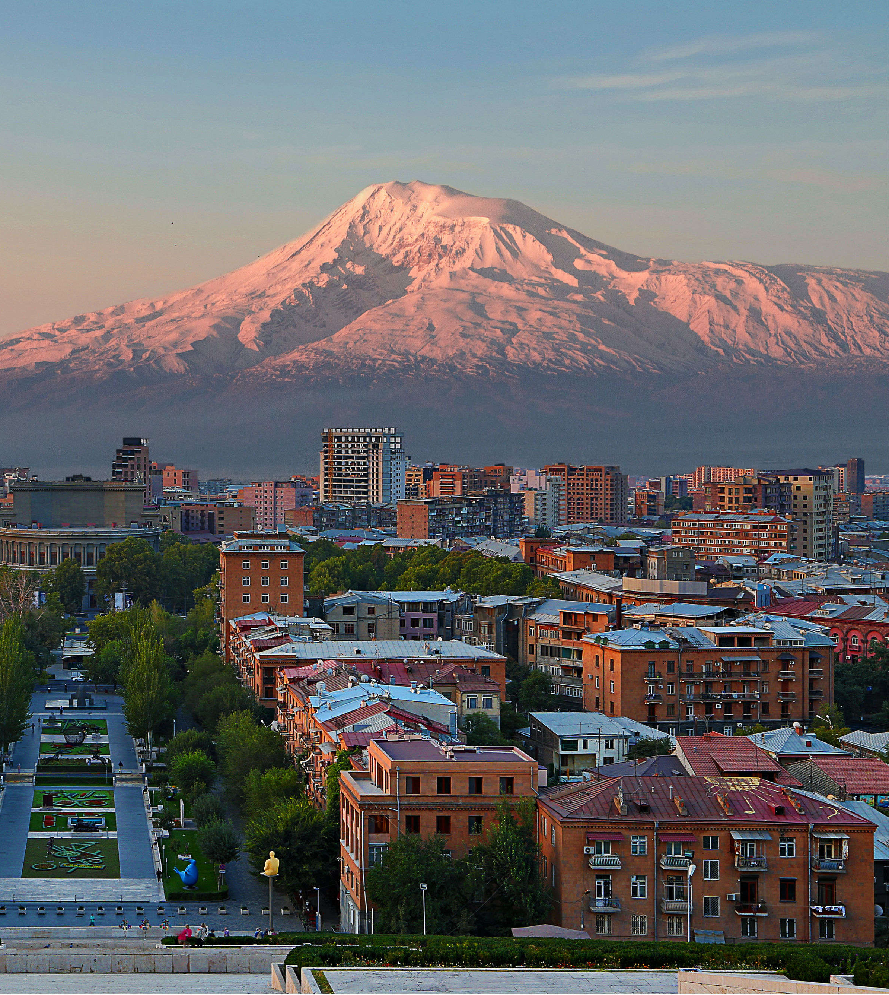
Next steps
Before COP17 (2026, Armenia):
Parties submit NBSAPs (if not submitted already) & National Reports (by Feb 2026) – importance to have as many NR as possible
AHSTAG outline of the global report (now) – possibility of sending comments (until today!), then discussion at SBSTTA (next slide)
Drafting of the report Winter-Spring 2026
Summer 2026 (SBI, SBSTTA, other informal dialogues)
At COP17: Adoption of decisions based on the first Global Review process
Key decisions for course correction and future implementation?
Notes:
Only 5 Parties (EU, Switzerland, UK, Canada, China) + around 10 CSOs submitted comments.

Slide 13
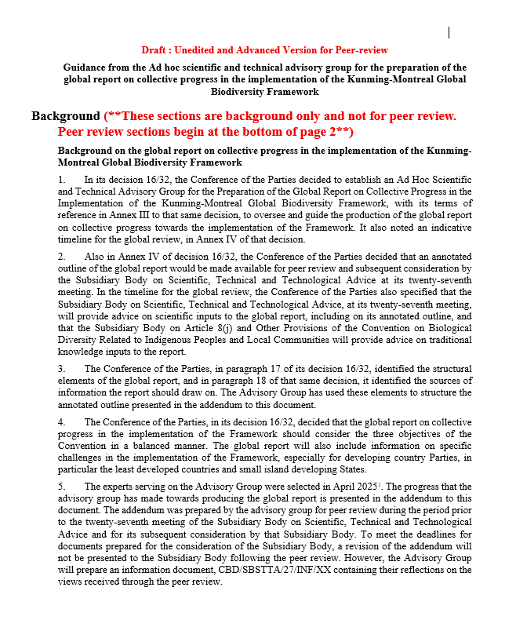
Global Report
Considerations related to national reports, as the primary source of information, and to other sources of information for the global report
Geographic and temporal coverage of cross-cutting issues
Outline:
Part 1. Introduction and status of and trends in biodiversity
Part 2. Collective progress
Status of NBSAPs, targets and reports
Collective progress towards the GBF
Review of 23 targets
Review of the provision of means of implementation
Compilation of examples of contributions of MEAs, organizations and other processes
Analysis of progress towards the 4 2050 goals
Part 3. Conclusions and key messages
Including ‘possible pathways and actions to overcome challenges’
Notes:
Preparation of an « information document for SBSTTA » by the Secretariat

Slide 14
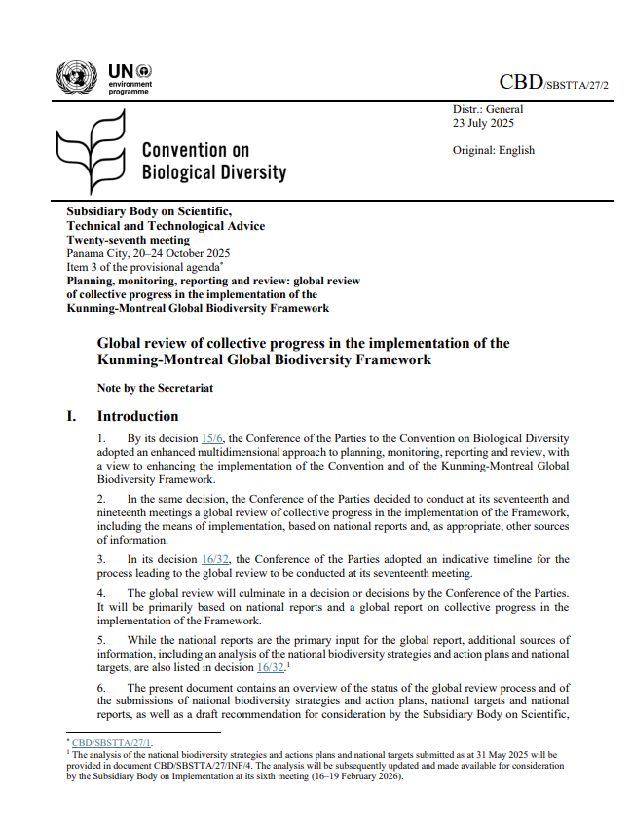
Discussions at SBSTTA
SBSTTA/27/2: Global review of collective progress
Consider the status of submission of NBSAPs and national targets
Recalling the importance of submitting national reports (primary source)
Encouraging other actors to submit information (template adopted, through the ORT)
But most importantly, to adopt the annotated outline – which will become the “scope” of the future technical assessment
N.B. Invitation to submit relevant information to support the production of the global report – by October 1st (notification 2025-099)

Slide 15
Several key challenges for an transformative Global Review
Tensions: persistent debates on who should act, who should pay, and what counts as fair ambition
Risk of stalemate if financing and means of implementation are not addressed
Data and reporting gaps: delays in NBSAPs and 7th National Reports submission jeopardize the quality and legitimacy of the Global Review
Uneven capacities between countries to provide structured and comparable data (as well as participating to “dialogues”)
Inclusivity and equity: despite creation of the new body at COP16 (article 8(j)), voices of vulnerable countries, civil society, and local actors remain underrepresented. Procedural equity is essential for legitimacy but still fragile
Lessons from the climate GST: risk that conclusions remain too general and not translated into actionable policies. Need to avoid “dialogue fatigue” and ensure political uptake of technical findings.
Parties want the process to remain non-intrusive and facilitative, but too much caution could limit its potential to deliver transformative impact

Slide 16
What can be reinforced over time for an impactful Global Review
Diagnose progress & gaps: provide an honest stocktake of successes, failures, and lessons learned
Foster peer learning & mutual support: build trust, enable exchange of practices, and strengthen ownership among Parties & stakeholders
Expose financing & implementation barriers: identify where additional support is needed and highlight systemic obstacles
Drive political momentum toward 2030 & 2050 goals: translate technical findings into actionable pathways and COP decisions
Key messages from dialogues (organized by PBL and IDDRI):
  the Global Review must be continuous, not a one-off to foster a culture of accountability
  needs to go beyond CBD circles to speak to other sectors, incl. business & finance
  balance ambition & feasibility for credible but realistic outputs
  Inclusivity is key. IPLCs, local actors, and private sector must be engaged early
  Political uptake matters, the global review should inform declarations, other multilateral processes, and public debate.

Slide 17

Policy analysis of national targets
Patterns of current ambitions reflected in national biodiversity targets: a contribution to the global review
© Marieke Boon

Slide 18
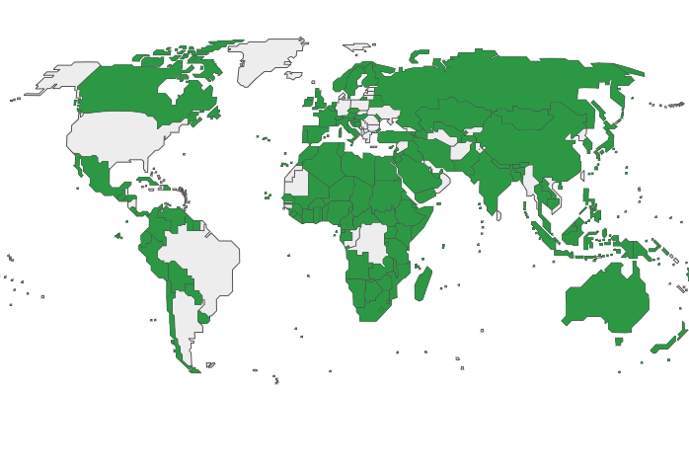
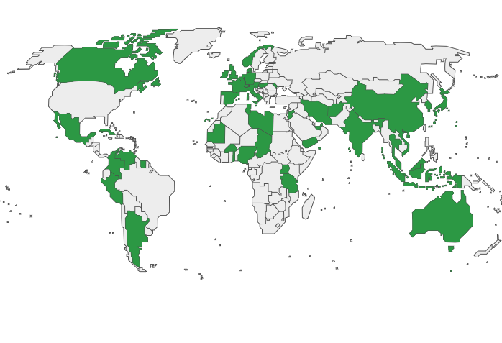
Policy analysis of national targets
Parties under the CBD create national policy aligned to the GBF
National Targets and/or NBSAPs
GBF targets are broad, not always SMART, and ask for a global implementation
Resultingly, national targets may not be comparable
CBD Parties that uploaded at least 1 National Target to the ORT, August 8th 2025. (139 Parties, 3276 targets)
CBD Parties that uploaded a NBSAP, August 8th 2025.
(55 Parties, 57 NBSAPs)

Slide 19
Policy analysis of national targets
Analysis of National Targets uploaded to the CBD’s Online Reporting Tool (ORT)
GBF targets 1 – 12 and 16, directly relevant for Goals A and B
Clustering method by use of large language model
  Clustering questions defined based on target text, guidance notes, monitoring framework and expert talks
Aim is to get a better understanding of the overall patterns of how the GBF is translated to the national level

Slide 20
Policy analysis of national targets
Guiding questions:
What elements of the GBF targets translated to the national level (and in what way)?
What quantified commitments are described?
What policy instruments do Parties use?
Which linkages do Parties make between GBF targets?
Which linkages do Parties make between policy fields?

Slide 21
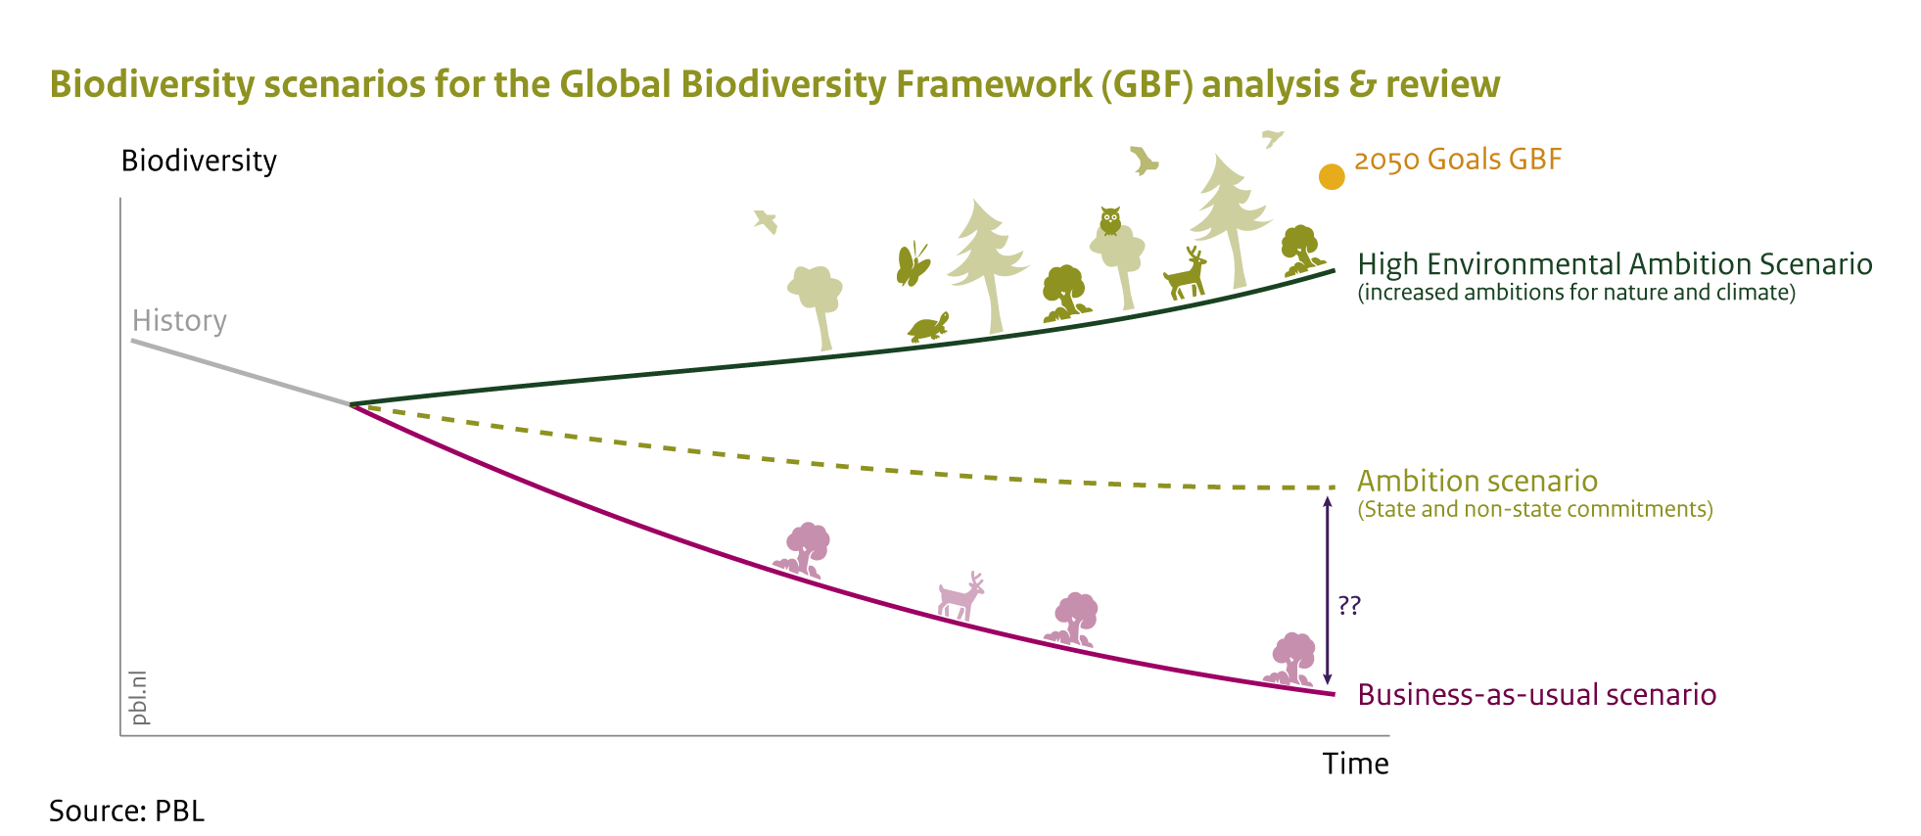
Outputs
Report to be published ahead of CBD SBSTTA 27 in October
  During SBSTTA: presenting and discussing the work, regional dialogues
Input for scenario analysis to be ready before CBD COP-17

Slide 22
Preliminary results
Target 1: Plan and Manage all Areas To Reduce Biodiversity Loss
Ensure that all areas are under participatory, integrated and biodiversity inclusive spatial planning and/or effective management processes addressing land- and sea use change, to bring the loss of areas of high biodiversity importance, including ecosystems of high ecological integrity, close to zero by 2030, while respecting the rights of indigenous peoples and local communities.

Slide 23
Preliminary results
Target 1: Plan and Manage all Areas To Reduce Biodiversity Loss
Ensure that all areas are under participatory, integrated and biodiversity inclusive spatial planning and/or effective management processes addressing land- and sea use change, to bring the loss of areas of high biodiversity importance, including ecosystems of high ecological integrity, close to zero by 2030, while respecting the rights of indigenous peoples and local communities.
(139 Parties total)

Slide 24

Preliminary results
Target 1: Plan and Manage all Areas To Reduce Biodiversity Loss
Ensure that all areas are under participatory, integrated and biodiversity inclusive spatial planning and/or effective management processes addressing land- and sea use change, to bring the loss of areas of high biodiversity importance, including ecosystems of high ecological integrity, close to zero by 2030, while respecting the rights of indigenous peoples and local communities.
(139 Parties total)
Cause of land- or sea use change | Number of Parties addressing cause
Agriculture | 17
Aquaculture | 3
Climate change | 20
Energy development | 5
Fishing | 4
Forestry | 19
Industrial activity | 3
Infrastructure | 5
Mining | 3
Urbanization | 12
Other | 4

Slide 25
Preliminary results
Target 1: Plan and Manage all Areas To Reduce Biodiversity Loss
Ensure that all areas are under participatory, integrated and biodiversity inclusive spatial planning and/or effective management processes addressing land- and sea use change, to bring the loss of areas of high biodiversity importance, including ecosystems of high ecological integrity, close to zero by 2030, while respecting the rights of indigenous peoples and local communities.
In what way is ‘participatory’ approached by Parties?
(139 Parties total)

Slide 26


Thank you for your attention!
Juliette Landry
Roos Immerzeel
juliette.landry@iddri.org roos.immerzeel@pbl.nl
Coming soon www.coop4cbd.eu
Follow COOP4CBD

